Slide 1
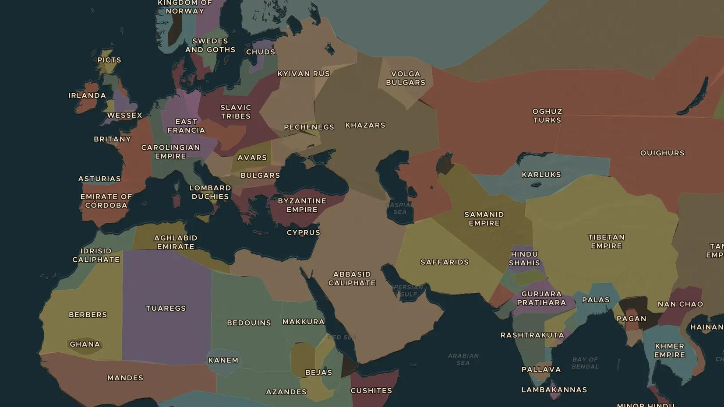
ABBASID CALIPHATE · ABOUT 800-1000
Silver on the Volga: the trade of the Abbasid world
ChronoAtlas Classroom · Plate 198 · Ages 12-15 · 50 min
ChronoAtlas Classroom · chronoatlas.nl/classroom/lesson/abbasid-trade-dirhams-ibn-fadlan

Slide 2
THIS LESSON
What students take from it
Arab silver coins turn up in buried treasure in Sweden. Students follow the routes north along the Volga and east by sea to China, meet the traveler Ibn Fadlan, and ask who gained and who suffered from this trade.
LENGTH
50 min
AGES
12-15
ON THE MAP
BY THE END, STUDENTS CAN
3 steps, AD 900
Trace the Volga Trade Route and the Maritime Spice Route on the map.
Describe the journey of Ibn Fadlan in 921-922.
Explain what goods, including enslaved people, moved along these routes and why.
QUIZ
7 rounds
ChronoAtlas Classroom · chronoatlas.nl/classroom/lesson/abbasid-trade-dirhams-ibn-fadlan
2

Slide 3
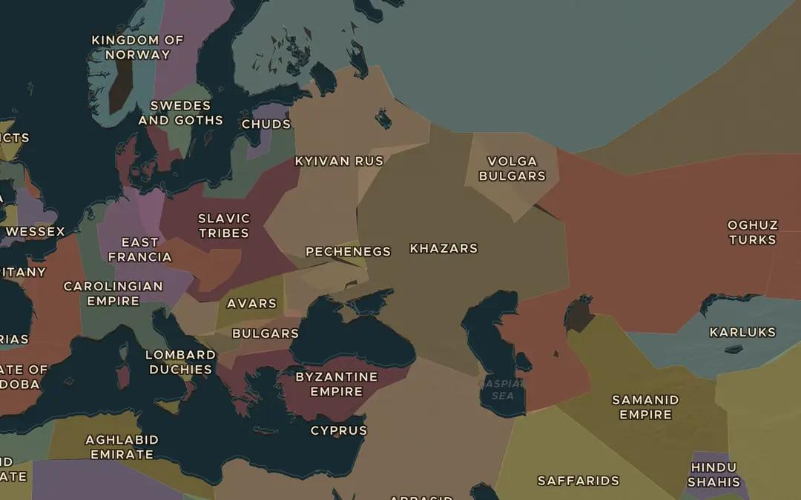
EXPLORE THE MAP · STEP A OF 3 · AD 900
a
The road north
Open the map in 900 and turn on the Trade Routes layer. Follow the Volga Trade Route from the Caspian Sea to the Baltic. Which peoples and states does it pass?
Open this view on the live map →
ChronoAtlas Classroom · chronoatlas.nl/classroom/lesson/abbasid-trade-dirhams-ibn-fadlan
3
Notes:
Open the map in 900 and turn on the Trade Routes layer. Follow the Volga Trade Route from the Caspian Sea to the Baltic. Which peoples and states does it pass?
https://chronoatlas.nl/?year=900&lat=50&lng=40&zoom=3.5

Slide 4
CHRONOATLAS CLASSROOM
The rest of this deck comes with Classroom
19 more slides: the other map steps, the discussion questions, the quiz with its answers, and the worksheet.
Every lesson as a deck, every worksheet, every live lesson and homework.
€19 a month, cancel anytime. The free lesson, Rome at its height, comes whole.
https://chronoatlas.nl/pricing
ChronoAtlas Classroom · chronoatlas.nl/classroom/lesson/abbasid-trade-dirhams-ibn-fadlan
4

