Slide 1
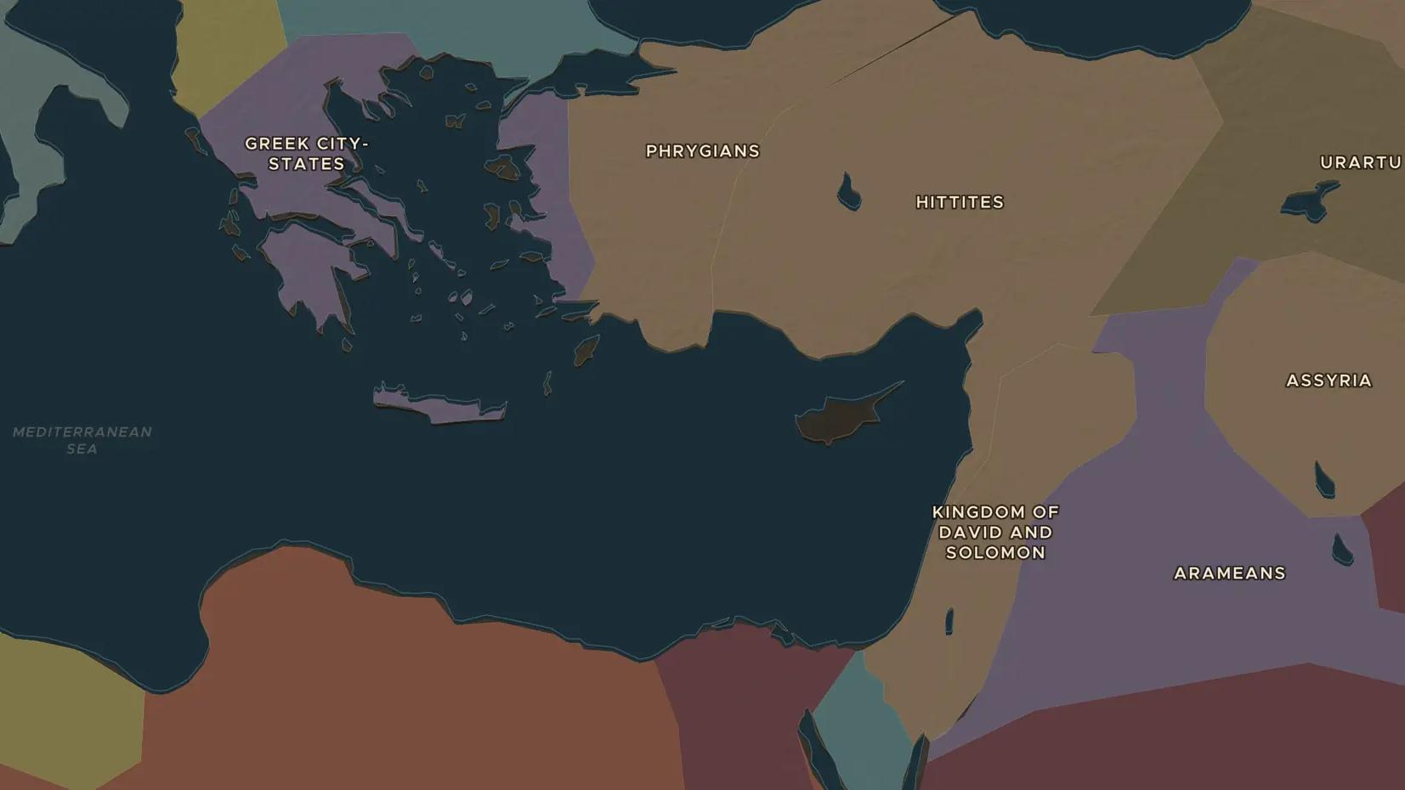
EARLY IRON AGE · 1100-900 BC
After the Bronze Age collapse: a new world
ChronoAtlas Classroom · Plate 37 · Ages 11-14 · 50 min
ChronoAtlas Classroom · chronoatlas.nl/classroom/lesson/after-the-bronze-age-collapse

Slide 2
THIS LESSON
What students take from it
Around 1200 BC the great Bronze Age kingdoms fell: the Hittite Empire vanished, Mycenaean palaces burned and Egypt barely held on. Students explore the smaller world that grew in the ruins, where iron, the alphabet and new peoples such as the Aramaeans got their start.
LENGTH
50 min
AGES
11-14
ON THE MAP
BY THE END, STUDENTS CAN
3 steps, 1,150 BC
Name two Bronze Age powers that collapsed around 1200 BC and one cause historians suggest.
Describe what the map of the Near East looked like around 1000 BC: many small kingdoms instead of a few giants.
Explain why the period 1100-800 BC in Greece is called a "Dark Age", and what that label leaves out.
QUIZ
7 rounds
ChronoAtlas Classroom · chronoatlas.nl/classroom/lesson/after-the-bronze-age-collapse
2

Slide 3
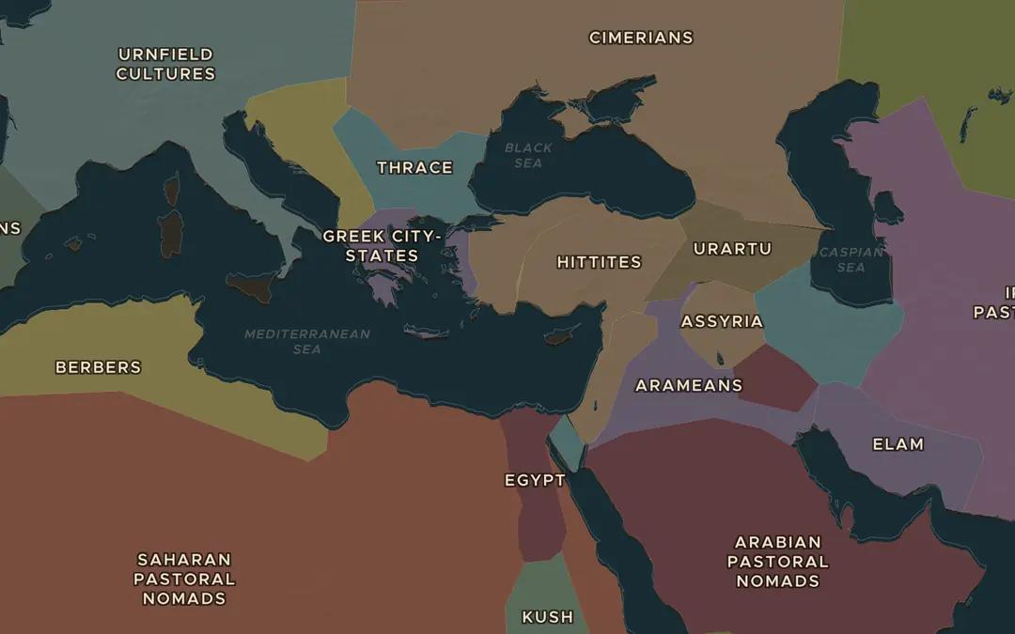
EXPLORE THE MAP · STEP A OF 3 · 1,150 BC
a
The drought years
Open the map in 1150 BC. Turn on Weather of History and look at the eastern Mediterranean: a long drought is marked for 1200-1100 BC. Which kingdoms around this sea would suffer first when harvests fail?
Open this view on the live map →
ChronoAtlas Classroom · chronoatlas.nl/classroom/lesson/after-the-bronze-age-collapse
3
Notes:
Open the map in 1150 BC. Turn on Weather of History and look at the eastern Mediterranean: a long drought is marked for 1200-1100 BC. Which kingdoms around this sea would suffer first when harvests fail?
https://chronoatlas.nl/?year=-1150&lat=36&lng=30&zoom=4

Slide 4
CHRONOATLAS CLASSROOM
The rest of this deck comes with Classroom
19 more slides: the other map steps, the discussion questions, the quiz with its answers, and the worksheet.
Every lesson as a deck, every worksheet, every live lesson and homework.
€19 a month, cancel anytime. The free lesson, Rome at its height, comes whole.
https://chronoatlas.nl/pricing
ChronoAtlas Classroom · chronoatlas.nl/classroom/lesson/after-the-bronze-age-collapse
4

