Slide 1
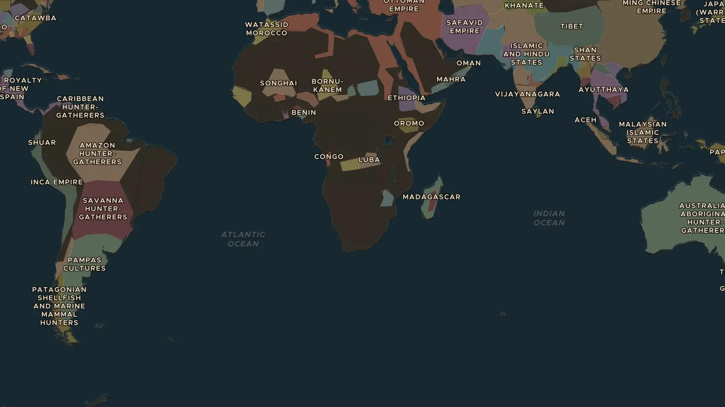
AGE OF EXPLORATION · 1492-1522
Around the world in three years
ChronoAtlas Classroom · Plate 287 · Ages 10-13 · 45 min
ChronoAtlas Classroom · chronoatlas.nl/classroom/lesson/age-of-exploration

Slide 2
THIS LESSON
What students take from it
Columbus sails west, Magellan's crew circles the globe. Students follow the journeys layer and discover how the world map itself was the discovery.
LENGTH
45 min
AGES
10-13
ON THE MAP
BY THE END, STUDENTS CAN
3 steps, AD 1490
Follow Magellan's expedition route on the map and name the oceans it crossed.
Explain why European kingdoms paid for these risky voyages.
Describe how the world map changed between 1490 and 1550.
QUIZ
7 rounds
ChronoAtlas Classroom · chronoatlas.nl/classroom/lesson/age-of-exploration
2

Slide 3
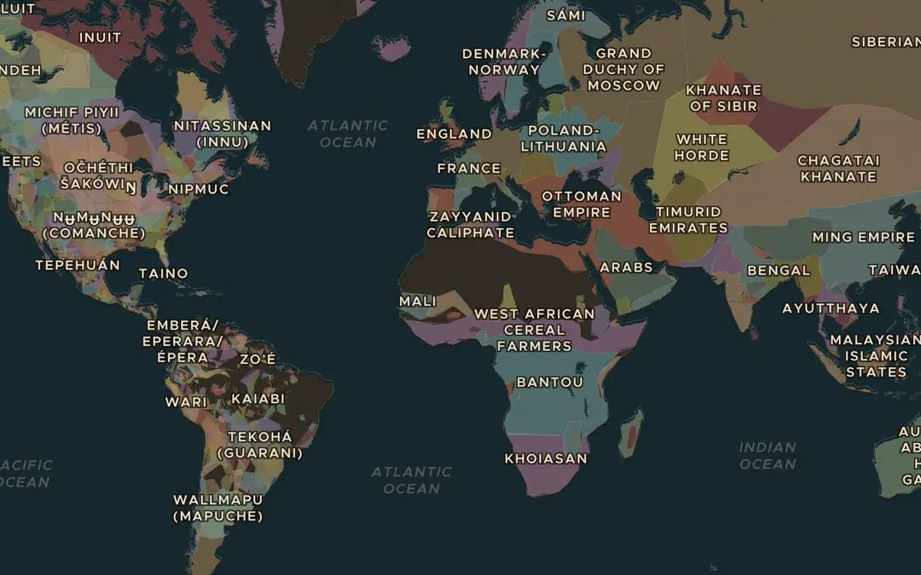
EXPLORE THE MAP · STEP A OF 3 · AD 1490
a
The world before
Open the map in 1490 and zoom out. Which parts of the world do European maps barely know at this point?
Open this view on the live map →
ChronoAtlas Classroom · chronoatlas.nl/classroom/lesson/age-of-exploration
3
Notes:
Open the map in 1490 and zoom out. Which parts of the world do European maps barely know at this point?
https://chronoatlas.nl/?year=1490&lat=20&lng=0&zoom=2

Slide 4
CHRONOATLAS CLASSROOM
The rest of this deck comes with Classroom
19 more slides: the other map steps, the discussion questions, the quiz with its answers, and the worksheet.
Every lesson as a deck, every worksheet, every live lesson and homework.
€19 a month, cancel anytime. The free lesson, Rome at its height, comes whole.
https://chronoatlas.nl/pricing
ChronoAtlas Classroom · chronoatlas.nl/classroom/lesson/age-of-exploration
4

