Slide 1
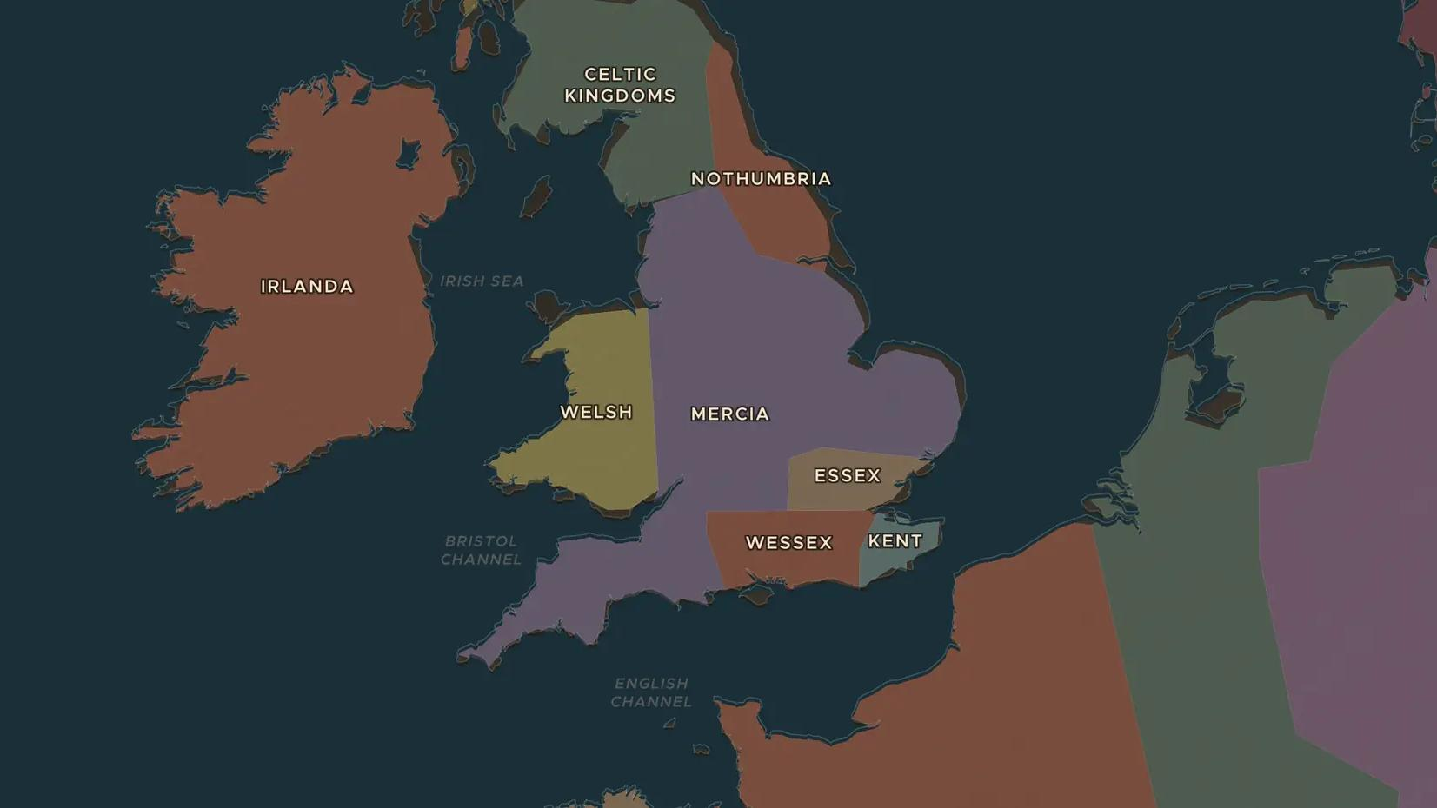
ANGLO-SAXON ENGLAND · 865-899
Alfred the Great and the Danelaw
ChronoAtlas Classroom · Plate 194 · Ages 10-13 · 50 min
ChronoAtlas Classroom · chronoatlas.nl/classroom/lesson/alfred-the-great-danelaw

Slide 2
THIS LESSON
What students take from it
In 878 a Danish army surprises the king of Wessex, who escapes into the marshes with a small band. Students follow Alfred's comeback, map the line between Wessex and the Danelaw, and ask how a king on the run became "the Great".
LENGTH
50 min
AGES
10-13
ON THE MAP
BY THE END, STUDENTS CAN
3 steps, AD 900
Describe the threat of the Great Heathen Army to the Anglo-Saxon kingdoms after 865.
Explain how Alfred defended Wessex with burhs, ships and treaties.
Locate the border between Wessex and the Danelaw and explain its lasting effects.
QUIZ
7 rounds
ChronoAtlas Classroom · chronoatlas.nl/classroom/lesson/alfred-the-great-danelaw
2

Slide 3
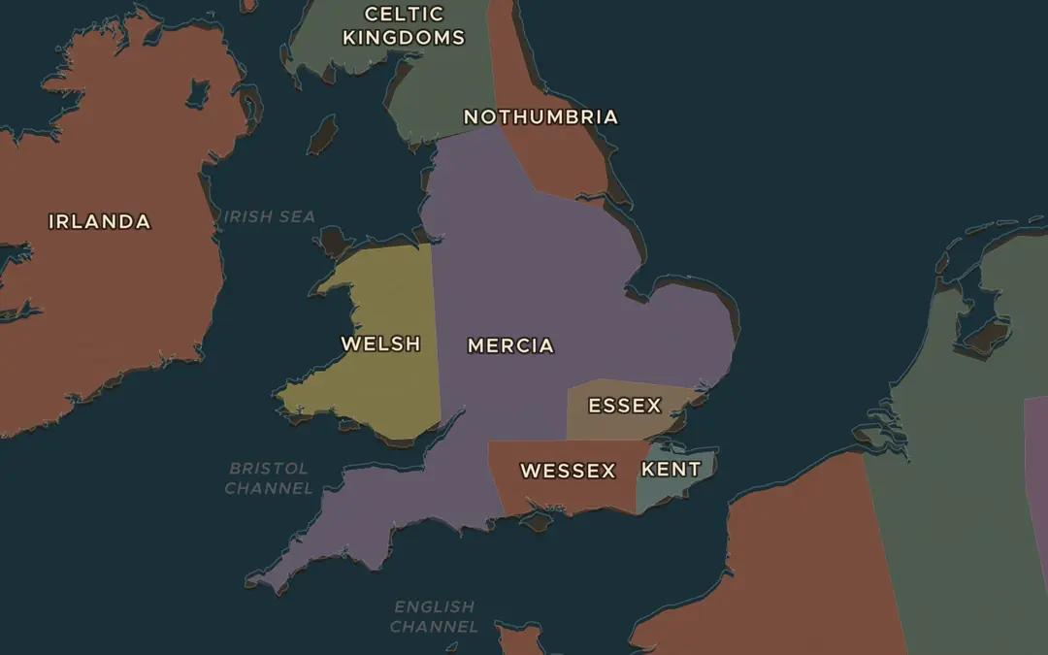
EXPLORE THE MAP · STEP A OF 3 · AD 900
a
England in 900
Open the map in 900 on England. Find Wessex in the south. Which other kingdoms and peoples share the island with it?
Open this view on the live map →
ChronoAtlas Classroom · chronoatlas.nl/classroom/lesson/alfred-the-great-danelaw
3
Notes:
Open the map in 900 on England. Find Wessex in the south. Which other kingdoms and peoples share the island with it?
https://chronoatlas.nl/?year=900&lat=52.5&lng=-1.5&zoom=6

Slide 4
CHRONOATLAS CLASSROOM
The rest of this deck comes with Classroom
19 more slides: the other map steps, the discussion questions, the quiz with its answers, and the worksheet.
Every lesson as a deck, every worksheet, every live lesson and homework.
€19 a month, cancel anytime. The free lesson, Rome at its height, comes whole.
https://chronoatlas.nl/pricing
ChronoAtlas Classroom · chronoatlas.nl/classroom/lesson/alfred-the-great-danelaw
4

