Slide 1
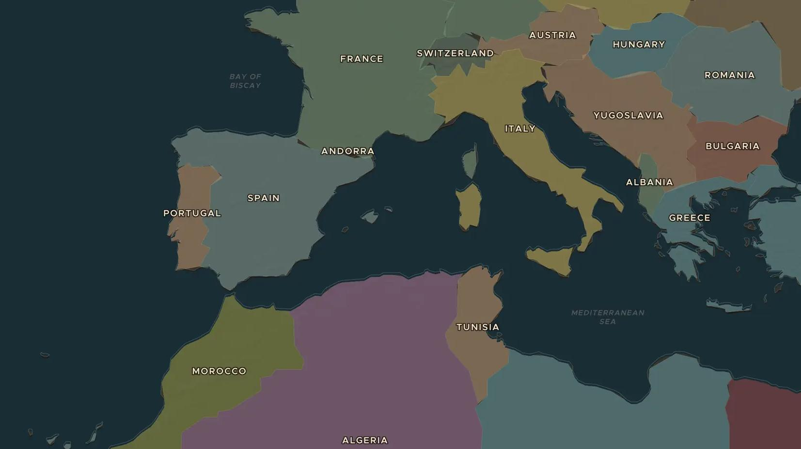
DECOLONIZATION · 1954-1962
Algeria's war of independence
ChronoAtlas Classroom · Plate 475 · Ages 13-16 · 50 min
ChronoAtlas Classroom · chronoatlas.nl/classroom/lesson/algerian-war-of-independence

Slide 2
THIS LESSON
What students take from it
France saw Algeria not as a colony but as part of France itself. In 1954 Algerian nationalists rose in revolt, and an eight-year war followed that toppled a French government and ended in independence in 1962. Students compare the views of Algerians, French settlers and people in France.
LENGTH
50 min
AGES
13-16
ON THE MAP
BY THE END, STUDENTS CAN
3 steps, AD 1938
Explain why Algeria was different from other French colonies.
Describe the main events of the war from 1954 to 1962.
Compare how Algerians, French settlers and people in France experienced the war.
QUIZ
7 rounds
ChronoAtlas Classroom · chronoatlas.nl/classroom/lesson/algerian-war-of-independence
2

Slide 3
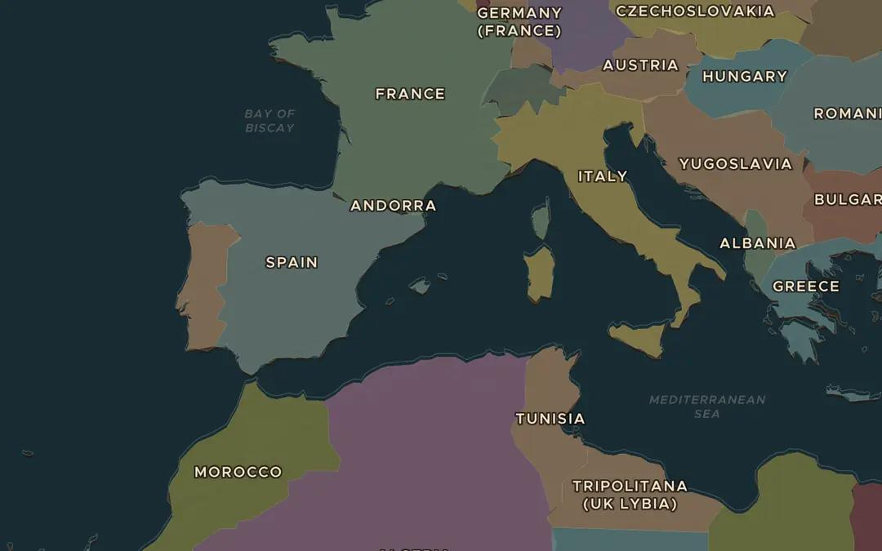
EXPLORE THE MAP · STEP A OF 3 · AD 1938
a
Across the sea
Open the map in 1938 and find Algeria, marked as French, and France across the Mediterranean. How far is Algiers from Marseille? Why did many French people see Algeria as part of France?
Open this view on the live map →
ChronoAtlas Classroom · chronoatlas.nl/classroom/lesson/algerian-war-of-independence
3
Notes:
Open the map in 1938 and find Algeria, marked as French, and France across the Mediterranean. How far is Algiers from Marseille? Why did many French people see Algeria as part of France?
https://chronoatlas.nl/?year=1938&lat=40&lng=4&zoom=4.5

Slide 4
CHRONOATLAS CLASSROOM
The rest of this deck comes with Classroom
19 more slides: the other map steps, the discussion questions, the quiz with its answers, and the worksheet.
Every lesson as a deck, every worksheet, every live lesson and homework.
€19 a month, cancel anytime. The free lesson, Rome at its height, comes whole.
https://chronoatlas.nl/pricing
ChronoAtlas Classroom · chronoatlas.nl/classroom/lesson/algerian-war-of-independence
4

