Slide 1
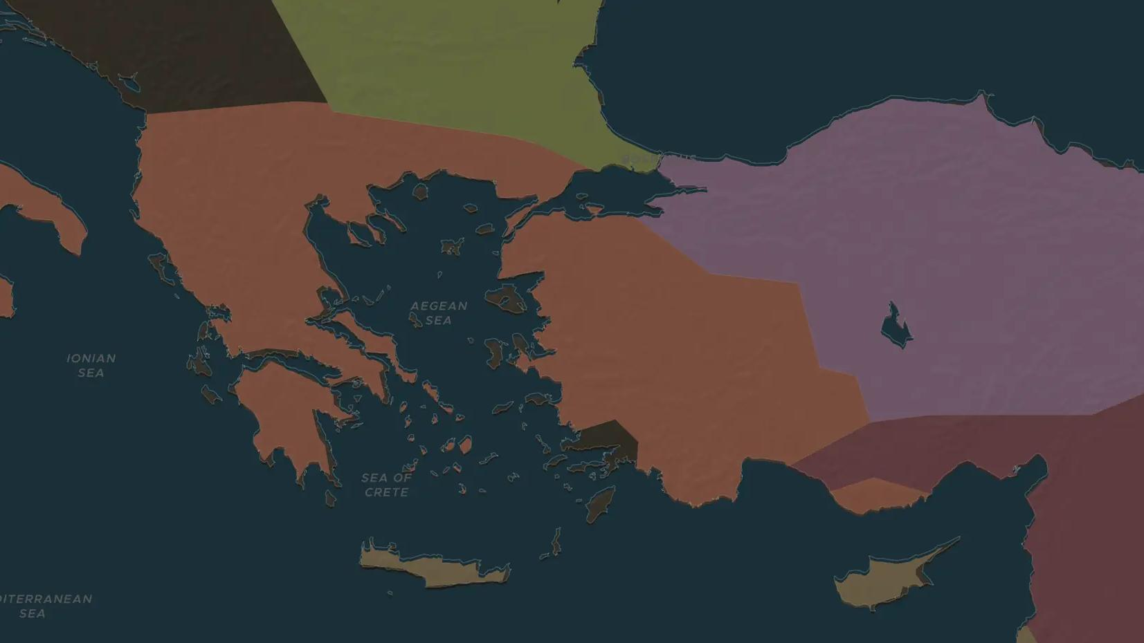
ROMAN REPUBLIC · 44-30 BC
Antony, Cleopatra and the battle of Actium
ChronoAtlas Classroom · Plate 122 · Ages 12-15 · 50 min
ChronoAtlas Classroom · chronoatlas.nl/classroom/lesson/antony-cleopatra-and-actium

Slide 2
THIS LESSON
What students take from it
After Caesar's death, his heir Octavian and his general Mark Antony split the Roman world. Antony allied with Cleopatra VII of Egypt, and the struggle ended at Actium. Students see the story from Rome and from Alexandria.
LENGTH
50 min
AGES
12-15
ON THE MAP
BY THE END, STUDENTS CAN
3 steps, 42 BC
Explain how the Roman world was divided between Octavian and Antony after 44 BC.
Describe Cleopatra's aims as ruler of Egypt and her alliance with Antony.
Explain how the battle of Actium (31 BC) led to the end of the Republic and of Ptolemaic Egypt.
QUIZ
7 rounds
ChronoAtlas Classroom · chronoatlas.nl/classroom/lesson/antony-cleopatra-and-actium
2

Slide 3
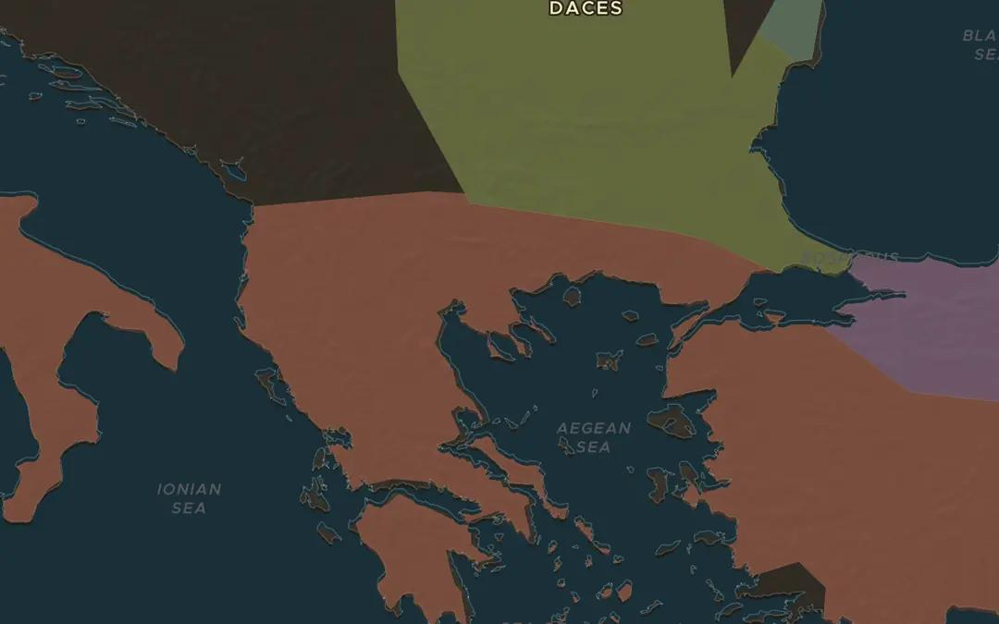
EXPLORE THE MAP · STEP A OF 3 · 42 BC
a
Avenging Caesar
Open the map in 42 BC, turn on Historical Events and choose Battles. Find Philippi, where Antony and Octavian beat Caesar's killers, Brutus and Cassius. Why was the battle fought so far from Rome?
Open this view on the live map →
ChronoAtlas Classroom · chronoatlas.nl/classroom/lesson/antony-cleopatra-and-actium
3
Notes:
Open the map in 42 BC, turn on Historical Events and choose Battles. Find Philippi, where Antony and Octavian beat Caesar's killers, Brutus and Cassius. Why was the battle fought so far from Rome?
https://chronoatlas.nl/?year=-42&lat=40.5&lng=23.5&zoom=6

Slide 4
CHRONOATLAS CLASSROOM
The rest of this deck comes with Classroom
19 more slides: the other map steps, the discussion questions, the quiz with its answers, and the worksheet.
Every lesson as a deck, every worksheet, every live lesson and homework.
€19 a month, cancel anytime. The free lesson, Rome at its height, comes whole.
https://chronoatlas.nl/pricing
ChronoAtlas Classroom · chronoatlas.nl/classroom/lesson/antony-cleopatra-and-actium
4

