Slide 1
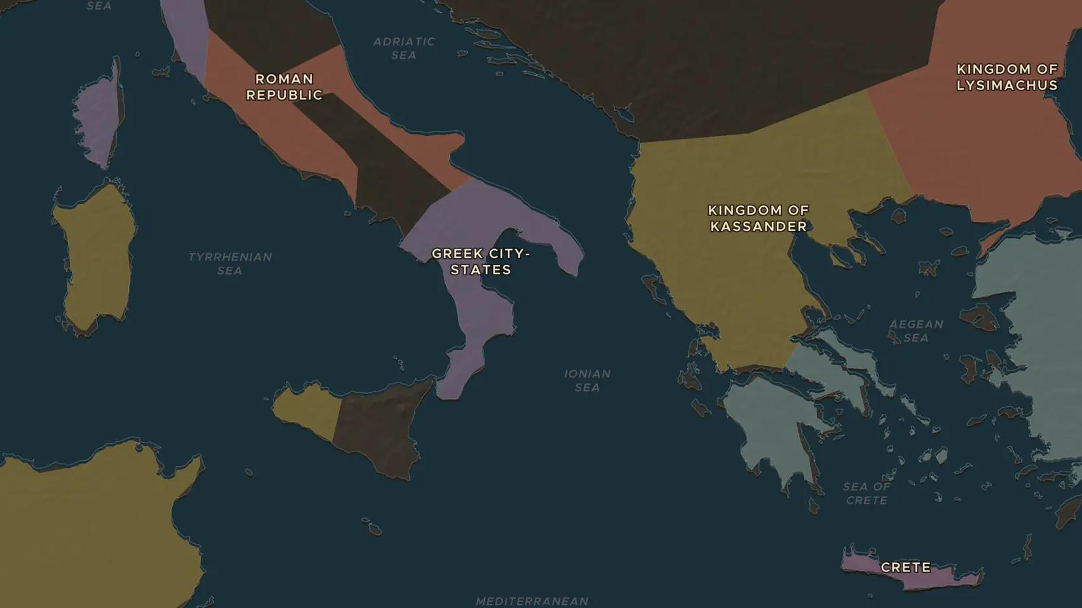
ROMAN REPUBLIC · 214-212 BC
Archimedes and the siege of Syracuse
ChronoAtlas Classroom · Plate 101 · Ages 10-13 · 45 min
ChronoAtlas Classroom · chronoatlas.nl/classroom/lesson/archimedes-and-the-siege-of-syracuse

Slide 2
THIS LESSON
What students take from it
When Syracuse switched to Carthage's side, Rome attacked it by land and sea, and the mathematician Archimedes defended it with his machines. Students separate fact from legend in one of history's most famous sieges.
LENGTH
45 min
AGES
10-13
ON THE MAP
BY THE END, STUDENTS CAN
3 steps, 212 BC
Explain why Rome besieged the Greek city of Syracuse during the Second Punic War.
Describe two machines Archimedes built and judge which stories about him are reliable.
Locate Syracuse and explain why it mattered for control of Sicily.
QUIZ
7 rounds
ChronoAtlas Classroom · chronoatlas.nl/classroom/lesson/archimedes-and-the-siege-of-syracuse
2

Slide 3
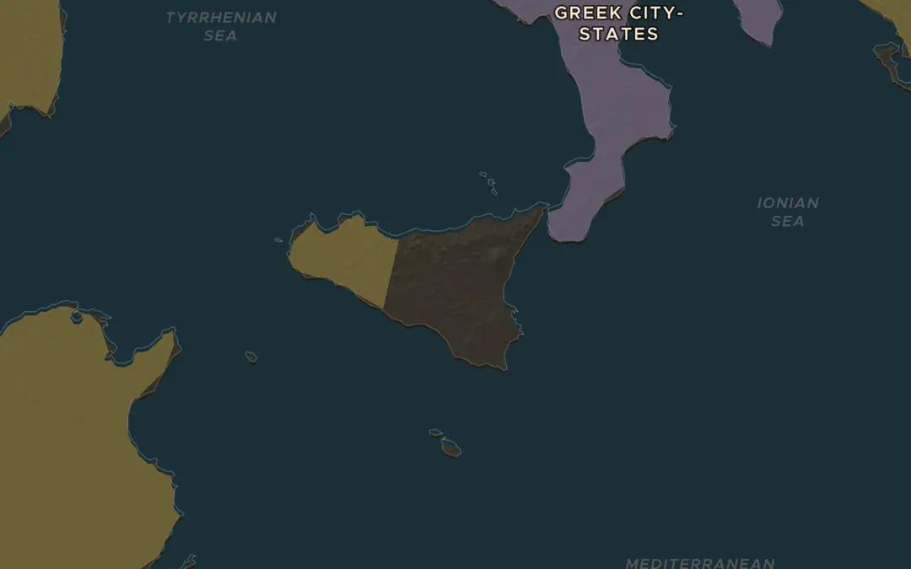
EXPLORE THE MAP · STEP A OF 3 · 212 BC
a
A Greek city in Sicily
Open the map in 212 BC and zoom in on Sicily. Turn on Historical Events and find the Sieges marker at Syracuse. Why would a harbor city on this coast matter to both Rome and Carthage?
Open this view on the live map →
ChronoAtlas Classroom · chronoatlas.nl/classroom/lesson/archimedes-and-the-siege-of-syracuse
3
Notes:
Open the map in 212 BC and zoom in on Sicily. Turn on Historical Events and find the Sieges marker at Syracuse. Why would a harbor city on this coast matter to both Rome and Carthage?
https://chronoatlas.nl/?year=-212&lat=37.5&lng=14.5&zoom=6.5

Slide 4
CHRONOATLAS CLASSROOM
The rest of this deck comes with Classroom
19 more slides: the other map steps, the discussion questions, the quiz with its answers, and the worksheet.
Every lesson as a deck, every worksheet, every live lesson and homework.
€19 a month, cancel anytime. The free lesson, Rome at its height, comes whole.
https://chronoatlas.nl/pricing
ChronoAtlas Classroom · chronoatlas.nl/classroom/lesson/archimedes-and-the-siege-of-syracuse
4

