Slide 1
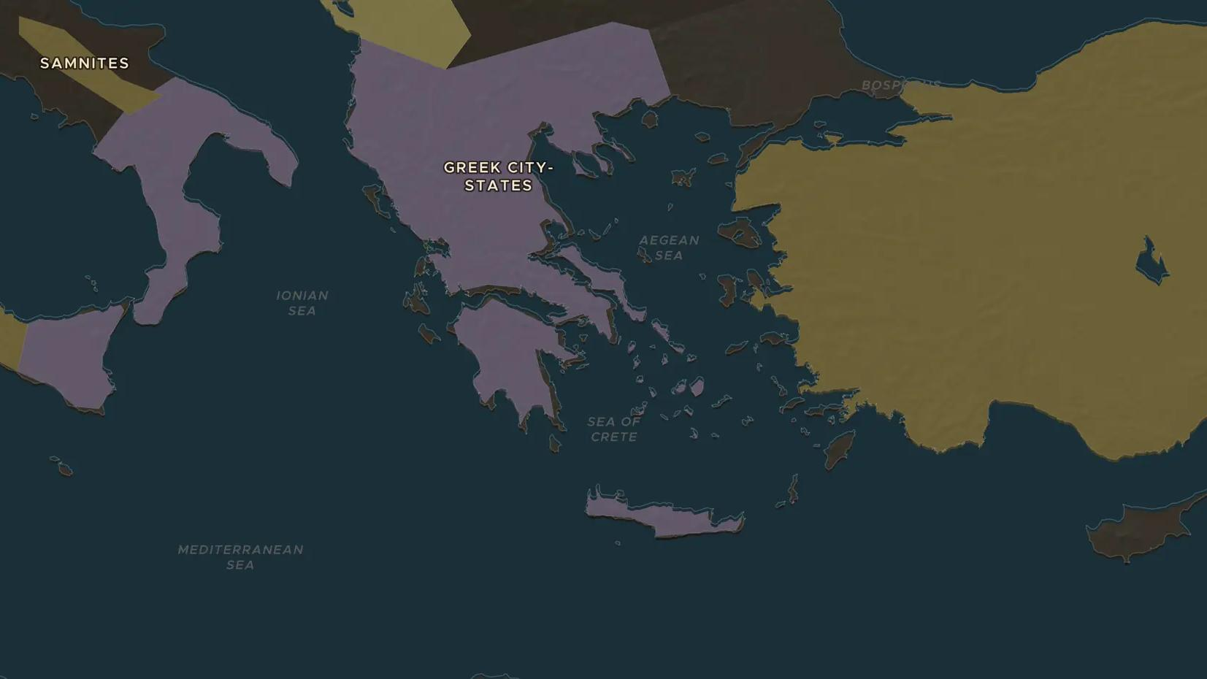
CLASSICAL GREECE · 594-430 BC
Athens invents democracy
ChronoAtlas Classroom · Plate 62 · Ages 12-15 · 50 min
ChronoAtlas Classroom · chronoatlas.nl/classroom/lesson/athenian-democracy

Slide 2
THIS LESSON
What students take from it
In 508 BC the Athenians began an experiment: the people themselves would vote on laws, war and peace. Students trace the steps from Solon to Cleisthenes to Pericles, visit the hill where 6,000 citizens met, and ask who was left out.
LENGTH
50 min
AGES
12-15
ON THE MAP
BY THE END, STUDENTS CAN
3 steps, 594 BC
Order the reforms of Solon (594 BC), Cleisthenes (508 BC) and Pericles (around 450 BC) and say what each changed.
Describe how the Assembly, the Council of 500 and the courts worked, including choosing officials by lot.
Explain who counted as a citizen in Athens and who did not.
QUIZ
7 rounds
ChronoAtlas Classroom · chronoatlas.nl/classroom/lesson/athenian-democracy
2

Slide 3
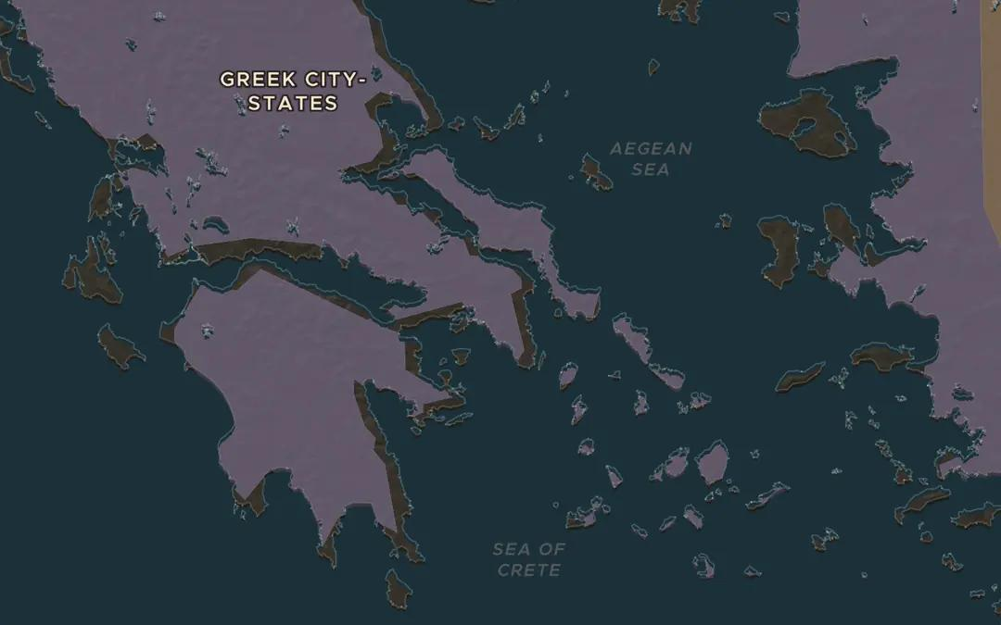
EXPLORE THE MAP · STEP A OF 3 · 594 BC
a
Solon stops a civil war
Open the map in 594 BC on Attica, the territory of Athens, with the Cities layer on. Poor farmers were being sold into slavery for debt. Solon cancelled the debts, banned debt slavery and let every citizen attend the Assembly. Zoom out to see the farmland and hills of Attica that Athens ruled.
Open this view on the live map →
ChronoAtlas Classroom · chronoatlas.nl/classroom/lesson/athenian-democracy
3
Notes:
Open the map in 594 BC on Attica, the territory of Athens, with the Cities layer on. Poor farmers were being sold into slavery for debt. Solon cancelled the debts, banned debt slavery and let every citizen attend the Assembly. Zoom out to see the farmland and hills of Attica that Athens ruled.
https://chronoatlas.nl/?year=-594&lat=38&lng=23.8&zoom=7

Slide 4
CHRONOATLAS CLASSROOM
The rest of this deck comes with Classroom
19 more slides: the other map steps, the discussion questions, the quiz with its answers, and the worksheet.
Every lesson as a deck, every worksheet, every live lesson and homework.
€19 a month, cancel anytime. The free lesson, Rome at its height, comes whole.
https://chronoatlas.nl/pricing
ChronoAtlas Classroom · chronoatlas.nl/classroom/lesson/athenian-democracy
4

