Slide 1
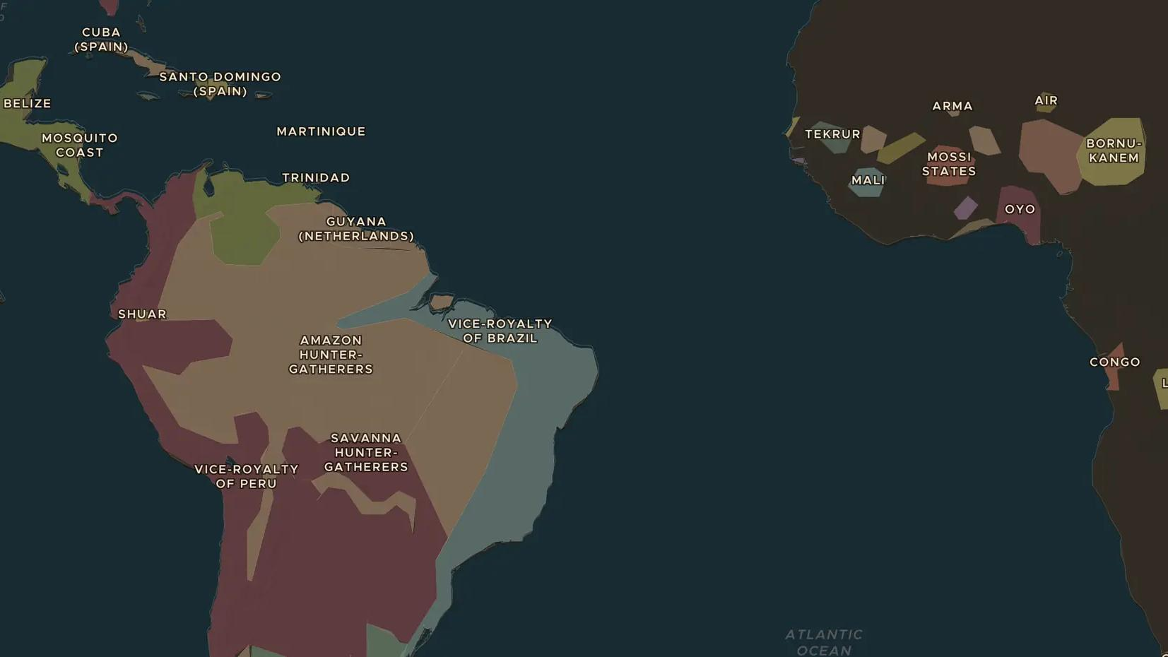
ATLANTIC WORLD · 1500S-1700S
The Atlantic slave trade and the Americas
ChronoAtlas Classroom · Plate 371 · Ages 13-16 · 50 min
ChronoAtlas Classroom · chronoatlas.nl/classroom/lesson/atlantic-slave-trade-americas

Slide 2
THIS LESSON
What students take from it
Over more than three centuries, about 12.5 million Africans were forced onto ships bound for the Americas. Students look at where they came from and where they were taken, the plantations their labour built, and the many ways enslaved people resisted and kept their cultures alive.
LENGTH
50 min
AGES
13-16
ON THE MAP
BY THE END, STUDENTS CAN
3 steps, AD 1700
Describe the scale and the main routes of the Atlantic slave trade to the Americas.
Explain why Brazil and the Caribbean received most enslaved Africans.
Give examples of resistance and cultural survival among enslaved Africans and their descendants.
QUIZ
7 rounds
ChronoAtlas Classroom · chronoatlas.nl/classroom/lesson/atlantic-slave-trade-americas
2

Slide 3
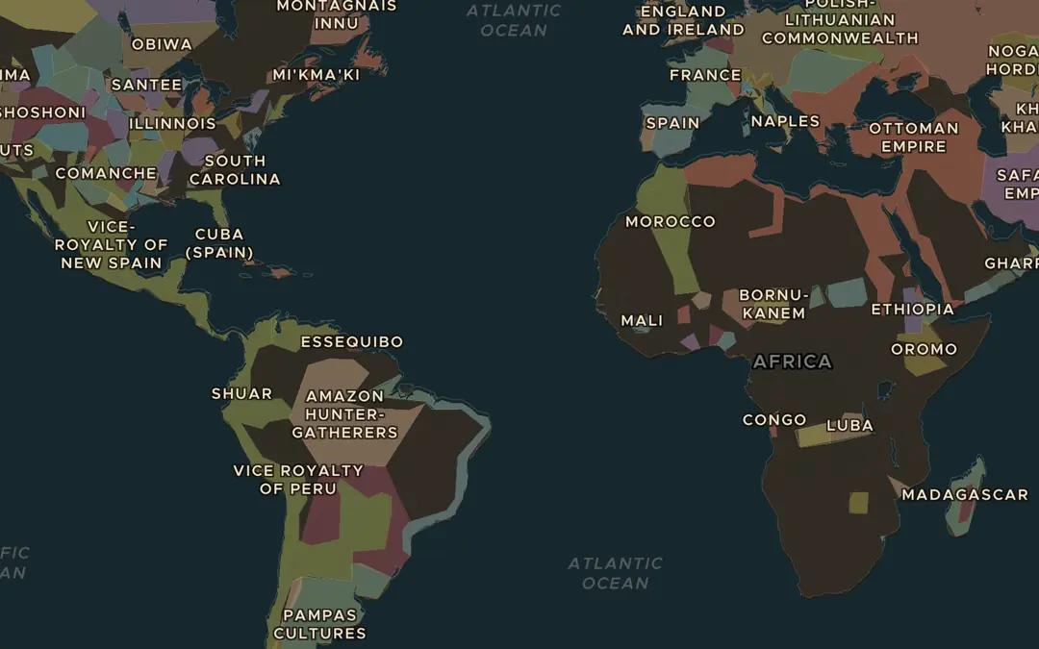
EXPLORE THE MAP · STEP A OF 3 · AD 1700
a
Three corners
Open the map in 1700, turn on Trade Routes and zoom out over the Atlantic. Follow the Atlantic Triangular Trade from Europe to West Africa, across to the Americas and back. What travelled on each leg?
Open this view on the live map →
ChronoAtlas Classroom · chronoatlas.nl/classroom/lesson/atlantic-slave-trade-americas
3
Notes:
Open the map in 1700, turn on Trade Routes and zoom out over the Atlantic. Follow the Atlantic Triangular Trade from Europe to West Africa, across to the Americas and back. What travelled on each leg?
https://chronoatlas.nl/?year=1700&lat=10&lng=-30&zoom=2.5

Slide 4
CHRONOATLAS CLASSROOM
The rest of this deck comes with Classroom
19 more slides: the other map steps, the discussion questions, the quiz with its answers, and the worksheet.
Every lesson as a deck, every worksheet, every live lesson and homework.
€19 a month, cancel anytime. The free lesson, Rome at its height, comes whole.
https://chronoatlas.nl/pricing
ChronoAtlas Classroom · chronoatlas.nl/classroom/lesson/atlantic-slave-trade-americas
4

