Slide 1
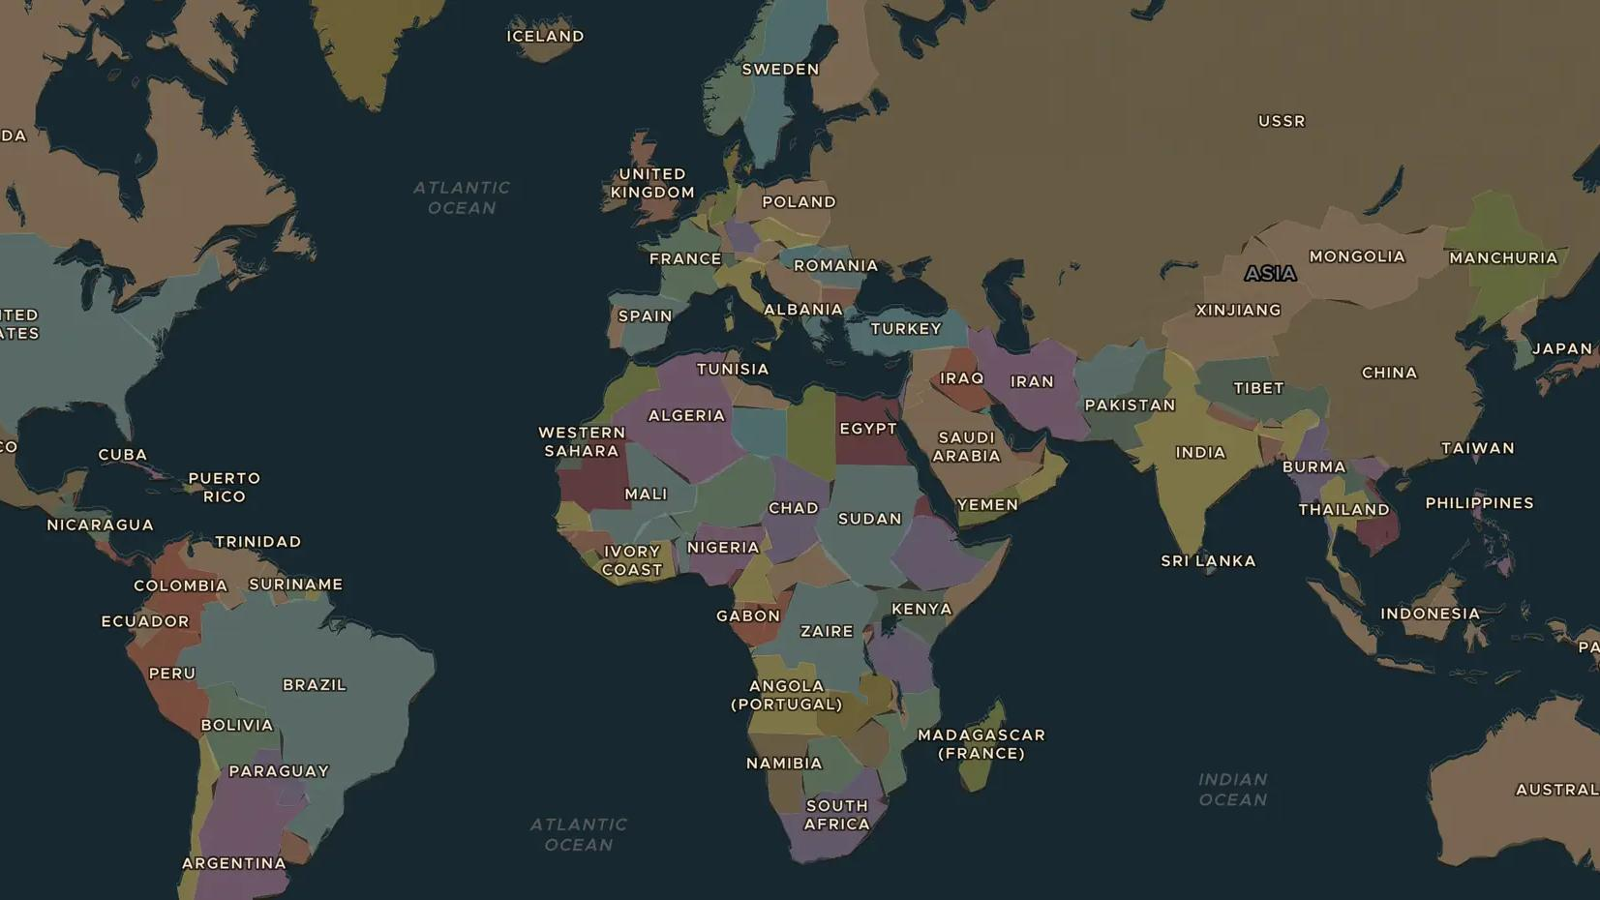
SECOND WORLD WAR · 1942-1945
1945: the atomic bombs and Japan's surrender
ChronoAtlas Classroom · Plate 491 · Ages 13-16 · 50 min
ChronoAtlas Classroom · chronoatlas.nl/classroom/lesson/atomic-bombs-1945

Slide 2
THIS LESSON
What students take from it
In August 1945 the United States dropped atomic bombs on Hiroshima and Nagasaki, and the Soviet Union declared war on Japan. Japan surrendered weeks later. Students trace the secret Manhattan Project and the path to surrender, and listen to the voices of survivors.
LENGTH
50 min
AGES
13-16
ON THE MAP
BY THE END, STUDENTS CAN
3 steps, AD 1945
Explain what the Manhattan Project was and where the first atomic bomb was tested.
Describe the events of August 1945 that led to Japan's surrender.
Compare the different ways historians and survivors explain and remember the bombings.
QUIZ
7 rounds
ChronoAtlas Classroom · chronoatlas.nl/classroom/lesson/atomic-bombs-1945
2

Slide 3
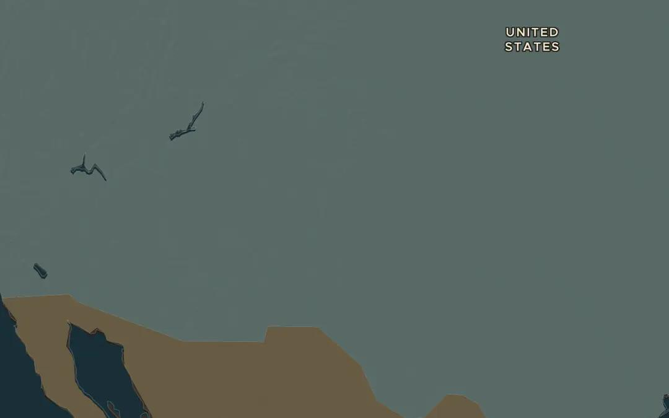
EXPLORE THE MAP · STEP A OF 3 · AD 1945
a
A secret laboratory
Open the map in 1945 and find New Mexico in the south-west of the United States. Ask the atlas: "What was Los Alamos?" Why would scientists work in such a remote place?
Open this view on the live map →
ChronoAtlas Classroom · chronoatlas.nl/classroom/lesson/atomic-bombs-1945
3
Notes:
Open the map in 1945 and find New Mexico in the south-west of the United States. Ask the atlas: "What was Los Alamos?" Why would scientists work in such a remote place?
https://chronoatlas.nl/?year=1945&lat=35&lng=-106&zoom=5.5

Slide 4
CHRONOATLAS CLASSROOM
The rest of this deck comes with Classroom
19 more slides: the other map steps, the discussion questions, the quiz with its answers, and the worksheet.
Every lesson as a deck, every worksheet, every live lesson and homework.
€19 a month, cancel anytime. The free lesson, Rome at its height, comes whole.
https://chronoatlas.nl/pricing
ChronoAtlas Classroom · chronoatlas.nl/classroom/lesson/atomic-bombs-1945
4

