Slide 1
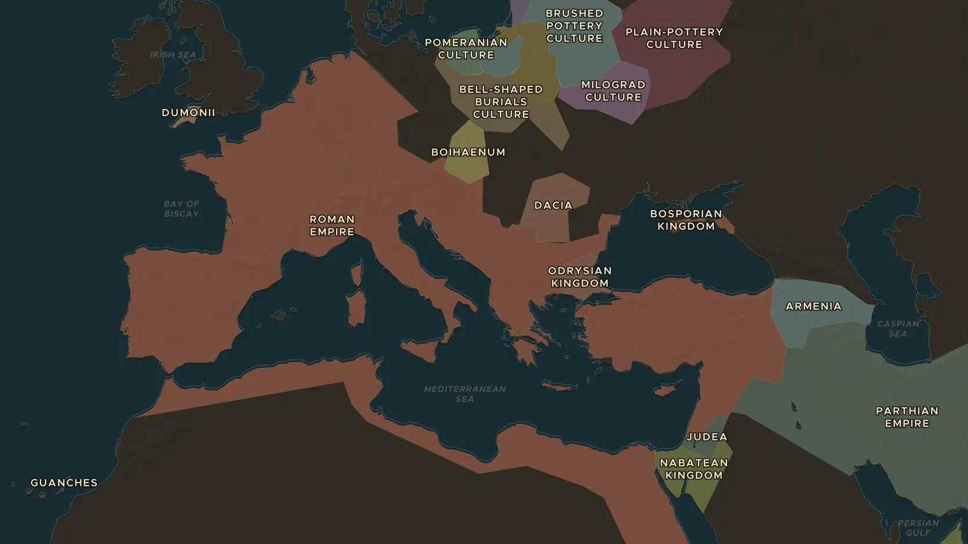
ROMAN EMPIRE · 27 BC-14 AD
Augustus and the Pax Romana
ChronoAtlas Classroom · Plate 123 · Ages 11-14 · 50 min
ChronoAtlas Classroom · chronoatlas.nl/classroom/lesson/augustus-and-the-pax-romana

Slide 2
THIS LESSON
What students take from it
Octavian became Augustus, the first emperor, while claiming to restore the Republic. Students explore how he ruled, what the Pax Romana meant and who paid for the peace.
LENGTH
50 min
AGES
11-14
ON THE MAP
BY THE END, STUDENTS CAN
3 steps, 27 BC
Explain how Augustus held total power while keeping the look of the Republic.
Describe what the Pax Romana was and roughly how long it lasted.
Identify the borders Augustus set for the empire and one place where he failed.
QUIZ
7 rounds
ChronoAtlas Classroom · chronoatlas.nl/classroom/lesson/augustus-and-the-pax-romana
2

Slide 3
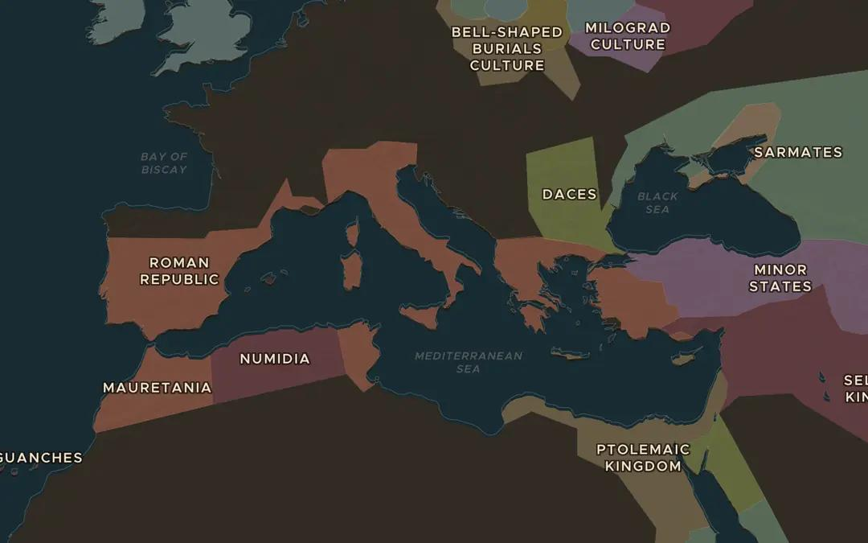
EXPLORE THE MAP · STEP A OF 3 · 27 BC
a
The first emperor
Open the map in 27 BC and turn on Historical Events. Find the Political Events markers in Rome for Augustus becoming emperor and the start of the Pax Romana. Zoom out: how big is Rome's empire?
Open this view on the live map →
ChronoAtlas Classroom · chronoatlas.nl/classroom/lesson/augustus-and-the-pax-romana
3
Notes:
Open the map in 27 BC and turn on Historical Events. Find the Political Events markers in Rome for Augustus becoming emperor and the start of the Pax Romana. Zoom out: how big is Rome's empire?
https://chronoatlas.nl/?year=-27&lat=40&lng=15&zoom=4

Slide 4
CHRONOATLAS CLASSROOM
The rest of this deck comes with Classroom
19 more slides: the other map steps, the discussion questions, the quiz with its answers, and the worksheet.
Every lesson as a deck, every worksheet, every live lesson and homework.
€19 a month, cancel anytime. The free lesson, Rome at its height, comes whole.
https://chronoatlas.nl/pricing
ChronoAtlas Classroom · chronoatlas.nl/classroom/lesson/augustus-and-the-pax-romana
4

