Slide 1
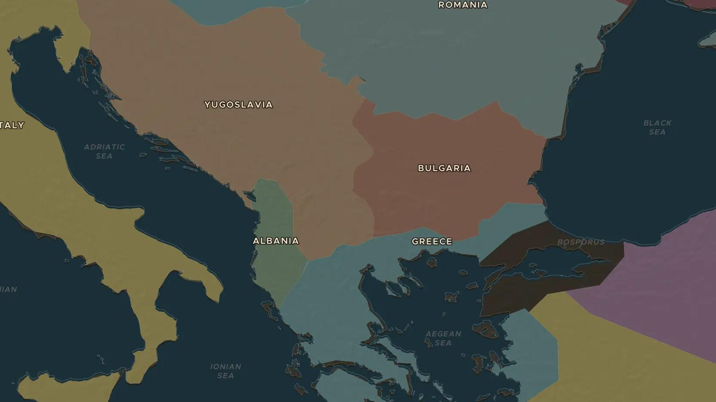
BALKANS · 1912-1914
The Balkan Wars
ChronoAtlas Classroom · Plate 449 · Ages 13-16 · 45 min
ChronoAtlas Classroom · chronoatlas.nl/classroom/lesson/balkan-wars-1912-1913

Slide 2
THIS LESSON
What students take from it
In 1912 four Balkan states join forces and drive the Ottoman Empire almost out of Europe. A year later they fight each other over the spoils. Students map the wars, the birth of Albania and the road to the shots in Sarajevo in June 1914.
LENGTH
45 min
AGES
13-16
ON THE MAP
BY THE END, STUDENTS CAN
3 steps, AD 1900
Compare the map of the Balkans in 1900 and 1914.
Explain the causes and results of the First and Second Balkan Wars (1912-1913).
Explain why the Balkans were called the "powder keg of Europe" before 1914.
QUIZ
7 rounds
ChronoAtlas Classroom · chronoatlas.nl/classroom/lesson/balkan-wars-1912-1913
2

Slide 3
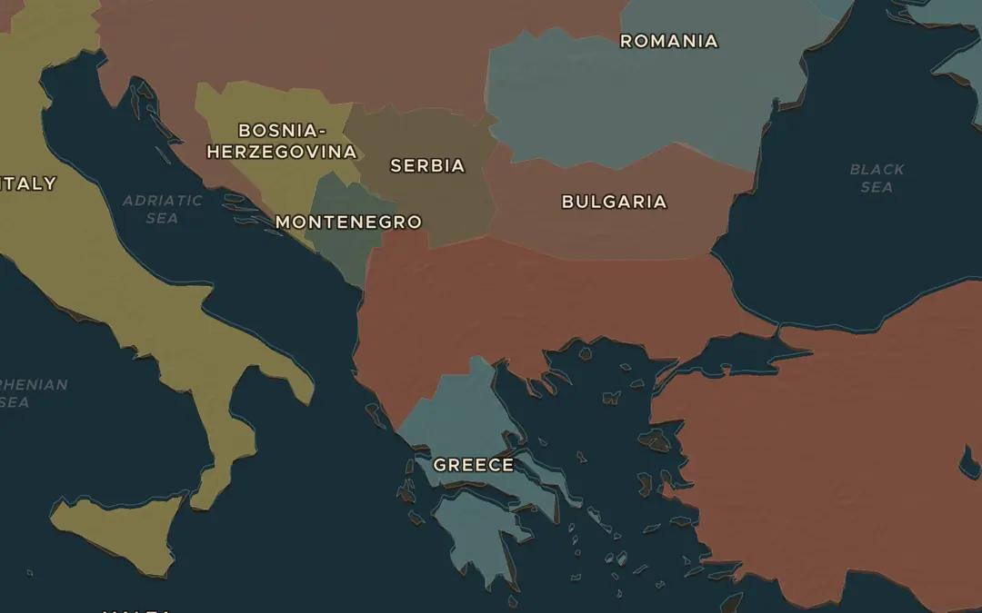
EXPLORE THE MAP · STEP A OF 3 · AD 1900
a
The Balkans in 1900
Open the map in 1900 and zoom in on the Balkans. Which lands does the Ottoman Empire still hold in Europe? Find Macedonia, Albania and Thrace.
Open this view on the live map →
ChronoAtlas Classroom · chronoatlas.nl/classroom/lesson/balkan-wars-1912-1913
3
Notes:
Open the map in 1900 and zoom in on the Balkans. Which lands does the Ottoman Empire still hold in Europe? Find Macedonia, Albania and Thrace.
https://chronoatlas.nl/?year=1900&lat=41.5&lng=22.5&zoom=5.5

Slide 4
CHRONOATLAS CLASSROOM
The rest of this deck comes with Classroom
19 more slides: the other map steps, the discussion questions, the quiz with its answers, and the worksheet.
Every lesson as a deck, every worksheet, every live lesson and homework.
€19 a month, cancel anytime. The free lesson, Rome at its height, comes whole.
https://chronoatlas.nl/pricing
ChronoAtlas Classroom · chronoatlas.nl/classroom/lesson/balkan-wars-1912-1913
4

