Slide 1
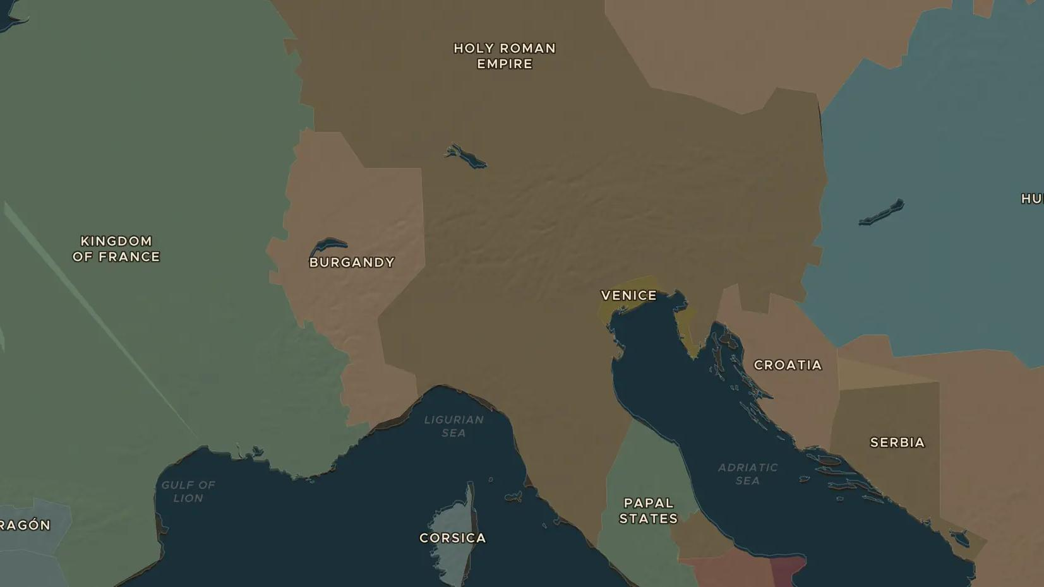
HOLY ROMAN EMPIRE · 1152-1190
Barbarossa and the cities of Italy
ChronoAtlas Classroom · Plate 232 · Ages 12-15 · 45 min
ChronoAtlas Classroom · chronoatlas.nl/classroom/lesson/barbarossa-lombard-league

Slide 2
THIS LESSON
What students take from it
Emperor Frederick Barbarossa marches into Italy to make its rich cities obey him, and they band together against him. Students map the Lombard League, replay the battle of Legnano in 1176 and discuss why self-governing cities mattered for Europe.
LENGTH
45 min
AGES
12-15
ON THE MAP
BY THE END, STUDENTS CAN
3 steps, AD 1176
Explain why Frederick Barbarossa and the cities of northern Italy came into conflict.
Locate the Lombard League and the battle of Legnano on the map.
Describe what the Peace of Constance (1183) gave the cities, and why it mattered.
QUIZ
7 rounds
ChronoAtlas Classroom · chronoatlas.nl/classroom/lesson/barbarossa-lombard-league
2

Slide 3
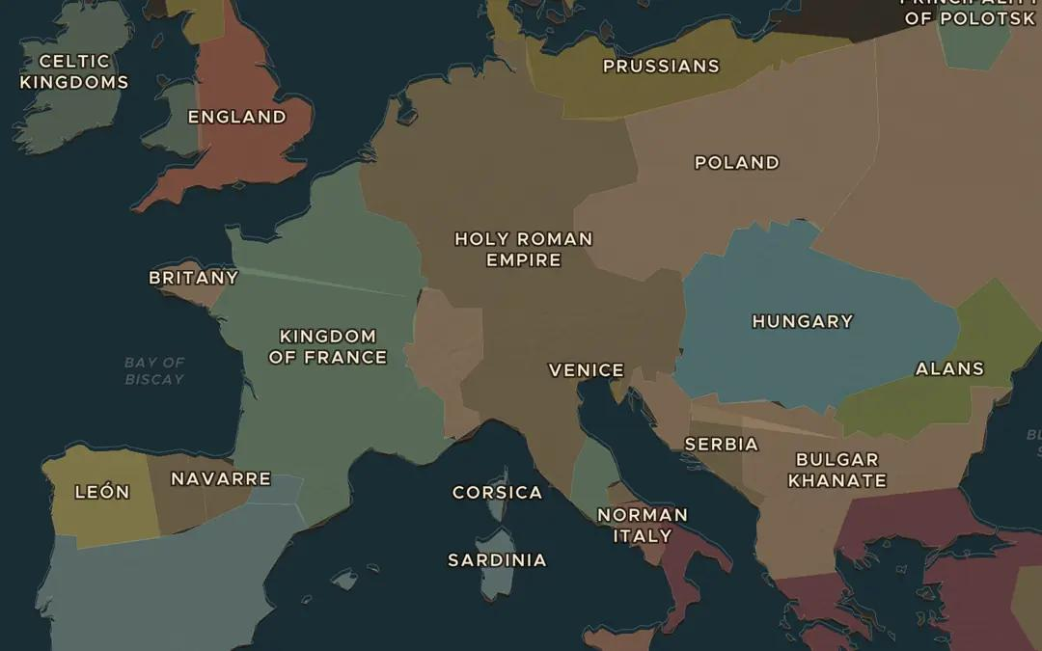
EXPLORE THE MAP · STEP A OF 3 · AD 1176
a
An empire across the Alps
Open the map in 1176. Find the Holy Roman Empire. How much of Italy does it include? What stands between the German lands and Lombardy?
Open this view on the live map →
ChronoAtlas Classroom · chronoatlas.nl/classroom/lesson/barbarossa-lombard-league
3
Notes:
Open the map in 1176. Find the Holy Roman Empire. How much of Italy does it include? What stands between the German lands and Lombardy?
https://chronoatlas.nl/?year=1176&lat=47&lng=10&zoom=4.6

Slide 4
CHRONOATLAS CLASSROOM
The rest of this deck comes with Classroom
19 more slides: the other map steps, the discussion questions, the quiz with its answers, and the worksheet.
Every lesson as a deck, every worksheet, every live lesson and homework.
€19 a month, cancel anytime. The free lesson, Rome at its height, comes whole.
https://chronoatlas.nl/pricing
ChronoAtlas Classroom · chronoatlas.nl/classroom/lesson/barbarossa-lombard-league
4

