Slide 1
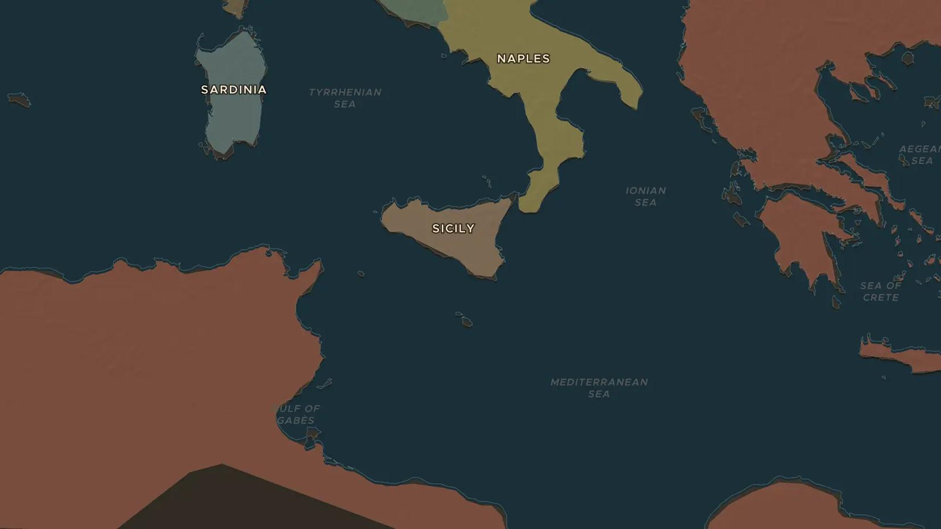
OTTOMAN EMPIRE · 1533-1573
Barbarossa, Malta and Lepanto
ChronoAtlas Classroom · Plate 331 · Ages 12-15 · 45 min
ChronoAtlas Classroom · chronoatlas.nl/classroom/lesson/barbarossa-malta-and-lepanto

Slide 2
THIS LESSON
What students take from it
For forty years Ottoman and Christian fleets fought for the Mediterranean. Students follow the corsair-admiral Barbarossa, the siege of Malta and the great galley battle of Lepanto, and ask who really won.
LENGTH
45 min
AGES
12-15
ON THE MAP
BY THE END, STUDENTS CAN
3 steps, AD 1538
Locate Algiers, Preveza, Malta, Lepanto and Cyprus on the map.
Describe the Battle of Lepanto in 1571 and its results.
Explain why Lepanto changed less on the map than its fame suggests.
QUIZ
7 rounds
ChronoAtlas Classroom · chronoatlas.nl/classroom/lesson/barbarossa-malta-and-lepanto
2

Slide 3
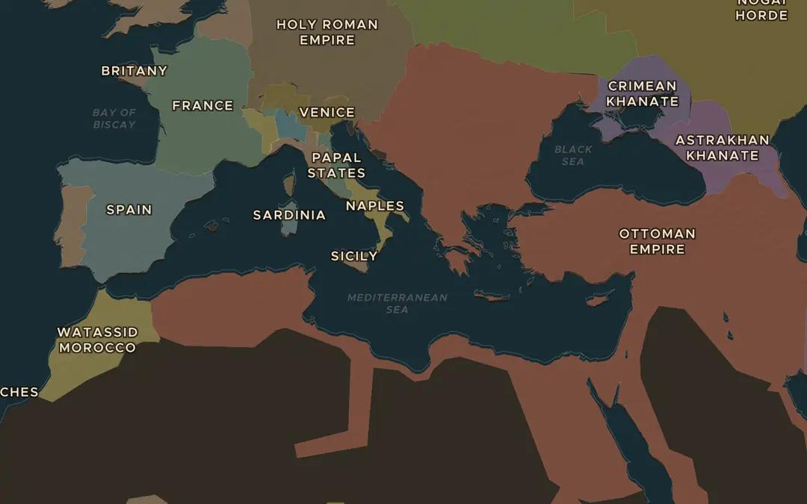
EXPLORE THE MAP · STEP A OF 3 · AD 1538
a
A sea of rivals
Open the map in 1538 and turn on Historical Events. Find the Battle of Preveza. Which empire holds the eastern coasts of the Mediterranean, and which holds the west?
Open this view on the live map →
ChronoAtlas Classroom · chronoatlas.nl/classroom/lesson/barbarossa-malta-and-lepanto
3
Notes:
Open the map in 1538 and turn on Historical Events. Find the Battle of Preveza. Which empire holds the eastern coasts of the Mediterranean, and which holds the west?
https://chronoatlas.nl/?year=1538&lat=38&lng=18&zoom=4

Slide 4
CHRONOATLAS CLASSROOM
The rest of this deck comes with Classroom
19 more slides: the other map steps, the discussion questions, the quiz with its answers, and the worksheet.
Every lesson as a deck, every worksheet, every live lesson and homework.
€19 a month, cancel anytime. The free lesson, Rome at its height, comes whole.
https://chronoatlas.nl/pricing
ChronoAtlas Classroom · chronoatlas.nl/classroom/lesson/barbarossa-malta-and-lepanto
4

