Slide 1
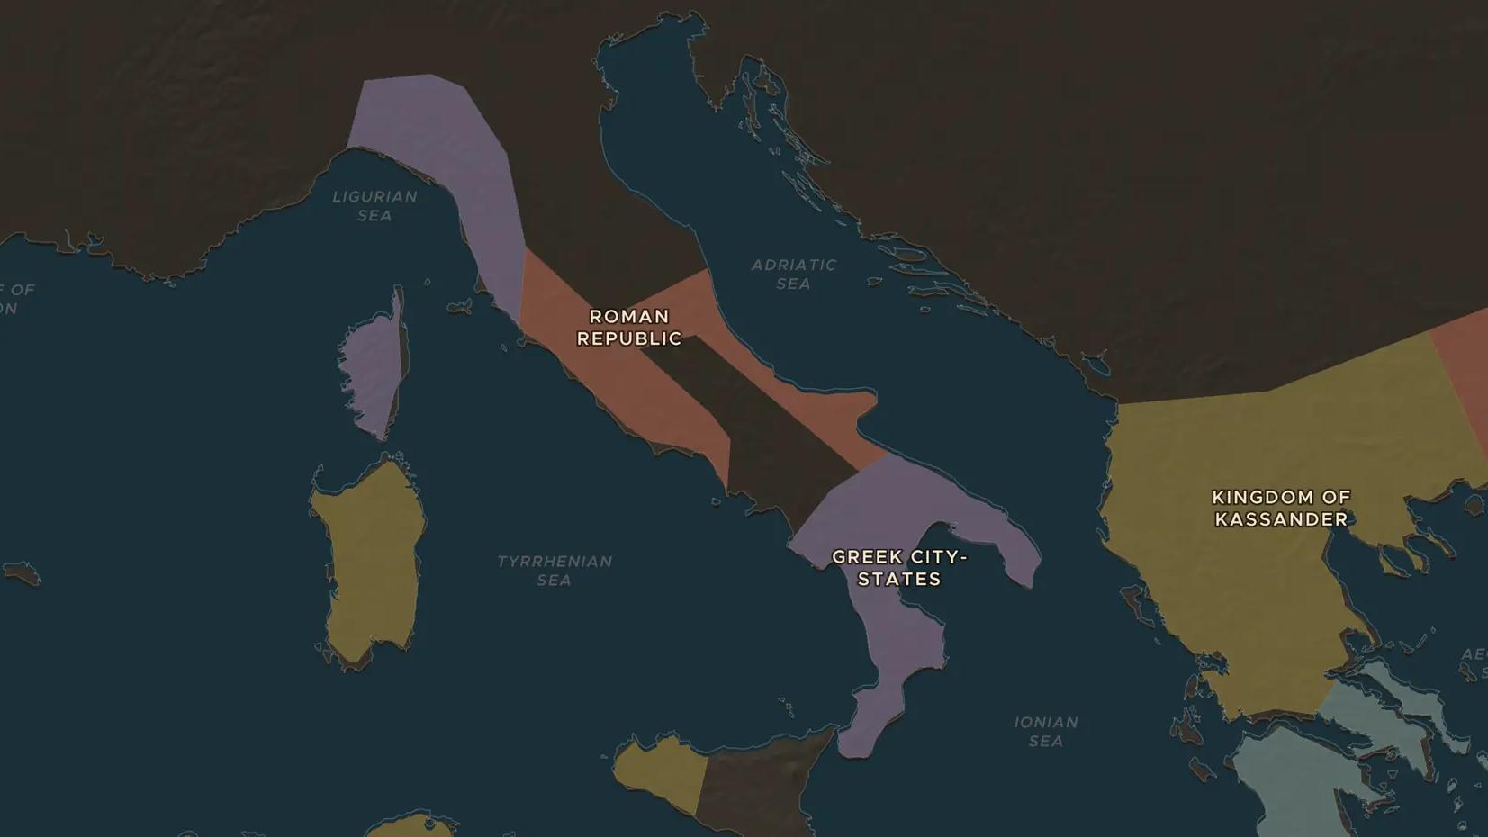
ROMAN REPUBLIC · 216 BC
Cannae, 216 BC: Rome's darkest day
ChronoAtlas Classroom · Plate 100 · Ages 12-15 · 50 min
ChronoAtlas Classroom · chronoatlas.nl/classroom/lesson/battle-of-cannae

Slide 2
THIS LESSON
What students take from it
At Cannae, Hannibal surrounded and destroyed the largest army Rome had ever sent into battle. Students study the famous double envelopment, then ask the bigger question: why did Rome not give up?
LENGTH
50 min
AGES
12-15
ON THE MAP
BY THE END, STUDENTS CAN
3 steps, 216 BC
Describe Hannibal's plan at Cannae and why it worked.
Explain why some Italian cities, such as Capua, went over to Hannibal after the battle.
Give two reasons why Rome survived the defeat and went on to win the war.
QUIZ
7 rounds
ChronoAtlas Classroom · chronoatlas.nl/classroom/lesson/battle-of-cannae
2

Slide 3
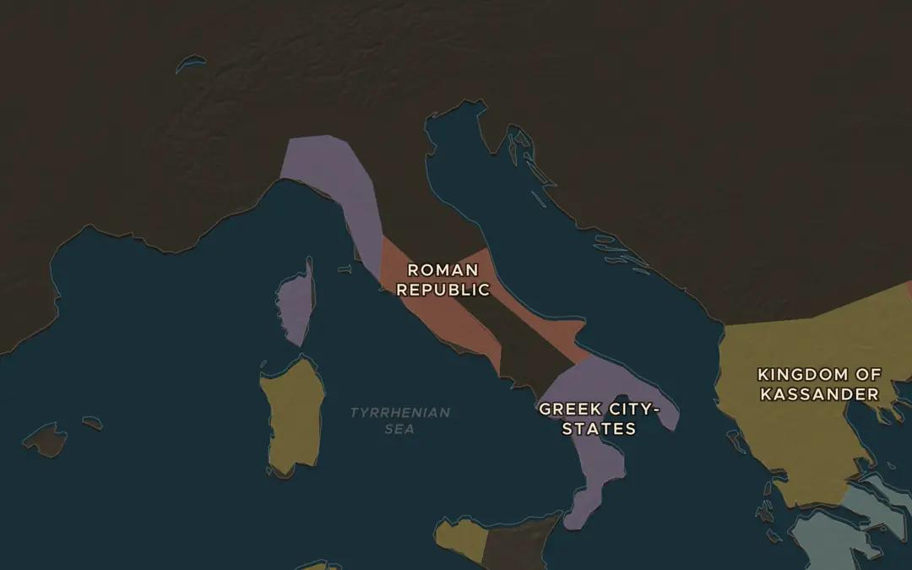
EXPLORE THE MAP · STEP A OF 3 · 216 BC
a
Hannibal in Italy
Open the map in 216 BC, turn on Historical Events and choose Battles. Find the markers for the Trebia, Lake Trasimene and Cannae. Where did Hannibal go after each battle?
Open this view on the live map →
ChronoAtlas Classroom · chronoatlas.nl/classroom/lesson/battle-of-cannae
3
Notes:
Open the map in 216 BC, turn on Historical Events and choose Battles. Find the markers for the Trebia, Lake Trasimene and Cannae. Where did Hannibal go after each battle?
https://chronoatlas.nl/?year=-216&lat=42.5&lng=13&zoom=5.5

Slide 4
CHRONOATLAS CLASSROOM
The rest of this deck comes with Classroom
19 more slides: the other map steps, the discussion questions, the quiz with its answers, and the worksheet.
Every lesson as a deck, every worksheet, every live lesson and homework.
€19 a month, cancel anytime. The free lesson, Rome at its height, comes whole.
https://chronoatlas.nl/pricing
ChronoAtlas Classroom · chronoatlas.nl/classroom/lesson/battle-of-cannae
4

