Slide 1
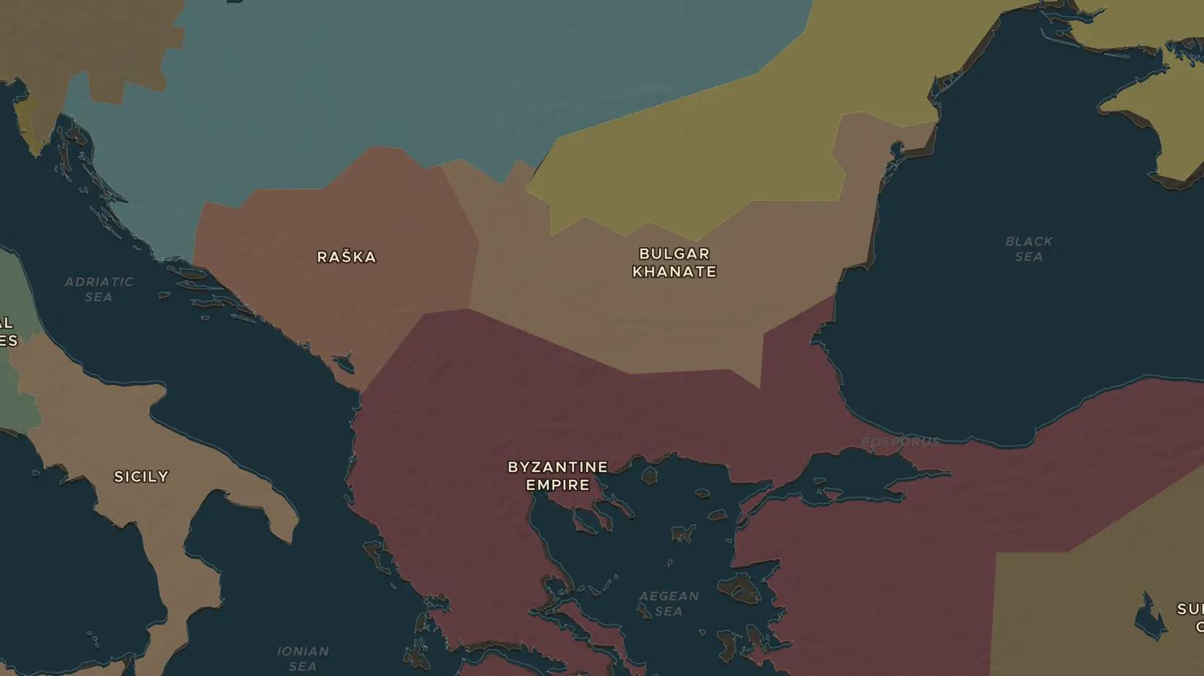
MEDIEVAL BALKANS · 1371-1389
Kosovo 1389: battle and memory
ChronoAtlas Classroom · Plate 261 · Ages 13-16 · 50 min
ChronoAtlas Classroom · chronoatlas.nl/classroom/lesson/battle-of-kosovo-1389

Slide 2
THIS LESSON
What students take from it
On the Field of Blackbirds in 1389 a Serbian-led army meets the Ottoman sultan Murad I, and both leaders die. Students place the battle in the Ottoman advance into the Balkans and explore how one battle became a powerful story of memory.
LENGTH
50 min
AGES
13-16
ON THE MAP
BY THE END, STUDENTS CAN
3 steps, AD 1300
Describe the Ottoman advance into the Balkans between 1354 and 1400.
Explain what happened at the battle of Kosovo in 1389 and why its result is debated.
Analyze how the battle has been remembered differently by different peoples.
QUIZ
7 rounds
ChronoAtlas Classroom · chronoatlas.nl/classroom/lesson/battle-of-kosovo-1389
2

Slide 3
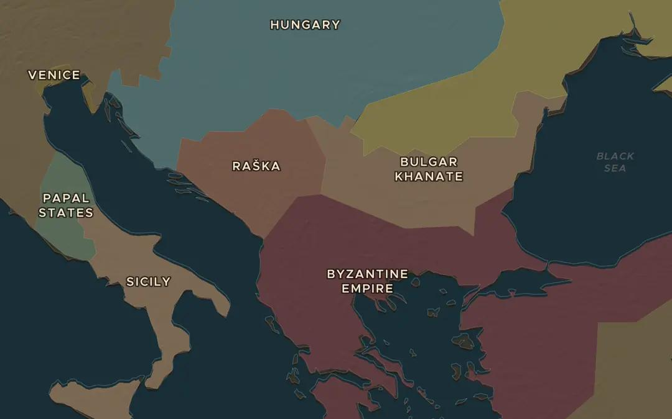
EXPLORE THE MAP · STEP A OF 3 · AD 1300
a
The Balkans in 1300
Open the map in 1300 on the Balkans. Find Raška, the Serbian kingdom, and the Byzantine Empire. Who are the main powers in the region?
Open this view on the live map →
ChronoAtlas Classroom · chronoatlas.nl/classroom/lesson/battle-of-kosovo-1389
3
Notes:
Open the map in 1300 on the Balkans. Find Raška, the Serbian kingdom, and the Byzantine Empire. Who are the main powers in the region?
https://chronoatlas.nl/?year=1300&lat=42.5&lng=22&zoom=5.5

Slide 4
CHRONOATLAS CLASSROOM
The rest of this deck comes with Classroom
19 more slides: the other map steps, the discussion questions, the quiz with its answers, and the worksheet.
Every lesson as a deck, every worksheet, every live lesson and homework.
€19 a month, cancel anytime. The free lesson, Rome at its height, comes whole.
https://chronoatlas.nl/pricing
ChronoAtlas Classroom · chronoatlas.nl/classroom/lesson/battle-of-kosovo-1389
4

