Slide 1
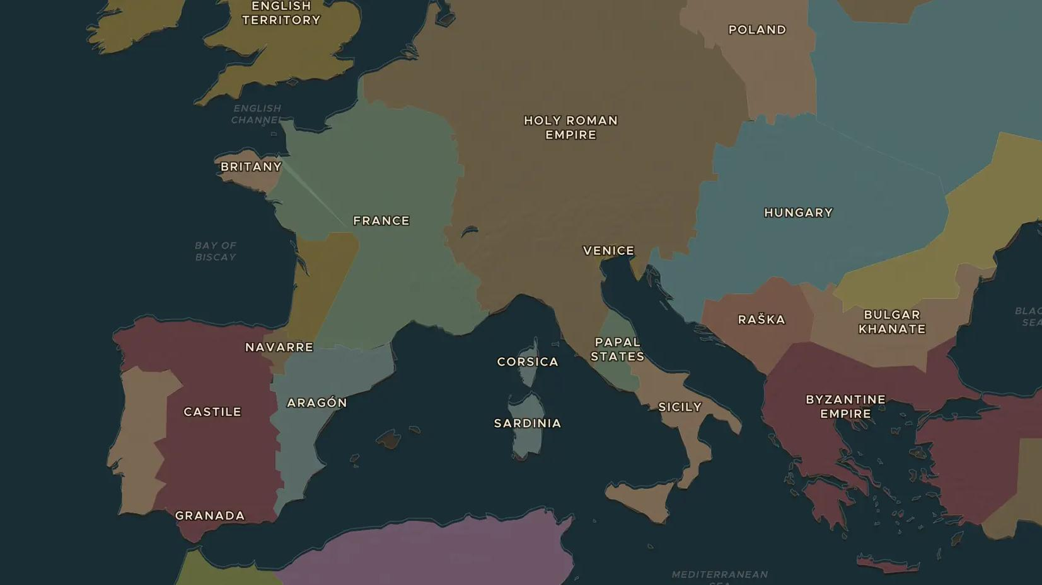
LATE MIDDLE AGES · 1346-1353
The Black Death
ChronoAtlas Classroom · Plate 275 · Ages 12-15 · 50 min
ChronoAtlas Classroom · chronoatlas.nl/classroom/lesson/black-death-1347

Slide 2
THIS LESSON
What students take from it
In 1347 ships from the Black Sea bring plague to Sicily, and within five years it has crossed all of Europe. Students watch the Black Death spread on the map, trace it along the trade routes and weigh how it changed the lives of the survivors.
LENGTH
50 min
AGES
12-15
ON THE MAP
BY THE END, STUDENTS CAN
3 steps, AD 1346
Describe how the Black Death spread from the Black Sea across Europe between 1346 and 1353.
Explain why trade routes and crowded towns helped the disease spread.
Describe the effects of the Black Death on society, including wages, persecution and faith.
QUIZ
7 rounds
ChronoAtlas Classroom · chronoatlas.nl/classroom/lesson/black-death-1347
2

Slide 3
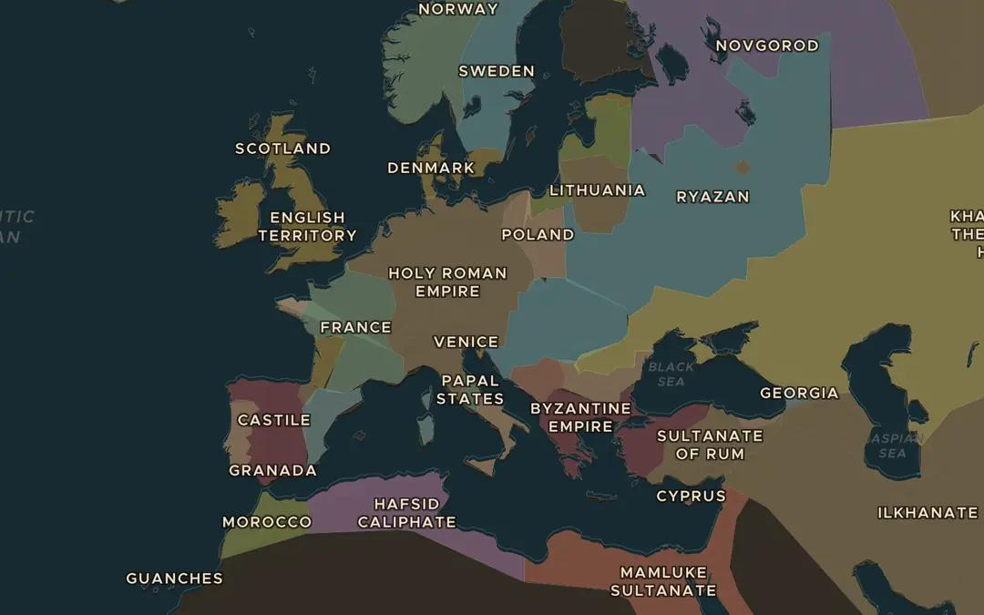
EXPLORE THE MAP · STEP A OF 3 · AD 1346
a
Watch it spread
Turn on Spreads and choose the Black Death. Start in 1346 and drag the slider slowly to 1353. Which regions are reached first, and which last?
Open this view on the live map →
ChronoAtlas Classroom · chronoatlas.nl/classroom/lesson/black-death-1347
3
Notes:
Turn on Spreads and choose the Black Death. Start in 1346 and drag the slider slowly to 1353. Which regions are reached first, and which last?
https://chronoatlas.nl/?year=1346&lat=48&lng=15&zoom=3.5

Slide 4
CHRONOATLAS CLASSROOM
The rest of this deck comes with Classroom
19 more slides: the other map steps, the discussion questions, the quiz with its answers, and the worksheet.
Every lesson as a deck, every worksheet, every live lesson and homework.
€19 a month, cancel anytime. The free lesson, Rome at its height, comes whole.
https://chronoatlas.nl/pricing
ChronoAtlas Classroom · chronoatlas.nl/classroom/lesson/black-death-1347
4

