Slide 1
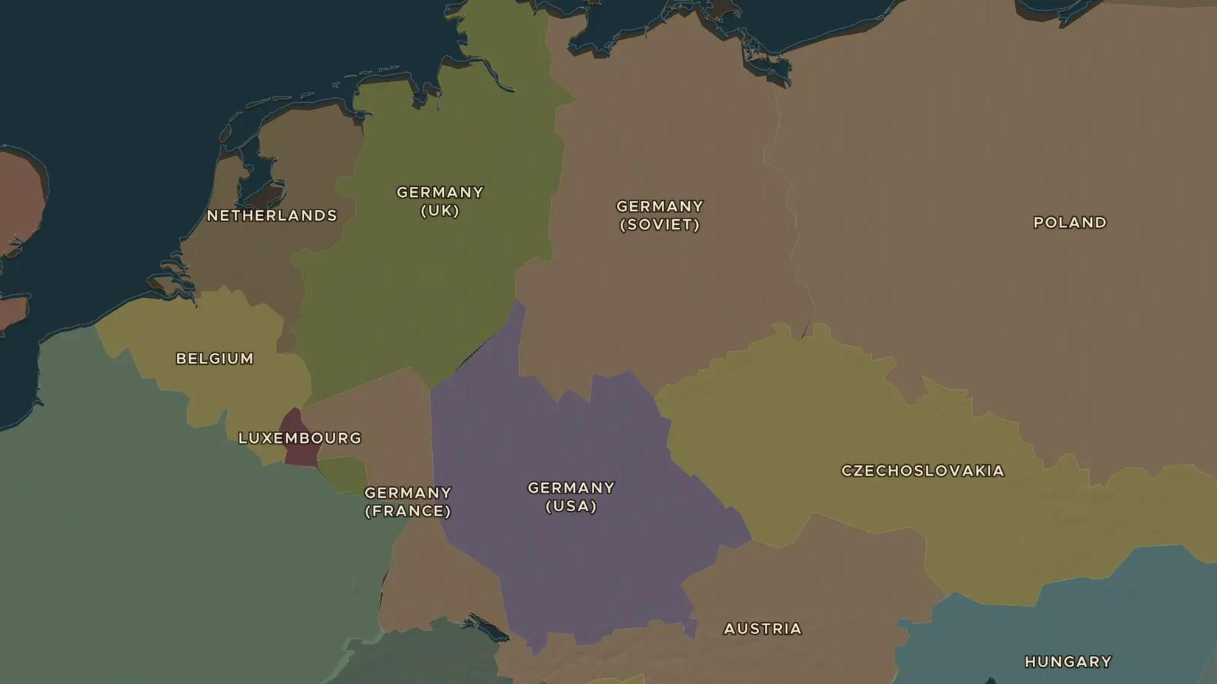
SECOND WORLD WAR · 1939-1940
1939-1940: Blitzkrieg and the fall of France
ChronoAtlas Classroom · Plate 473 · Ages 12-15 · 50 min
ChronoAtlas Classroom · chronoatlas.nl/classroom/lesson/blitzkrieg-1939-1940

Slide 2
THIS LESSON
What students take from it
In September 1939 Germany and the Soviet Union crushed Poland. In May 1940 German tanks broke through the Ardennes and reached the Channel in days, and France fell in six weeks. Students follow the fast campaigns on the map and ask why the Allies were caught by surprise.
LENGTH
50 min
AGES
12-15
ON THE MAP
BY THE END, STUDENTS CAN
3 steps, AD 1938
Describe how Germany defeated Poland in 1939 and France in 1940.
Explain what "Blitzkrieg" means and why the route through the Ardennes surprised the Allies.
Explain why the evacuation from Dunkirk mattered for Britain.
QUIZ
7 rounds
ChronoAtlas Classroom · chronoatlas.nl/classroom/lesson/blitzkrieg-1939-1940
2

Slide 3
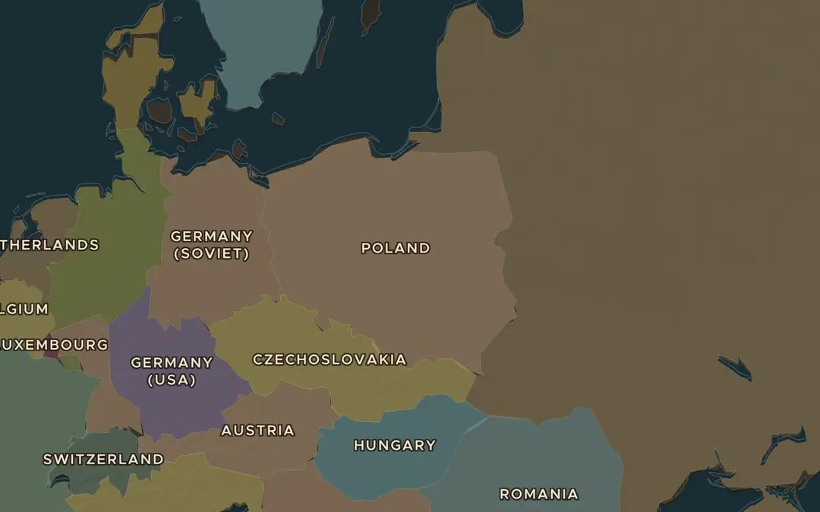
EXPLORE THE MAP · STEP A OF 3 · AD 1938
a
Poland, 1939
Open the map in 1938 and find Poland between Germany and the USSR. On 1 September 1939 Germany attacked from the west; on 17 September the Soviet Union attacked from the east. Why could Poland not hold out?
Open this view on the live map →
ChronoAtlas Classroom · chronoatlas.nl/classroom/lesson/blitzkrieg-1939-1940
3
Notes:
Open the map in 1938 and find Poland between Germany and the USSR. On 1 September 1939 Germany attacked from the west; on 17 September the Soviet Union attacked from the east. Why could Poland not hold out?
https://chronoatlas.nl/?year=1938&lat=52&lng=20&zoom=5

Slide 4
CHRONOATLAS CLASSROOM
The rest of this deck comes with Classroom
19 more slides: the other map steps, the discussion questions, the quiz with its answers, and the worksheet.
Every lesson as a deck, every worksheet, every live lesson and homework.
€19 a month, cancel anytime. The free lesson, Rome at its height, comes whole.
https://chronoatlas.nl/pricing
ChronoAtlas Classroom · chronoatlas.nl/classroom/lesson/blitzkrieg-1939-1940
4

