Slide 1
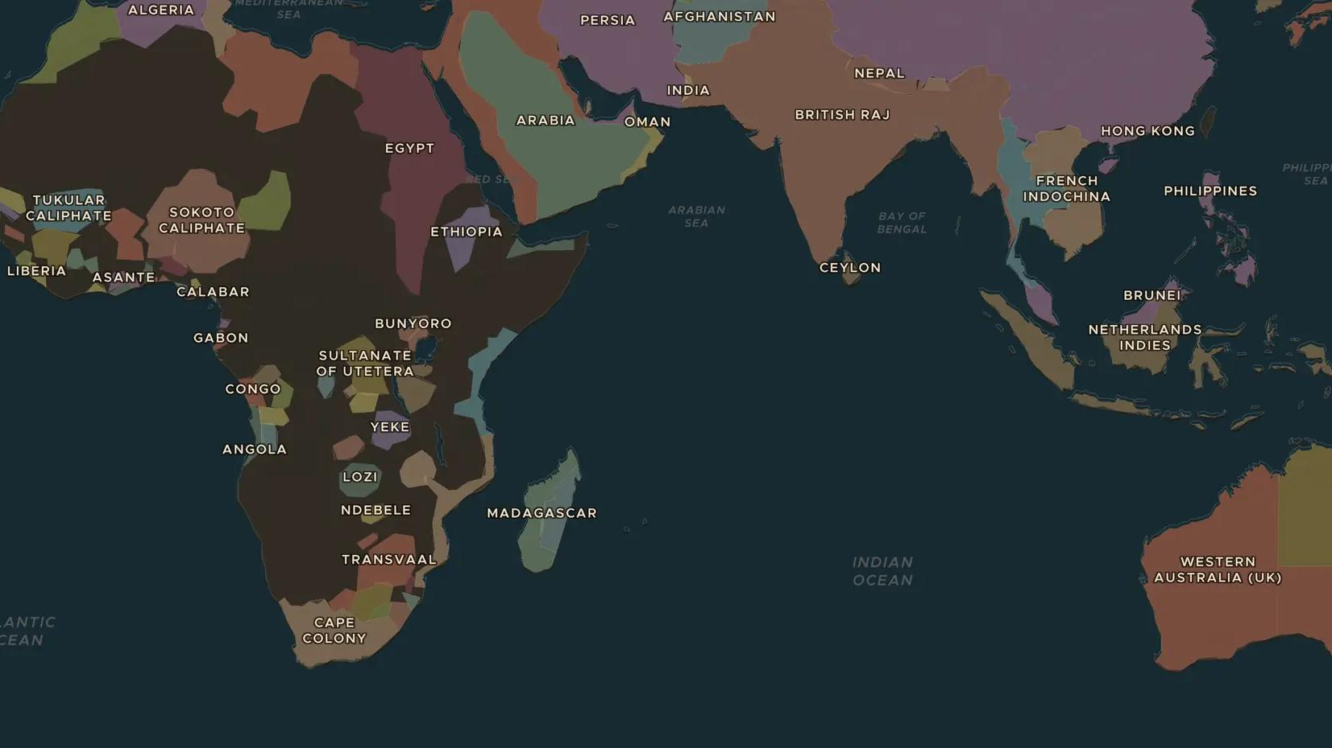
BRITISH RAJ · 1858-1911
The British Raj and the rise of Indian nationalism
ChronoAtlas Classroom · Plate 444 · Ages 13-16 · 50 min
ChronoAtlas Classroom · chronoatlas.nl/classroom/lesson/british-raj-indian-nationalism

Slide 2
THIS LESSON
What students take from it
After 1858 India is ruled by a British viceroy, with railways, famines and a small number of British officials governing hundreds of millions of people. Students follow the birth of the Indian National Congress and the protests against the partition of Bengal.
LENGTH
50 min
AGES
13-16
ON THE MAP
BY THE END, STUDENTS CAN
3 steps, AD 1880
Describe how Britain ruled India after 1858, including the princely states.
Explain why the Indian National Congress was founded in 1885 and what it wanted.
Explain the protests against the partition of Bengal (1905-1911).
QUIZ
7 rounds
ChronoAtlas Classroom · chronoatlas.nl/classroom/lesson/british-raj-indian-nationalism
2

Slide 3
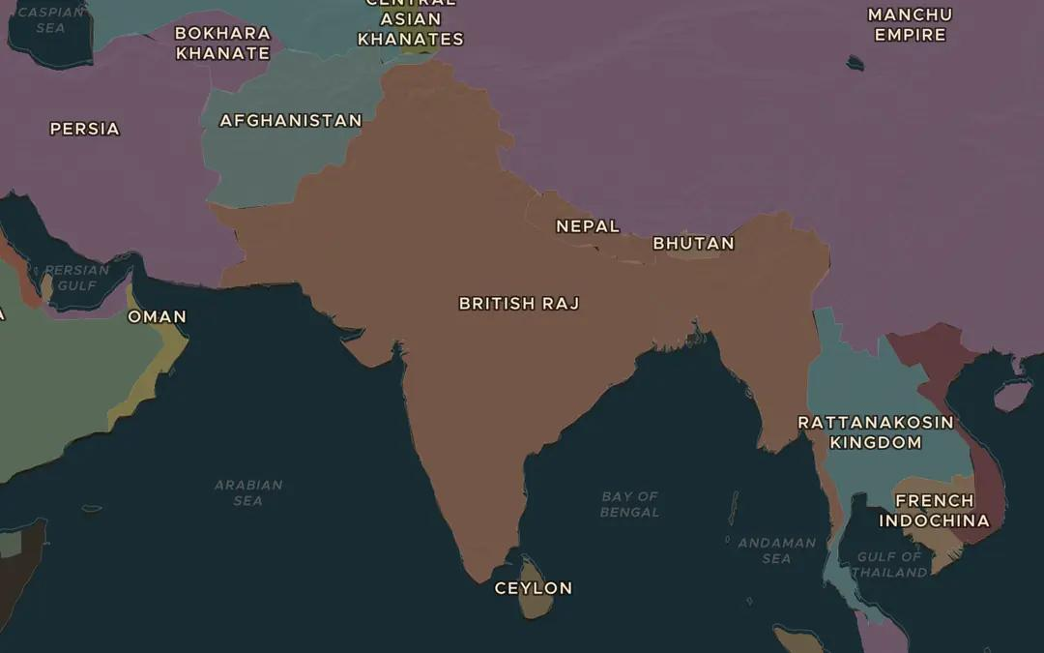
EXPLORE THE MAP · STEP A OF 3 · AD 1880
a
The Raj
Open the map in 1880 and zoom out over British India. Find Calcutta, Bombay, Madras and Delhi. Which neighbouring states lie outside British rule?
Open this view on the live map →
ChronoAtlas Classroom · chronoatlas.nl/classroom/lesson/british-raj-indian-nationalism
3
Notes:
Open the map in 1880 and zoom out over British India. Find Calcutta, Bombay, Madras and Delhi. Which neighbouring states lie outside British rule?
https://chronoatlas.nl/?year=1880&lat=23&lng=80&zoom=4

Slide 4
CHRONOATLAS CLASSROOM
The rest of this deck comes with Classroom
19 more slides: the other map steps, the discussion questions, the quiz with its answers, and the worksheet.
Every lesson as a deck, every worksheet, every live lesson and homework.
€19 a month, cancel anytime. The free lesson, Rome at its height, comes whole.
https://chronoatlas.nl/pricing
ChronoAtlas Classroom · chronoatlas.nl/classroom/lesson/british-raj-indian-nationalism
4

