Slide 1
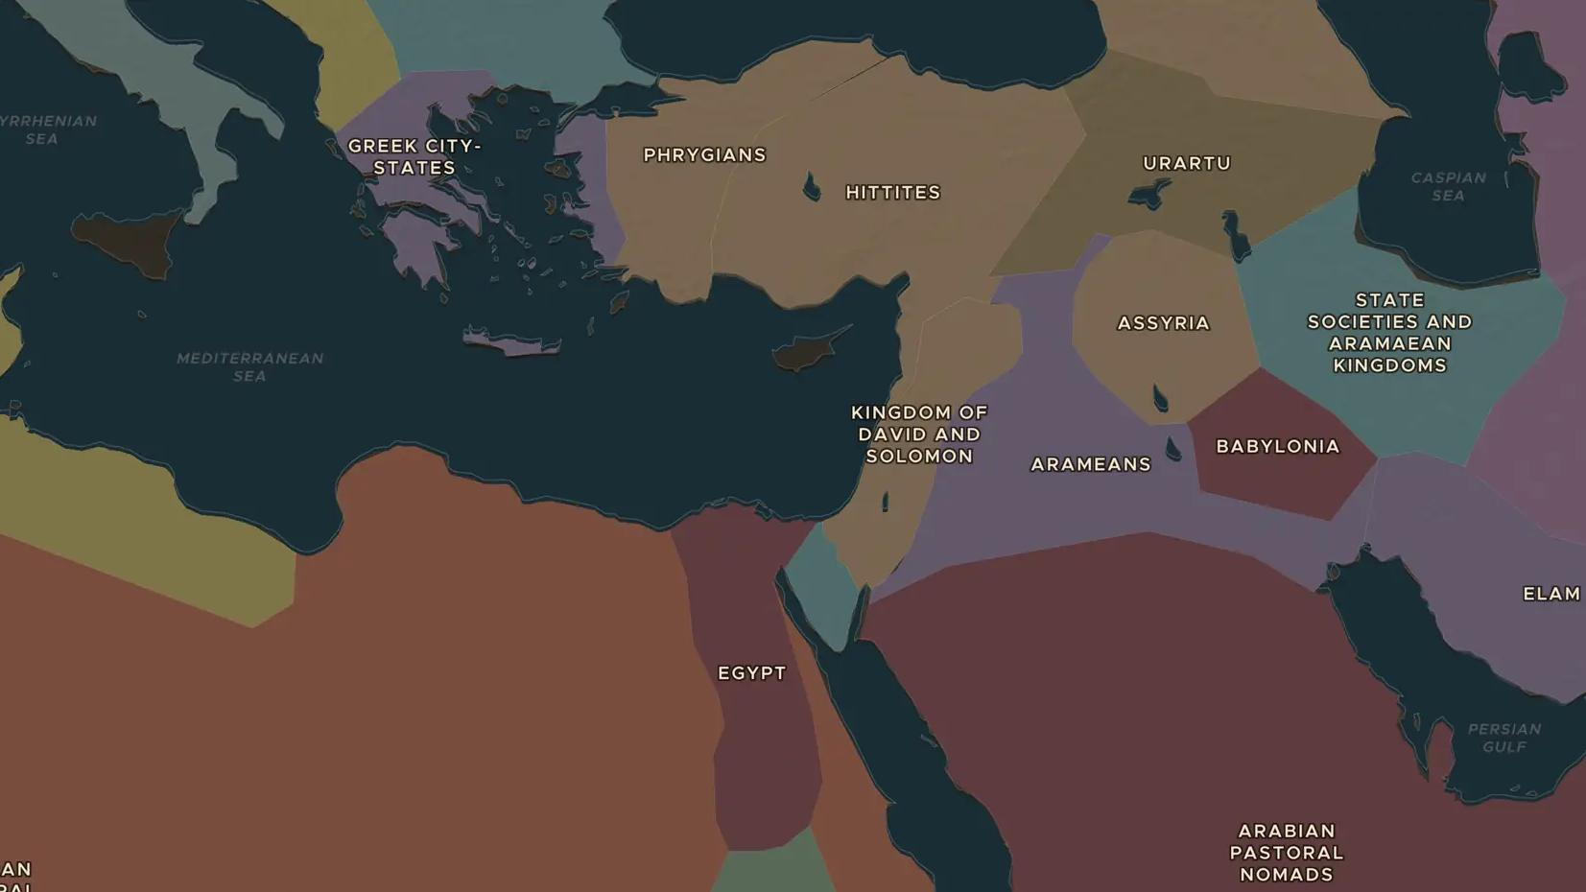
LATE BRONZE AGE · ABOUT 1200-1150 BC
The Bronze Age collapse
ChronoAtlas Classroom · Plate 36 · Ages 13-16 · 50 min
ChronoAtlas Classroom · chronoatlas.nl/classroom/lesson/bronze-age-collapse

Slide 2
THIS LESSON
What students take from it
Within about fifty years, the Hittite Empire, the Mycenaean palaces and great ports like Ugarit were gone. Students investigate drought, raiders, earthquakes and broken trade, and decide how a connected world could fall apart.
LENGTH
50 min
AGES
13-16
ON THE MAP
BY THE END, STUDENTS CAN
3 steps, 1,250 BC
Name the kingdoms and cities that fell or shrank around 1200-1150 BC.
Explain at least three possible causes of the collapse and how they were linked.
Use Egyptian sources to discuss who the "Sea Peoples" were.
QUIZ
7 rounds
ChronoAtlas Classroom · chronoatlas.nl/classroom/lesson/bronze-age-collapse
2

Slide 3
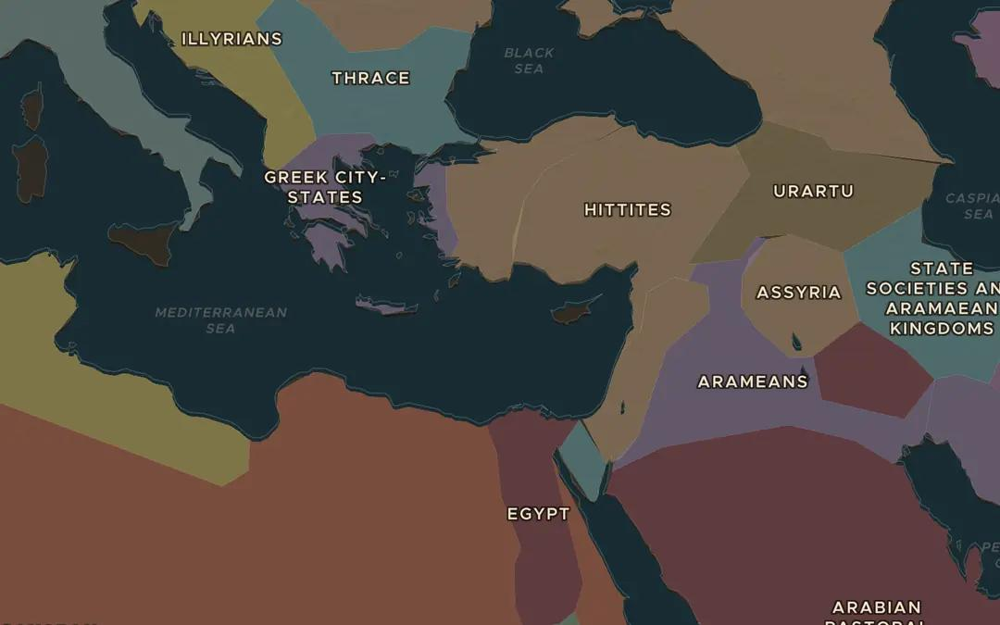
EXPLORE THE MAP · STEP A OF 3 · 1,250 BC
a
A connected world
Open the map in 1250 BC. Find Mycenaean Greece, the Hittite lands, Egypt and the ports of the Levant. Turn on Trade Routes. How did these kingdoms depend on one another?
Open this view on the live map →
ChronoAtlas Classroom · chronoatlas.nl/classroom/lesson/bronze-age-collapse
3
Notes:
Open the map in 1250 BC. Find Mycenaean Greece, the Hittite lands, Egypt and the ports of the Levant. Turn on Trade Routes. How did these kingdoms depend on one another?
https://chronoatlas.nl/?year=-1250&lat=35&lng=30&zoom=4.5

Slide 4
CHRONOATLAS CLASSROOM
The rest of this deck comes with Classroom
19 more slides: the other map steps, the discussion questions, the quiz with its answers, and the worksheet.
Every lesson as a deck, every worksheet, every live lesson and homework.
€19 a month, cancel anytime. The free lesson, Rome at its height, comes whole.
https://chronoatlas.nl/pricing
ChronoAtlas Classroom · chronoatlas.nl/classroom/lesson/bronze-age-collapse
4

