Slide 1
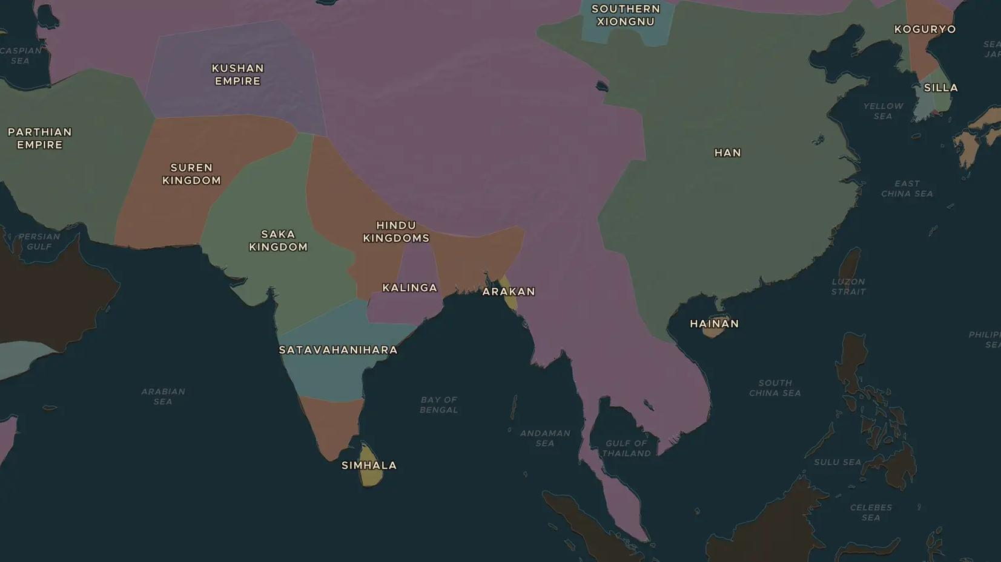
BUDDHIST ASIA · 250 BC - 552 AD
Buddhism crosses Asia
ChronoAtlas Classroom · Plate 96 · Ages 11-14 · 50 min
ChronoAtlas Classroom · chronoatlas.nl/classroom/lesson/buddhism-spreads-across-asia

Slide 2
THIS LESSON
What students take from it
From the Ganges plain, Buddhism traveled with monks and merchants over mountains, deserts and seas: to Sri Lanka, Central Asia, China, Korea and Japan. Students watch the spread unfold on the map and find out how a faith changes when it travels.
LENGTH
50 min
AGES
11-14
ON THE MAP
BY THE END, STUDENTS CAN
3 steps, 250 BC
Trace the spread of Buddhism from India to Sri Lanka, Central Asia, China, Korea and Japan on the map.
Explain how trade routes over land and sea carried Buddhism across Asia.
Give two examples of how Buddhism changed as it reached new cultures.
QUIZ
7 rounds
ChronoAtlas Classroom · chronoatlas.nl/classroom/lesson/buddhism-spreads-across-asia
2

Slide 3
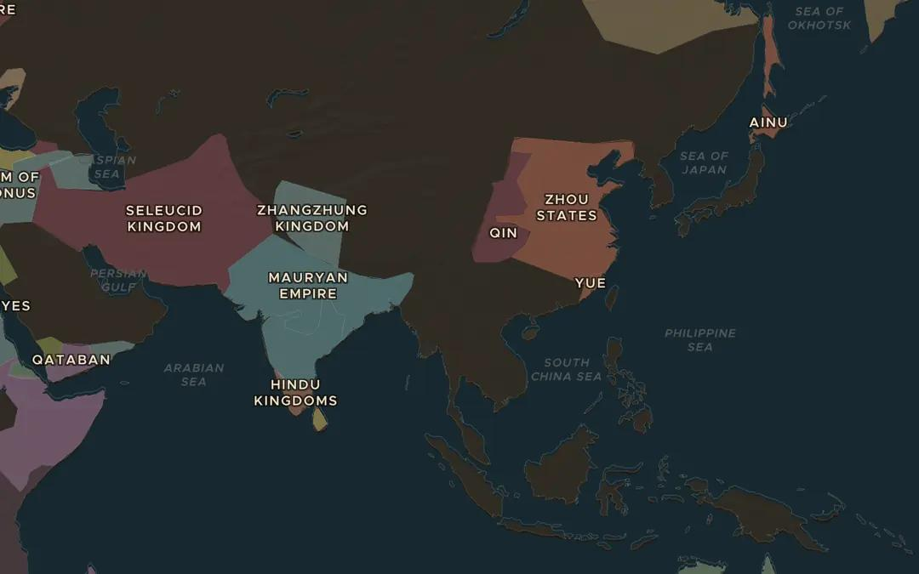
EXPLORE THE MAP · STEP A OF 3 · 250 BC
a
Watch it spread
Turn on Spreads and choose Buddhism. Drag the time slider slowly from 250 BC to AD 600. Write down the order in which India, Sri Lanka, China, Korea and Japan light up.
Open this view on the live map →
ChronoAtlas Classroom · chronoatlas.nl/classroom/lesson/buddhism-spreads-across-asia
3
Notes:
Turn on Spreads and choose Buddhism. Drag the time slider slowly from 250 BC to AD 600. Write down the order in which India, Sri Lanka, China, Korea and Japan light up.
https://chronoatlas.nl/?year=-250&lat=25&lng=100&zoom=3

Slide 4
CHRONOATLAS CLASSROOM
The rest of this deck comes with Classroom
19 more slides: the other map steps, the discussion questions, the quiz with its answers, and the worksheet.
Every lesson as a deck, every worksheet, every live lesson and homework.
€19 a month, cancel anytime. The free lesson, Rome at its height, comes whole.
https://chronoatlas.nl/pricing
ChronoAtlas Classroom · chronoatlas.nl/classroom/lesson/buddhism-spreads-across-asia
4

