Slide 1
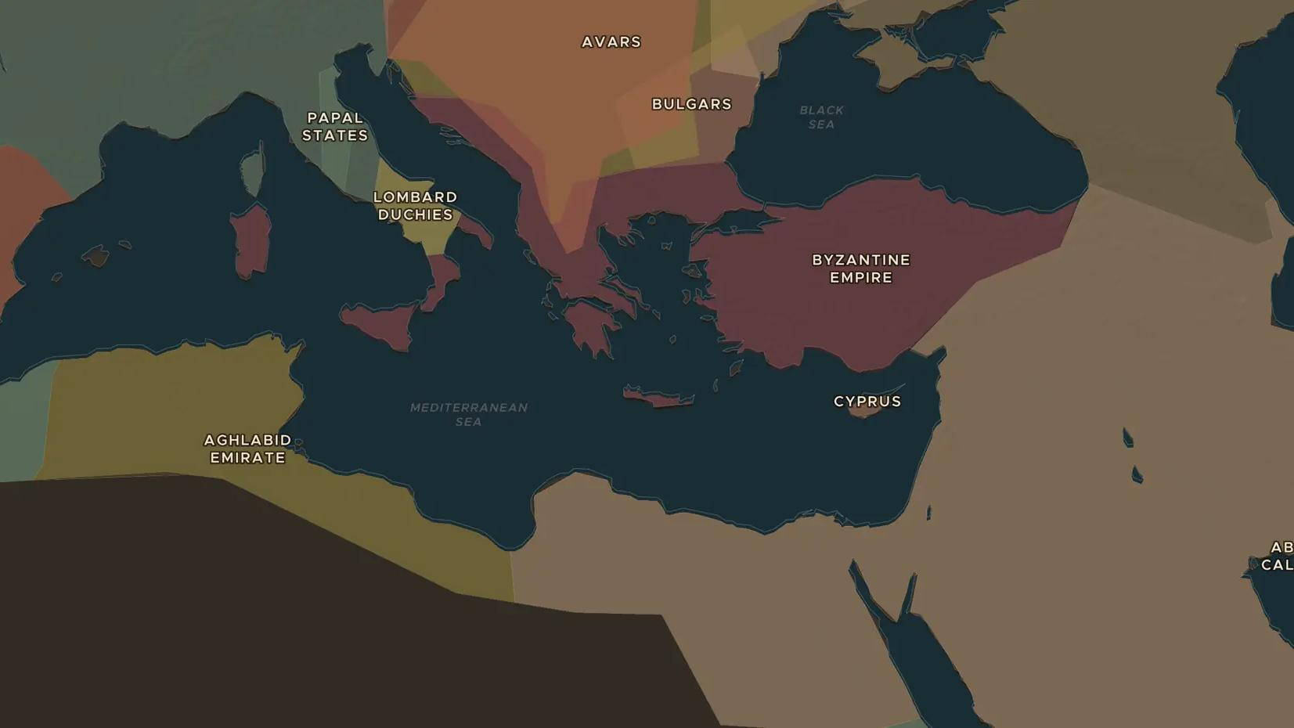
BYZANTINE EMPIRE · 726-843
Byzantium's battle over icons
ChronoAtlas Classroom · Plate 176 · Ages 13-16 · 50 min
ChronoAtlas Classroom · chronoatlas.nl/classroom/lesson/byzantine-iconoclasm

Slide 2
THIS LESSON
What students take from it
For more than a century Byzantine emperors, monks and empresses fought over whether holy images were sacred or forbidden. Students follow iconoclasm from Leo III to Empress Theodora and discuss why images stir such strong feelings.
LENGTH
50 min
AGES
13-16
ON THE MAP
BY THE END, STUDENTS CAN
3 steps, AD 726
Explain what icons are and what the iconoclasts objected to.
Describe the role of two empresses, Irene and Theodora, in ending iconoclasm.
Discuss how the dispute widened the gap between Constantinople and Rome.
QUIZ
7 rounds
ChronoAtlas Classroom · chronoatlas.nl/classroom/lesson/byzantine-iconoclasm
2

Slide 3
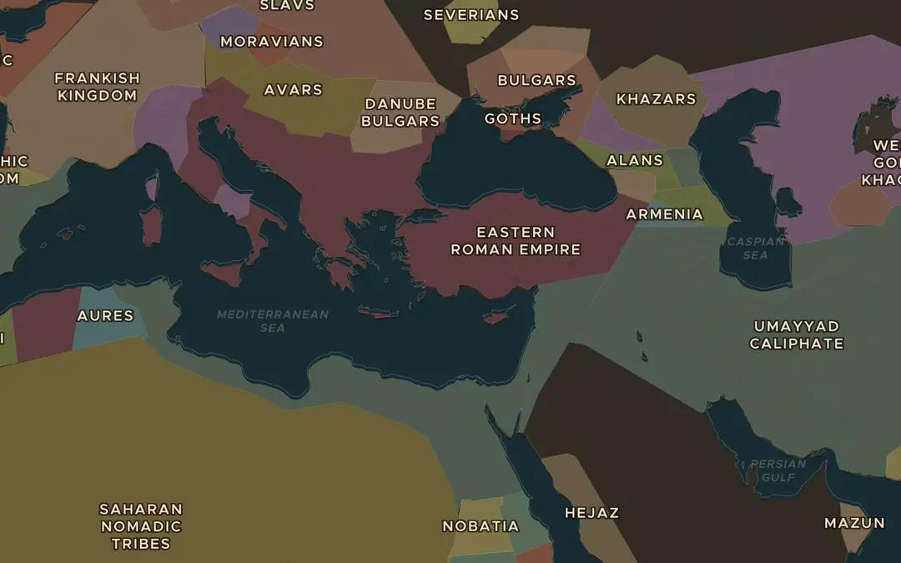
EXPLORE THE MAP · STEP A OF 3 · AD 726
a
An empire under pressure
Open the map in 726. Compare the Eastern Roman Empire with the Umayyad Caliphate next to it. Which lands has the empire lost since the time of Justinian?
Open this view on the live map →
ChronoAtlas Classroom · chronoatlas.nl/classroom/lesson/byzantine-iconoclasm
3
Notes:
Open the map in 726. Compare the Eastern Roman Empire with the Umayyad Caliphate next to it. Which lands has the empire lost since the time of Justinian?
https://chronoatlas.nl/?year=726&lat=37&lng=30&zoom=4

Slide 4
CHRONOATLAS CLASSROOM
The rest of this deck comes with Classroom
19 more slides: the other map steps, the discussion questions, the quiz with its answers, and the worksheet.
Every lesson as a deck, every worksheet, every live lesson and homework.
€19 a month, cancel anytime. The free lesson, Rome at its height, comes whole.
https://chronoatlas.nl/pricing
ChronoAtlas Classroom · chronoatlas.nl/classroom/lesson/byzantine-iconoclasm
4

