Slide 1
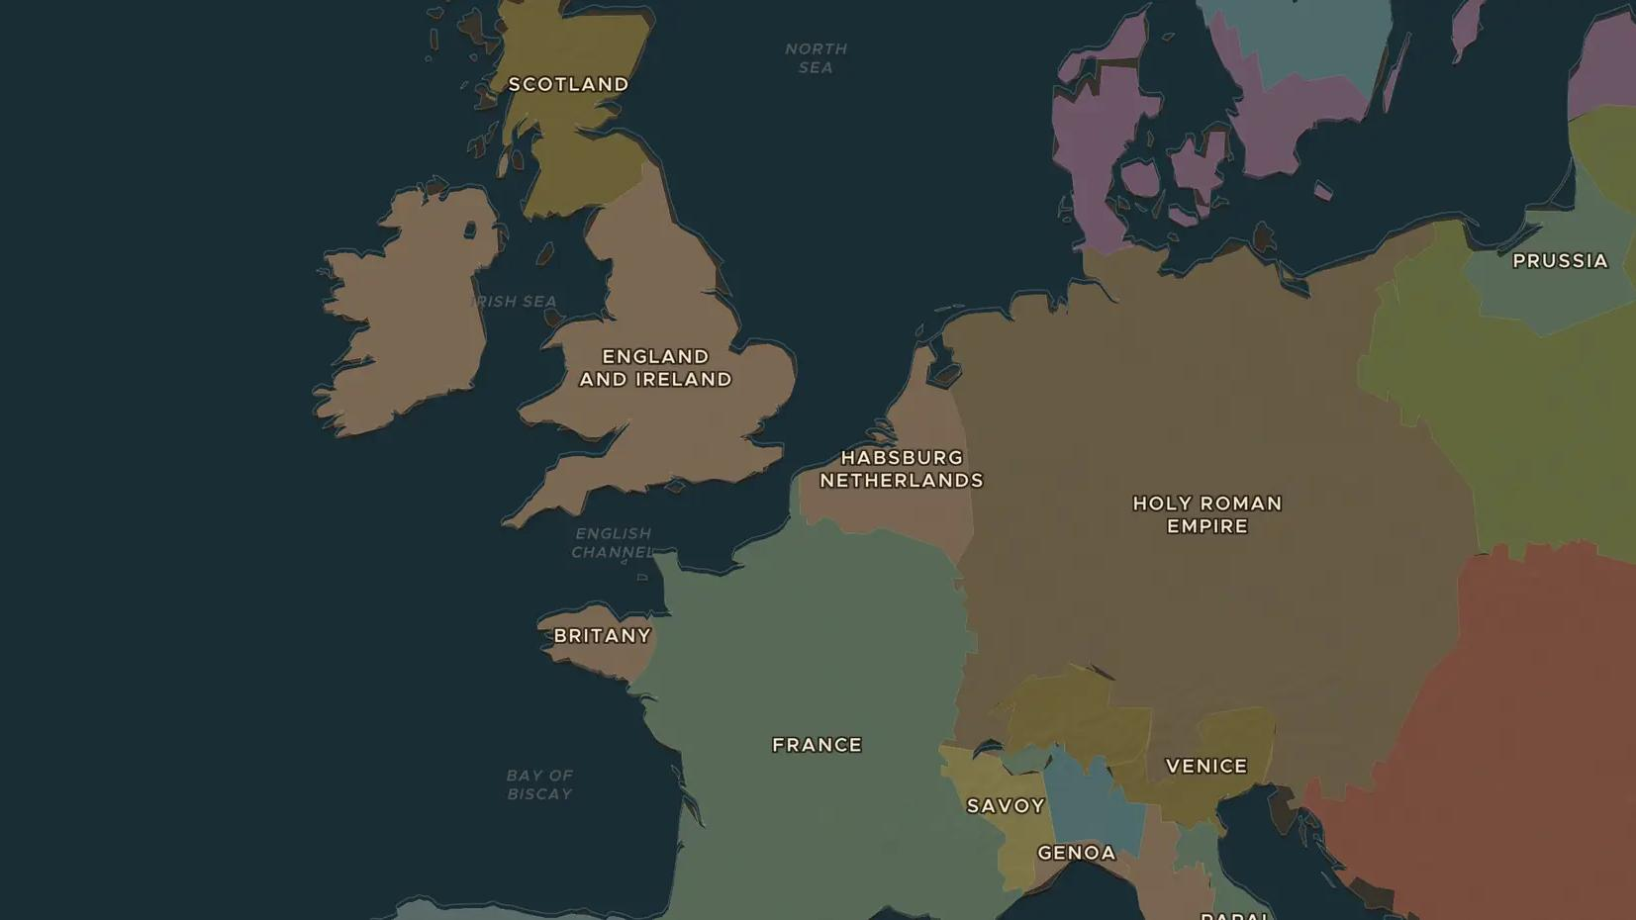
REFORMATION · 1536-1564
Calvin's Geneva
ChronoAtlas Classroom · Plate 334 · Ages 13-16 · 45 min
ChronoAtlas Classroom · chronoatlas.nl/classroom/lesson/calvin-geneva-reformation

Slide 2
THIS LESSON
What students take from it
A French refugee turns a small city on Lake Geneva into a training school for Protestants from all over Europe. Students map how Calvin's ideas travelled to France, Scotland and the Netherlands, and debate life in a city with strict rules for everyone.
LENGTH
45 min
AGES
13-16
ON THE MAP
BY THE END, STUDENTS CAN
3 steps, AD 1550
Explain how Calvin's Geneva was governed and why it attracted refugees.
Trace on the map how Calvinism spread to at least three countries.
Compare one idea of Calvin with one idea of Luther.
QUIZ
7 rounds
ChronoAtlas Classroom · chronoatlas.nl/classroom/lesson/calvin-geneva-reformation
2

Slide 3
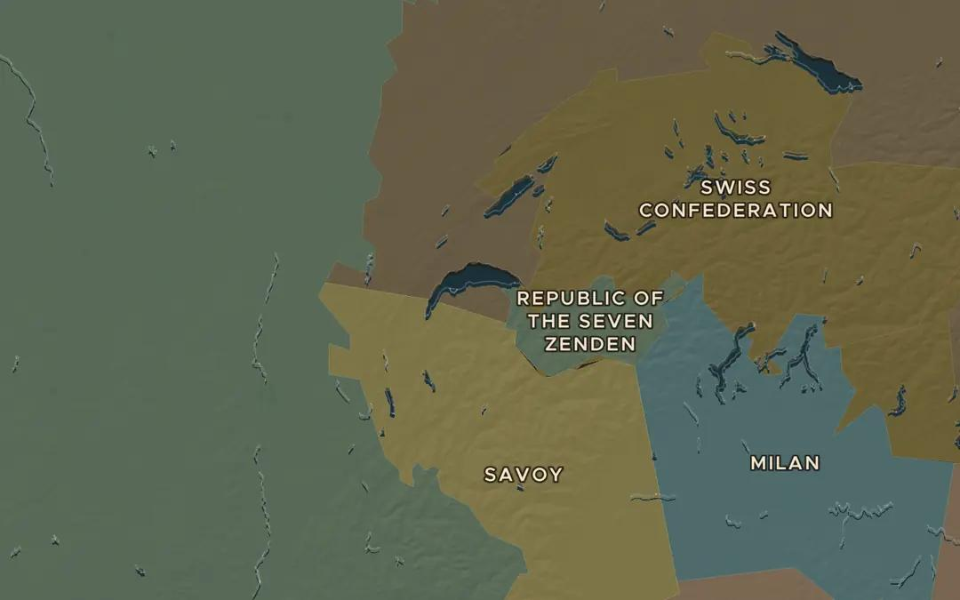
EXPLORE THE MAP · STEP A OF 3 · AD 1550
a
A city on the lake
Open the map in 1550 and zoom in on the western tip of Lake Geneva. Old borders are approximate: here the lands of the Duke of Savoy surround the city. Why would a small city need strong friends like Bern?
Open this view on the live map →
ChronoAtlas Classroom · chronoatlas.nl/classroom/lesson/calvin-geneva-reformation
3
Notes:
Open the map in 1550 and zoom in on the western tip of Lake Geneva. Old borders are approximate: here the lands of the Duke of Savoy surround the city. Why would a small city need strong friends like Bern?
https://chronoatlas.nl/?year=1550&lat=46.3&lng=6.6&zoom=7

Slide 4
CHRONOATLAS CLASSROOM
The rest of this deck comes with Classroom
19 more slides: the other map steps, the discussion questions, the quiz with its answers, and the worksheet.
Every lesson as a deck, every worksheet, every live lesson and homework.
€19 a month, cancel anytime. The free lesson, Rome at its height, comes whole.
https://chronoatlas.nl/pricing
ChronoAtlas Classroom · chronoatlas.nl/classroom/lesson/calvin-geneva-reformation
4

