Slide 1
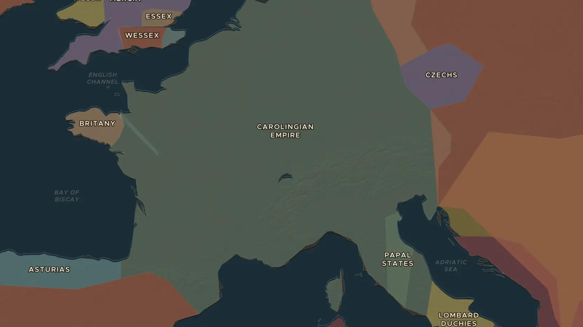
CAROLINGIAN EMPIRE · 768-814
Charlemagne: emperor of the West
ChronoAtlas Classroom · Plate 184 · Ages 11-14 · 50 min
ChronoAtlas Classroom · chronoatlas.nl/classroom/lesson/charlemagne-emperor-of-the-west

Slide 2
THIS LESSON
What students take from it
On Christmas Day 800 the pope crowns a Frankish king emperor in Rome. Students map Charlemagne's wars, visit his capital at Aachen, and judge a ruler who built schools but also forced conquered peoples to convert.
LENGTH
50 min
AGES
11-14
ON THE MAP
BY THE END, STUDENTS CAN
3 steps, AD 800
Describe the extent of the Carolingian Empire in 800 using the map.
Explain why Charlemagne's coronation in Rome in 800 was a turning point.
Weigh Charlemagne's work for learning against the violence of his wars against the Saxons.
QUIZ
7 rounds
ChronoAtlas Classroom · chronoatlas.nl/classroom/lesson/charlemagne-emperor-of-the-west
2

Slide 3
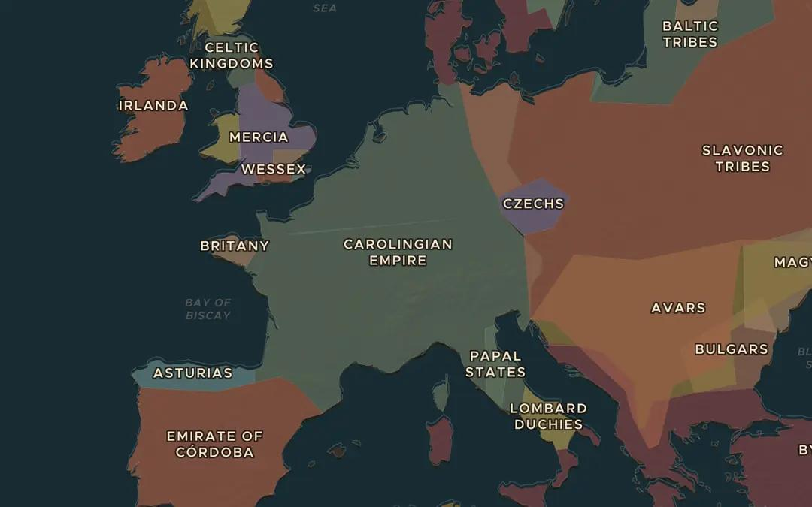
EXPLORE THE MAP · STEP A OF 3 · AD 800
a
The empire in 800
Open the map in 800. Zoom out until you see the whole Carolingian Empire. Which present-day countries lie partly inside it?
Open this view on the live map →
ChronoAtlas Classroom · chronoatlas.nl/classroom/lesson/charlemagne-emperor-of-the-west
3
Notes:
Open the map in 800. Zoom out until you see the whole Carolingian Empire. Which present-day countries lie partly inside it?
https://chronoatlas.nl/?year=800&lat=48&lng=7&zoom=4.4

Slide 4
CHRONOATLAS CLASSROOM
The rest of this deck comes with Classroom
19 more slides: the other map steps, the discussion questions, the quiz with its answers, and the worksheet.
Every lesson as a deck, every worksheet, every live lesson and homework.
€19 a month, cancel anytime. The free lesson, Rome at its height, comes whole.
https://chronoatlas.nl/pricing
ChronoAtlas Classroom · chronoatlas.nl/classroom/lesson/charlemagne-emperor-of-the-west
4

