Slide 1
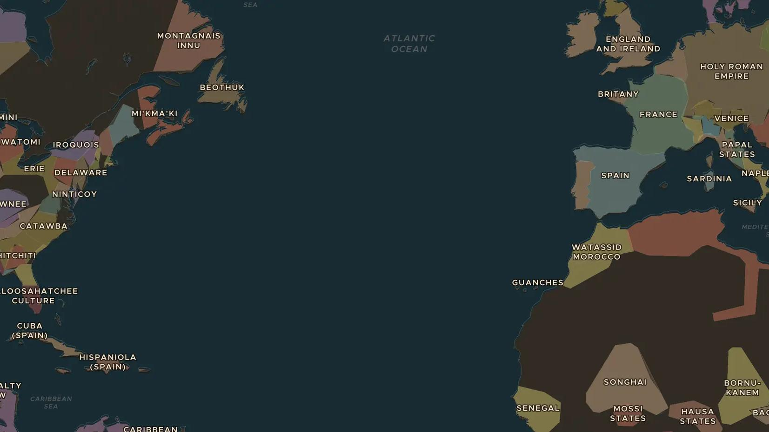
HABSBURG EMPIRE · 1519-1556
Charles V and the Habsburg world
ChronoAtlas Classroom · Plate 321 · Ages 11-14 · 50 min
ChronoAtlas Classroom · chronoatlas.nl/classroom/lesson/charles-v-habsburg-world

Slide 2
THIS LESSON
What students take from it
Born in Ghent in 1500, Charles inherits Spain, the Low Countries, Austria, southern Italy and new lands in the Americas, and is then elected emperor. Students map the largest inheritance in European history and see why it was so hard to rule.
LENGTH
50 min
AGES
11-14
ON THE MAP
BY THE END, STUDENTS CAN
3 steps, AD 1530
Name four regions Charles V ruled and explain how he inherited them.
Explain three enemies Charles faced, often at the same time.
Explain why Charles divided his lands when he stepped down in 1555-1556.
QUIZ
7 rounds
ChronoAtlas Classroom · chronoatlas.nl/classroom/lesson/charles-v-habsburg-world
2

Slide 3
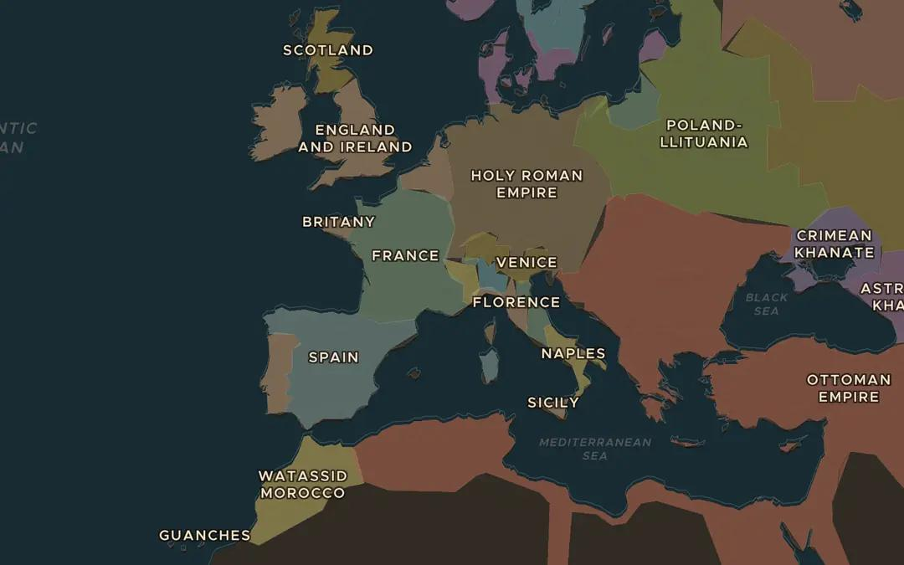
EXPLORE THE MAP · STEP A OF 3 · AD 1530
a
A scattered inheritance
Open the map in 1530 and zoom out over Europe. Find Spain, the Habsburg Netherlands, the Holy Roman Empire, Naples and Sicily. Are Charles's lands joined together or scattered?
Open this view on the live map →
ChronoAtlas Classroom · chronoatlas.nl/classroom/lesson/charles-v-habsburg-world
3
Notes:
Open the map in 1530 and zoom out over Europe. Find Spain, the Habsburg Netherlands, the Holy Roman Empire, Naples and Sicily. Are Charles's lands joined together or scattered?
https://chronoatlas.nl/?year=1530&lat=45&lng=6&zoom=3.8

Slide 4
CHRONOATLAS CLASSROOM
The rest of this deck comes with Classroom
19 more slides: the other map steps, the discussion questions, the quiz with its answers, and the worksheet.
Every lesson as a deck, every worksheet, every live lesson and homework.
€19 a month, cancel anytime. The free lesson, Rome at its height, comes whole.
https://chronoatlas.nl/pricing
ChronoAtlas Classroom · chronoatlas.nl/classroom/lesson/charles-v-habsburg-world
4

