Slide 1
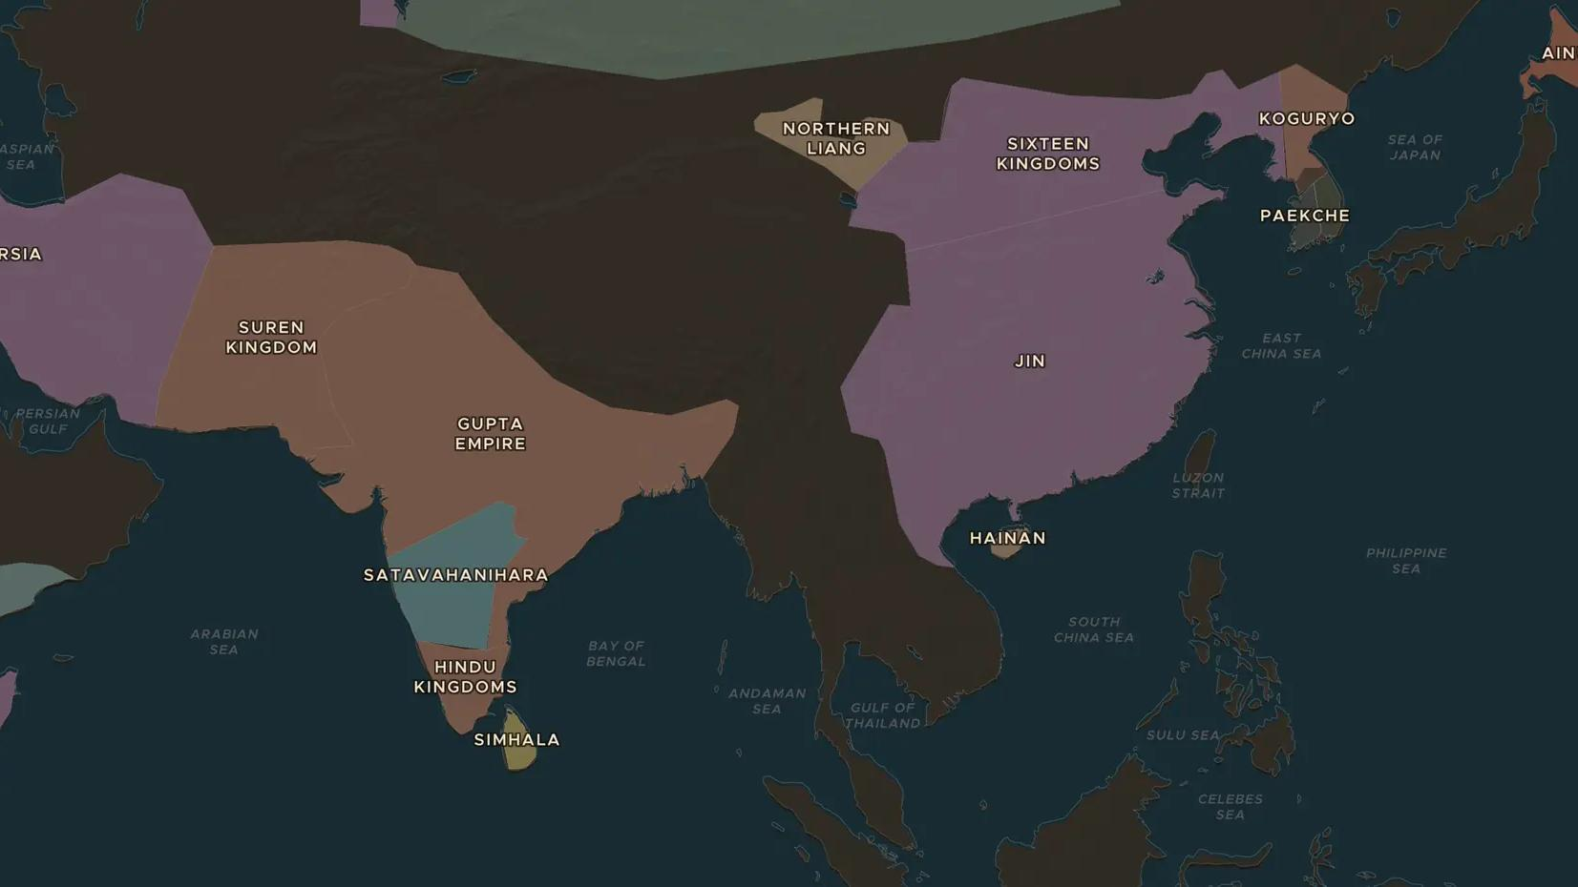
NORTHERN AND SOUTHERN DYNASTIES · 316-589 AD
China divided: Buddhism and the road to 589
ChronoAtlas Classroom · Plate 145 · Ages 12-15 · 50 min
ChronoAtlas Classroom · chronoatlas.nl/classroom/lesson/china-divided-buddhism

Slide 2
THIS LESSON
What students take from it
After 316 China split between northern kingdoms, many founded by steppe peoples, and southern dynasties along the Yangtze. In this age of war a foreign faith, Buddhism, won millions of followers. Students explore cave temples, a pilgrim's journey and the reunion of 589.
LENGTH
50 min
AGES
12-15
ON THE MAP
BY THE END, STUDENTS CAN
3 steps, AD 400
Describe how China was divided between north and south from 316 to 589.
Explain how Buddhism spread in China, using the Buddhism spread on the map.
Identify a cave temple and a traveler that show how Buddhism took root in China.
QUIZ
7 rounds
ChronoAtlas Classroom · chronoatlas.nl/classroom/lesson/china-divided-buddhism
2

Slide 3
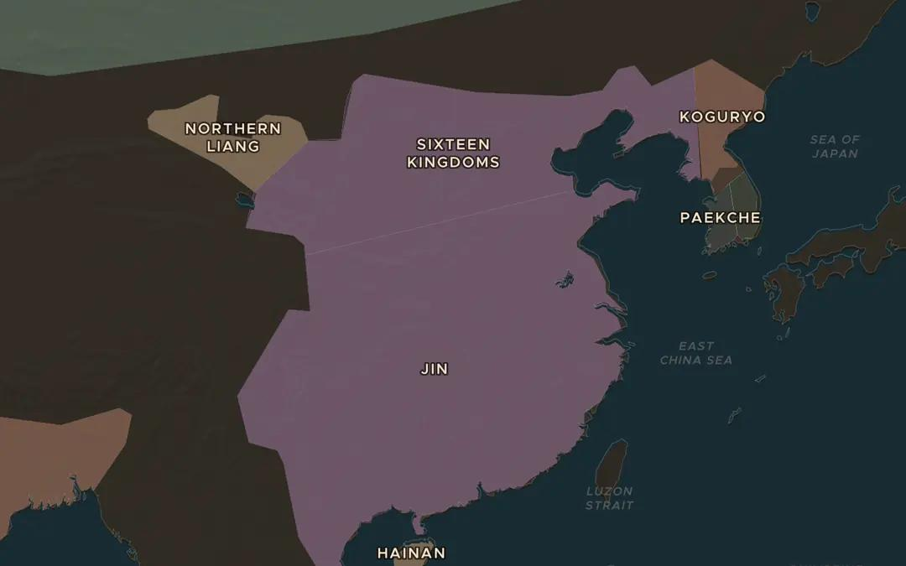
EXPLORE THE MAP · STEP A OF 3 · AD 400
a
North and south
Open the map in AD 400. Find Jin in the south and the Sixteen Kingdoms in the north. Roughly where does the line between north and south run?
Open this view on the live map →
ChronoAtlas Classroom · chronoatlas.nl/classroom/lesson/china-divided-buddhism
3
Notes:
Open the map in AD 400. Find Jin in the south and the Sixteen Kingdoms in the north. Roughly where does the line between north and south run?
https://chronoatlas.nl/?year=400&lat=33&lng=112&zoom=4.3

Slide 4
CHRONOATLAS CLASSROOM
The rest of this deck comes with Classroom
19 more slides: the other map steps, the discussion questions, the quiz with its answers, and the worksheet.
Every lesson as a deck, every worksheet, every live lesson and homework.
€19 a month, cancel anytime. The free lesson, Rome at its height, comes whole.
https://chronoatlas.nl/pricing
ChronoAtlas Classroom · chronoatlas.nl/classroom/lesson/china-divided-buddhism
4

