Slide 1
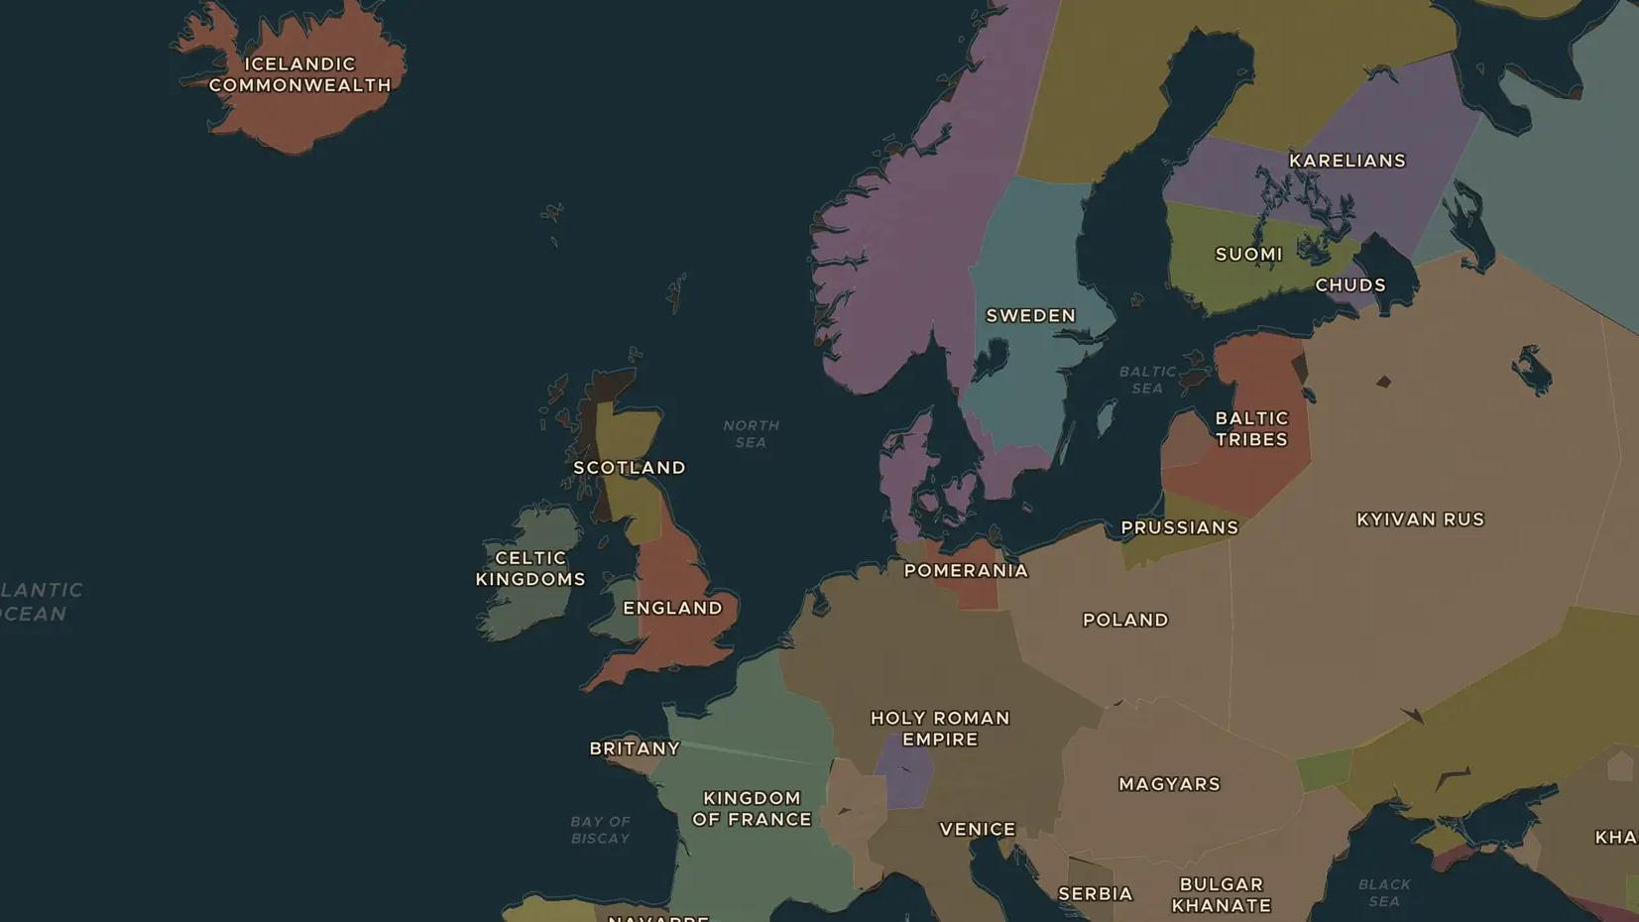
VIKING AGE · 1013-1042
Cnut and the North Sea empire
ChronoAtlas Classroom · Plate 214 · Ages 12-15 · 45 min
ChronoAtlas Classroom · chronoatlas.nl/classroom/lesson/cnut-north-sea-empire

Slide 2
THIS LESSON
What students take from it
In 1016 a Danish prince wins the English crown, and soon he rules Denmark and Norway as well. Students map Cnut's empire around the North Sea, examine how a Viking conqueror ruled as a Christian king, and test the famous legend of the waves.
LENGTH
45 min
AGES
12-15
ON THE MAP
BY THE END, STUDENTS CAN
3 steps, AD 1030
Locate the three kingdoms of Cnut's North Sea empire on the map.
Explain how Cnut won and kept power in England, including his marriage to Emma and his earls.
Distinguish between the facts of Cnut's reign and the later legend of the waves.
QUIZ
7 rounds
ChronoAtlas Classroom · chronoatlas.nl/classroom/lesson/cnut-north-sea-empire
2

Slide 3
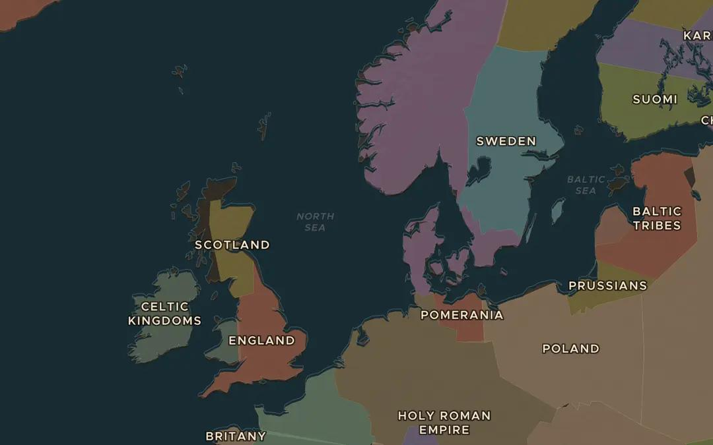
EXPLORE THE MAP · STEP A OF 3 · AD 1030
a
Around the North Sea
Open the map in 1030 and zoom out over the North Sea. Find England and the Scandinavian kingdoms. Why might the sea join these lands rather than divide them?
Open this view on the live map →
ChronoAtlas Classroom · chronoatlas.nl/classroom/lesson/cnut-north-sea-empire
3
Notes:
Open the map in 1030 and zoom out over the North Sea. Find England and the Scandinavian kingdoms. Why might the sea join these lands rather than divide them?
https://chronoatlas.nl/?year=1030&lat=57&lng=5&zoom=4.4

Slide 4
CHRONOATLAS CLASSROOM
The rest of this deck comes with Classroom
19 more slides: the other map steps, the discussion questions, the quiz with its answers, and the worksheet.
Every lesson as a deck, every worksheet, every live lesson and homework.
€19 a month, cancel anytime. The free lesson, Rome at its height, comes whole.
https://chronoatlas.nl/pricing
ChronoAtlas Classroom · chronoatlas.nl/classroom/lesson/cnut-north-sea-empire
4

