Slide 1
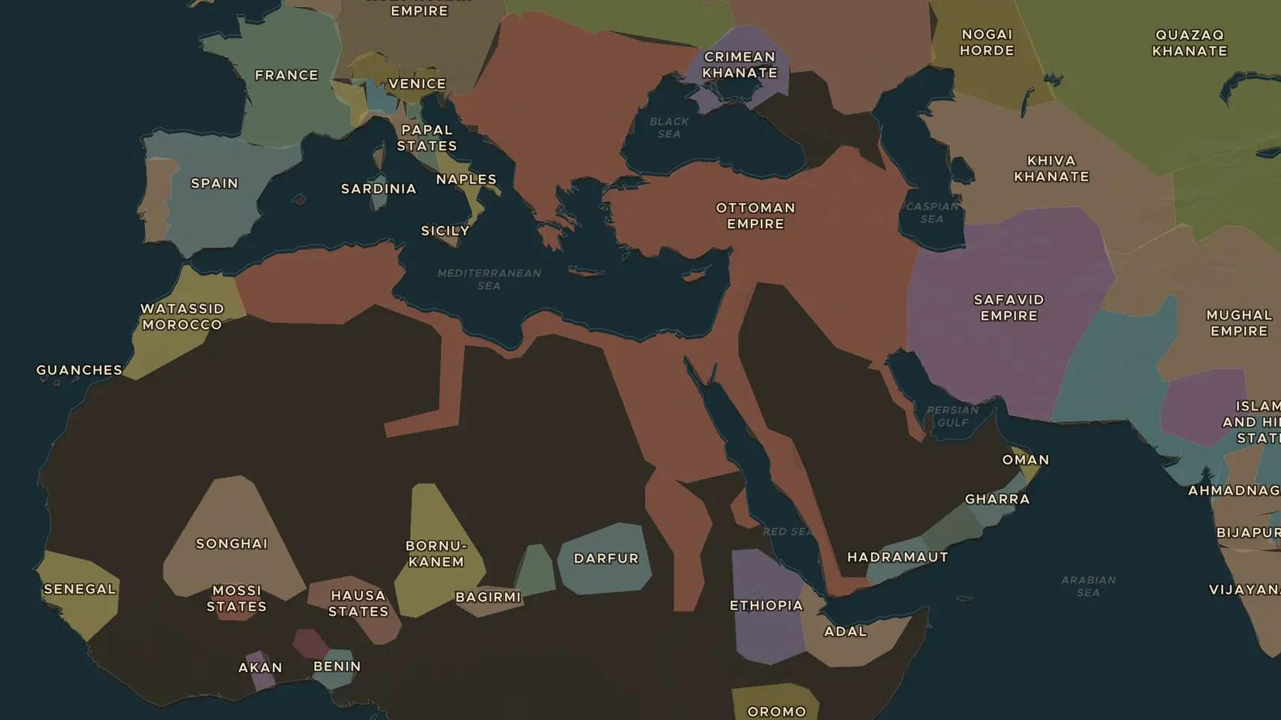
OTTOMAN EMPIRE · ABOUT 1450-1700
Coffee and the coffeehouse
ChronoAtlas Classroom · Plate 298 · Ages 11-14 · 45 min
ChronoAtlas Classroom · chronoatlas.nl/classroom/lesson/coffee-and-the-coffeehouse

Slide 2
THIS LESSON
What students take from it
Coffee began as a drink of Sufis in Yemen and became a worldwide habit. Students follow the bean from the Red Sea to Istanbul and London, and find out why rulers both loved and feared the coffeehouse.
LENGTH
45 min
AGES
11-14
ON THE MAP
BY THE END, STUDENTS CAN
3 steps, AD 1500
Trace the spread of coffee from Yemen to Istanbul and Europe on the map.
Describe what happened in an Ottoman coffeehouse.
Explain why some rulers tried to ban coffee or coffeehouses.
QUIZ
7 rounds
ChronoAtlas Classroom · chronoatlas.nl/classroom/lesson/coffee-and-the-coffeehouse
2

Slide 3
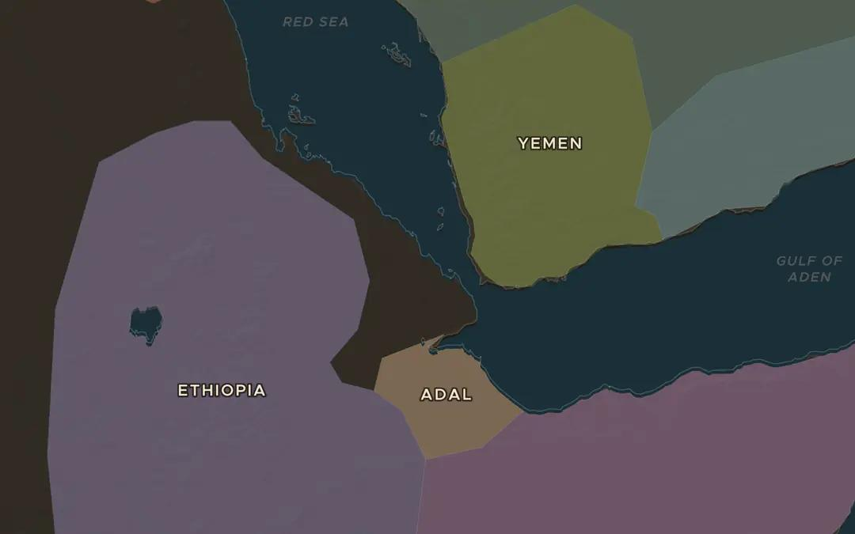
EXPLORE THE MAP · STEP A OF 3 · AD 1500
a
Where coffee began
Open the map in 1500 and zoom in on the south-west corner of Arabia and the hills of Ethiopia across the Red Sea. The coffee plant grew wild in Ethiopia. Which narrow strait separates the two coasts?
Open this view on the live map →
ChronoAtlas Classroom · chronoatlas.nl/classroom/lesson/coffee-and-the-coffeehouse
3
Notes:
Open the map in 1500 and zoom in on the south-west corner of Arabia and the hills of Ethiopia across the Red Sea. The coffee plant grew wild in Ethiopia. Which narrow strait separates the two coasts?
https://chronoatlas.nl/?year=1500&lat=13&lng=42.5&zoom=6

Slide 4
CHRONOATLAS CLASSROOM
The rest of this deck comes with Classroom
19 more slides: the other map steps, the discussion questions, the quiz with its answers, and the worksheet.
Every lesson as a deck, every worksheet, every live lesson and homework.
€19 a month, cancel anytime. The free lesson, Rome at its height, comes whole.
https://chronoatlas.nl/pricing
ChronoAtlas Classroom · chronoatlas.nl/classroom/lesson/coffee-and-the-coffeehouse
4

