Slide 1
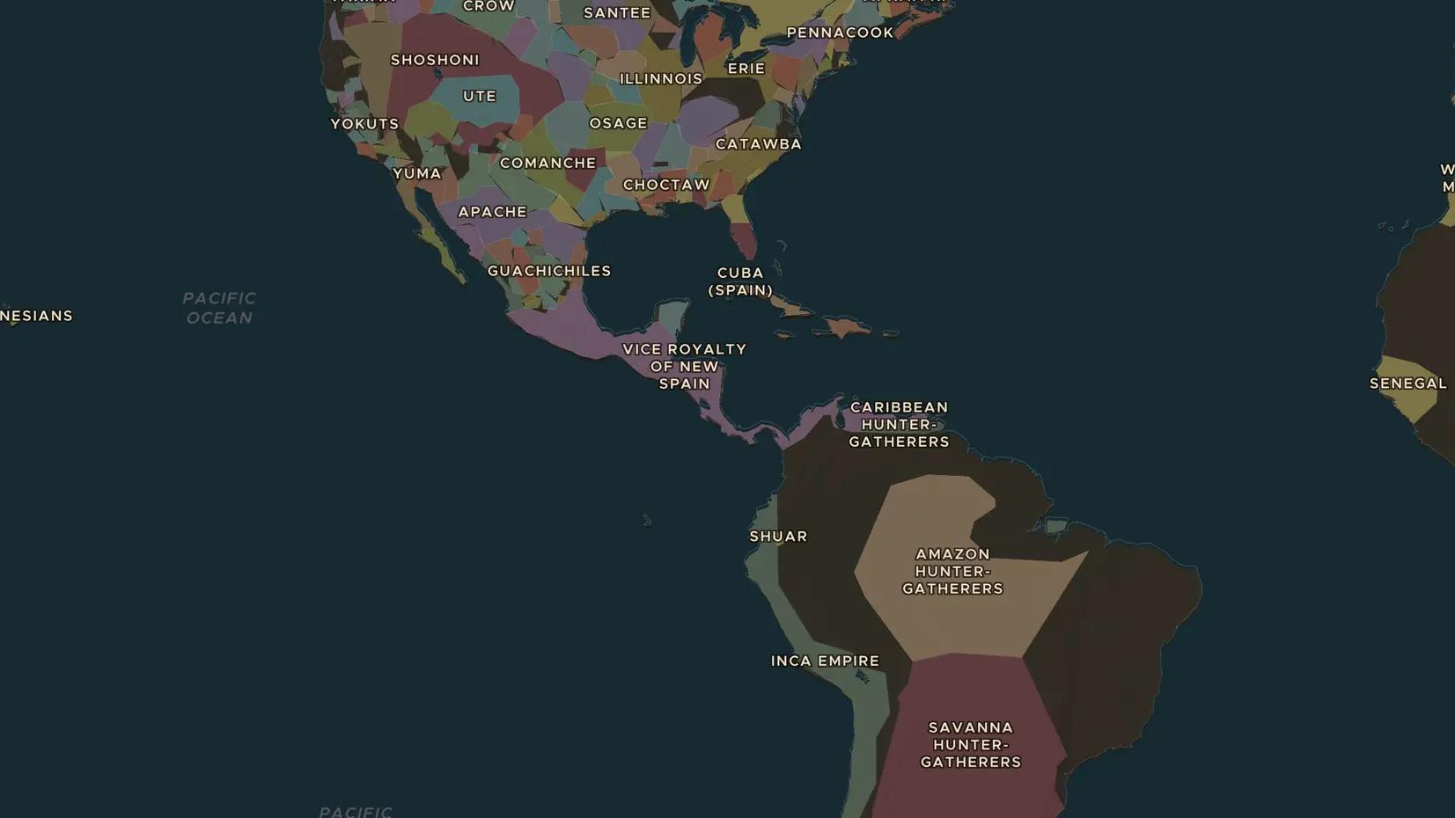
COLUMBIAN EXCHANGE · 1492-1700
The Columbian Exchange: a world of new foods
ChronoAtlas Classroom · Plate 344 · Ages 10-13 · 45 min
ChronoAtlas Classroom · chronoatlas.nl/classroom/lesson/columbian-exchange

Slide 2
THIS LESSON
What students take from it
After 1492, plants, animals and people crossed the oceans in both directions. Potatoes and maize fed Europe, Africa and Asia; horses and cattle changed the Americas. Students trace the exchange on the trade routes and in the food on their own plates.
LENGTH
45 min
AGES
10-13
ON THE MAP
BY THE END, STUDENTS CAN
3 steps, AD 1600
Name at least four crops or animals that crossed the Atlantic in each direction after 1492.
Follow the trade routes that linked the Americas with Europe, Africa and Asia.
Explain one way the Columbian Exchange changed life on each continent.
QUIZ
7 rounds
ChronoAtlas Classroom · chronoatlas.nl/classroom/lesson/columbian-exchange
2

Slide 3
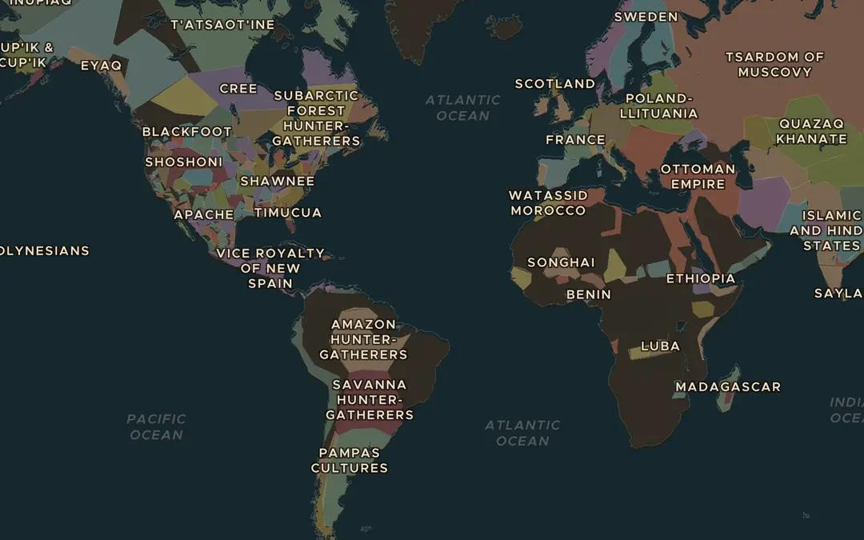
EXPLORE THE MAP · STEP A OF 3 · AD 1600
a
Oceans become roads
Open the map in 1600, turn on Trade Routes and zoom out to the whole world. Find routes that cross the Atlantic and one that crosses the Pacific. Which continents are now connected?
Open this view on the live map →
ChronoAtlas Classroom · chronoatlas.nl/classroom/lesson/columbian-exchange
3
Notes:
Open the map in 1600, turn on Trade Routes and zoom out to the whole world. Find routes that cross the Atlantic and one that crosses the Pacific. Which continents are now connected?
https://chronoatlas.nl/?year=1600&lat=15&lng=-40&zoom=2

Slide 4
CHRONOATLAS CLASSROOM
The rest of this deck comes with Classroom
19 more slides: the other map steps, the discussion questions, the quiz with its answers, and the worksheet.
Every lesson as a deck, every worksheet, every live lesson and homework.
€19 a month, cancel anytime. The free lesson, Rome at its height, comes whole.
https://chronoatlas.nl/pricing
ChronoAtlas Classroom · chronoatlas.nl/classroom/lesson/columbian-exchange
4

