Slide 1
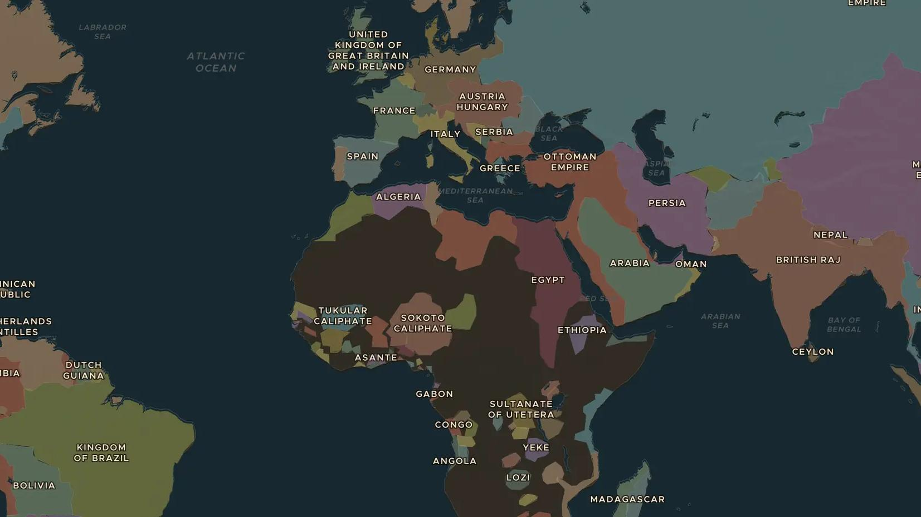
AGE OF EMPIRE · 1885-1908
The Congo Free State
ChronoAtlas Classroom · Plate 451 · Ages 14-16 · 50 min
ChronoAtlas Classroom · chronoatlas.nl/classroom/lesson/congo-free-state

Slide 2
THIS LESSON
What students take from it
For 23 years King Leopold II of Belgium owns the Congo as his private state. Forced rubber collection brings him a fortune and brings terror and death to the Congolese. Students learn how the system worked and how one of the first international human rights campaigns exposed it.
LENGTH
50 min
AGES
14-16
ON THE MAP
BY THE END, STUDENTS CAN
3 steps, AD 1900
Explain how King Leopold II came to own the Congo Free State and how it was run.
Describe the system of forced labour for rubber and its effects on Congolese people.
Explain how campaigners exposed the abuses and why Belgium took over in 1908.
QUIZ
7 rounds
ChronoAtlas Classroom · chronoatlas.nl/classroom/lesson/congo-free-state
2

Slide 3
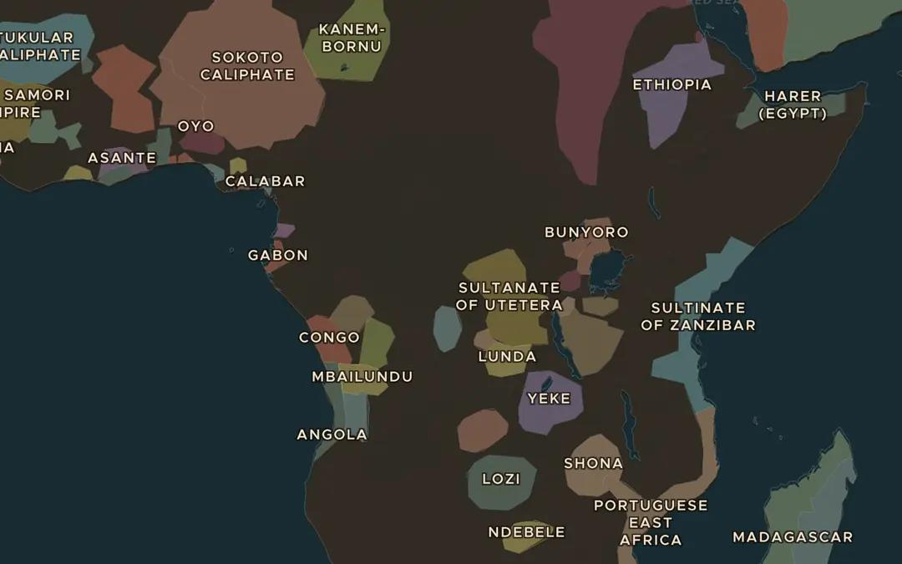
EXPLORE THE MAP · STEP A OF 3 · AD 1900
a
The Congo basin
Open the map in 1900 and zoom in on Central Africa. Follow the great bend of the Congo River. Compare the size of the Congo with Belgium. About how many times bigger is it?
Open this view on the live map →
ChronoAtlas Classroom · chronoatlas.nl/classroom/lesson/congo-free-state
3
Notes:
Open the map in 1900 and zoom in on Central Africa. Follow the great bend of the Congo River. Compare the size of the Congo with Belgium. About how many times bigger is it?
https://chronoatlas.nl/?year=1900&lat=-2&lng=22&zoom=4

Slide 4
CHRONOATLAS CLASSROOM
The rest of this deck comes with Classroom
19 more slides: the other map steps, the discussion questions, the quiz with its answers, and the worksheet.
Every lesson as a deck, every worksheet, every live lesson and homework.
€19 a month, cancel anytime. The free lesson, Rome at its height, comes whole.
https://chronoatlas.nl/pricing
ChronoAtlas Classroom · chronoatlas.nl/classroom/lesson/congo-free-state
4

