Slide 1
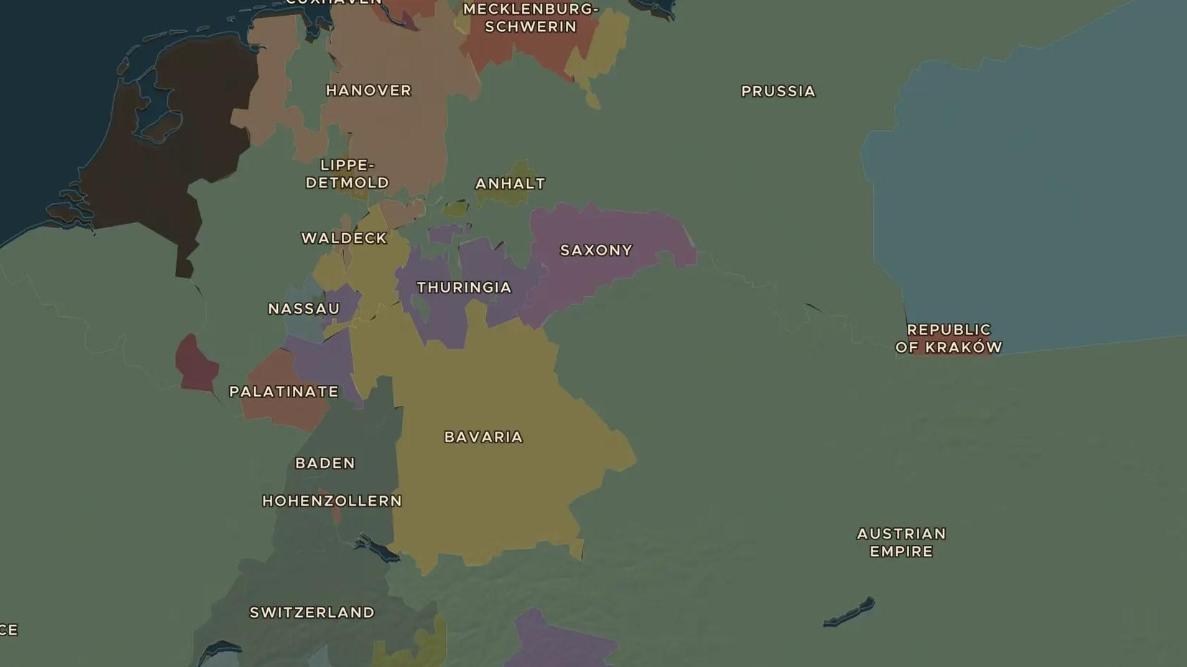
RESTORATION EUROPE · 1814-1815
The Congress of Vienna redraws Europe
ChronoAtlas Classroom · Plate 416 · Ages 13-16 · 50 min
ChronoAtlas Classroom · chronoatlas.nl/classroom/lesson/congress-of-vienna-1815

Slide 2
THIS LESSON
What students take from it
After 20 years of war, emperors, kings and diplomats meet in Vienna to redraw the map of Europe. Students compare the borders before and after, and judge a peace that lasted, but ignored what peoples wanted.
LENGTH
50 min
AGES
13-16
ON THE MAP
BY THE END, STUDENTS CAN
3 steps, AD 1815
Compare the map of Europe in 1800 and 1815 and name three changes made at Vienna.
Explain the ideas of balance of power and legitimacy.
Judge the strengths and weaknesses of the Vienna settlement.
QUIZ
7 rounds
ChronoAtlas Classroom · chronoatlas.nl/classroom/lesson/congress-of-vienna-1815
2

Slide 3
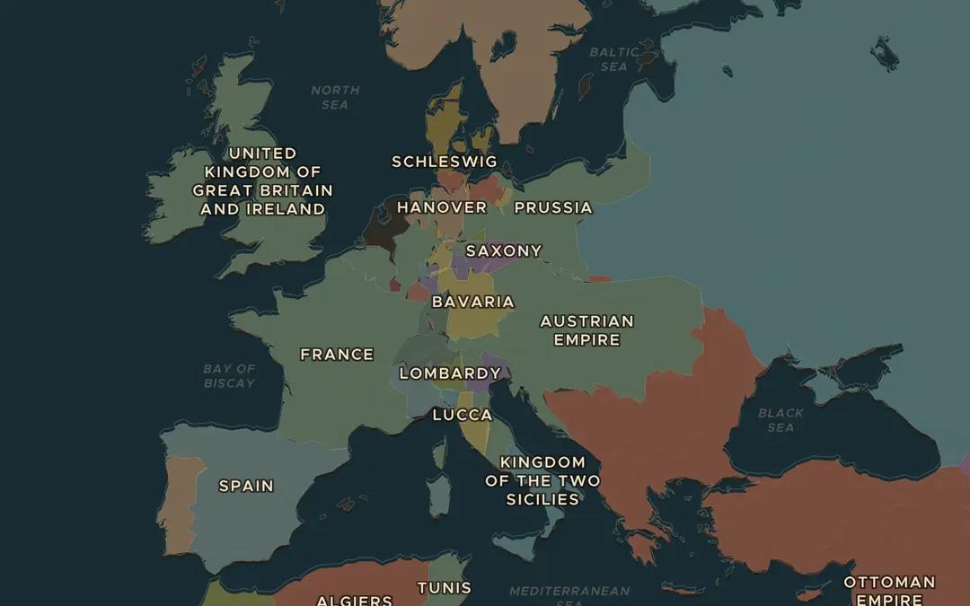
EXPLORE THE MAP · STEP A OF 3 · AD 1815
a
Before and after
Open the map in 1800 and zoom out over Europe. Then drag the slider to 1815. Which states have disappeared, and which new ones have appeared?
Open this view on the live map →
ChronoAtlas Classroom · chronoatlas.nl/classroom/lesson/congress-of-vienna-1815
3
Notes:
Open the map in 1800 and zoom out over Europe. Then drag the slider to 1815. Which states have disappeared, and which new ones have appeared?
https://chronoatlas.nl/?year=1815&lat=49&lng=12&zoom=4

Slide 4
CHRONOATLAS CLASSROOM
The rest of this deck comes with Classroom
19 more slides: the other map steps, the discussion questions, the quiz with its answers, and the worksheet.
Every lesson as a deck, every worksheet, every live lesson and homework.
€19 a month, cancel anytime. The free lesson, Rome at its height, comes whole.
https://chronoatlas.nl/pricing
ChronoAtlas Classroom · chronoatlas.nl/classroom/lesson/congress-of-vienna-1815
4

