Slide 1
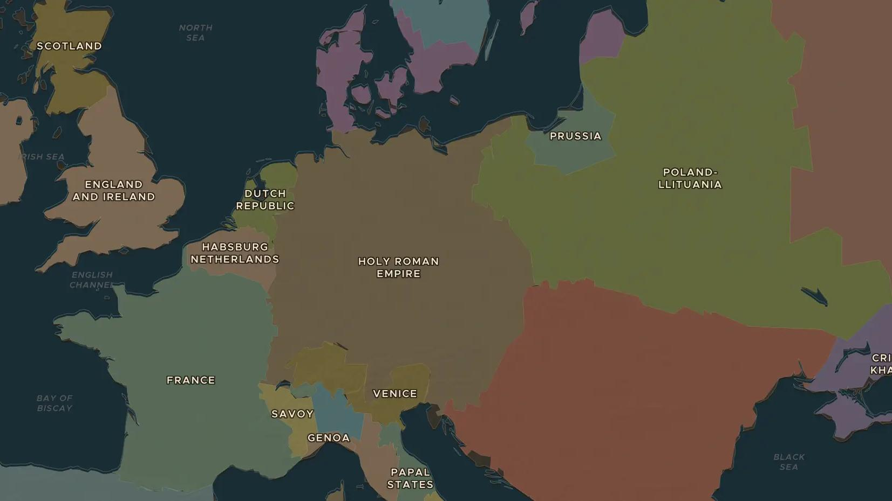
SCIENTIFIC REVOLUTION · 1543-1642
Copernicus, Galileo and a Sun-centred universe
ChronoAtlas Classroom · Plate 332 · Ages 11-14 · 50 min
ChronoAtlas Classroom · chronoatlas.nl/classroom/lesson/copernicus-galileo-heliocentric

Slide 2
THIS LESSON
What students take from it
A Polish church official puts the Sun at the centre of the universe; an Italian professor points a telescope at the sky and finds moons circling Jupiter. Students follow the new astronomy across Europe and discuss Galileo's trial in 1633.
LENGTH
50 min
AGES
11-14
ON THE MAP
BY THE END, STUDENTS CAN
3 steps, AD 1543
Explain the difference between an Earth-centred and a Sun-centred model of the universe.
Locate the places where Copernicus, Tycho Brahe and Galileo worked.
Explain why Galileo was put on trial in 1633 and what that shows about science and authority.
QUIZ
7 rounds
ChronoAtlas Classroom · chronoatlas.nl/classroom/lesson/copernicus-galileo-heliocentric
2

Slide 3
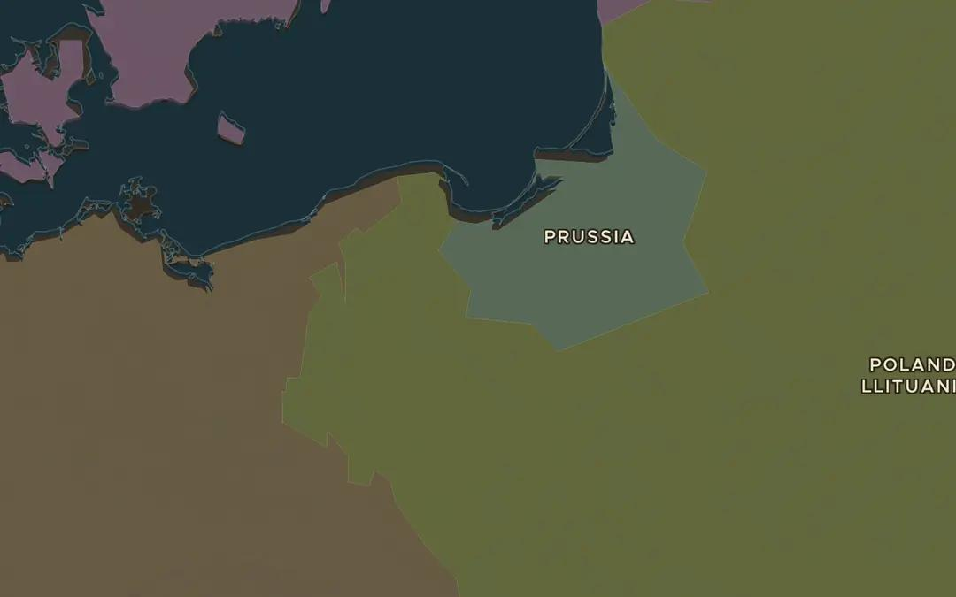
EXPLORE THE MAP · STEP A OF 3 · AD 1543
a
Copernicus's country
Open the map in 1543 and find Toruń on the river Vistula, where Copernicus was born. Which state is it in? Then follow the Vistula north to the Baltic, where he worked.
Open this view on the live map →
ChronoAtlas Classroom · chronoatlas.nl/classroom/lesson/copernicus-galileo-heliocentric
3
Notes:
Open the map in 1543 and find Toruń on the river Vistula, where Copernicus was born. Which state is it in? Then follow the Vistula north to the Baltic, where he worked.
https://chronoatlas.nl/?year=1543&lat=53.5&lng=19&zoom=6

Slide 4
CHRONOATLAS CLASSROOM
The rest of this deck comes with Classroom
19 more slides: the other map steps, the discussion questions, the quiz with its answers, and the worksheet.
Every lesson as a deck, every worksheet, every live lesson and homework.
€19 a month, cancel anytime. The free lesson, Rome at its height, comes whole.
https://chronoatlas.nl/pricing
ChronoAtlas Classroom · chronoatlas.nl/classroom/lesson/copernicus-galileo-heliocentric
4

