Slide 1
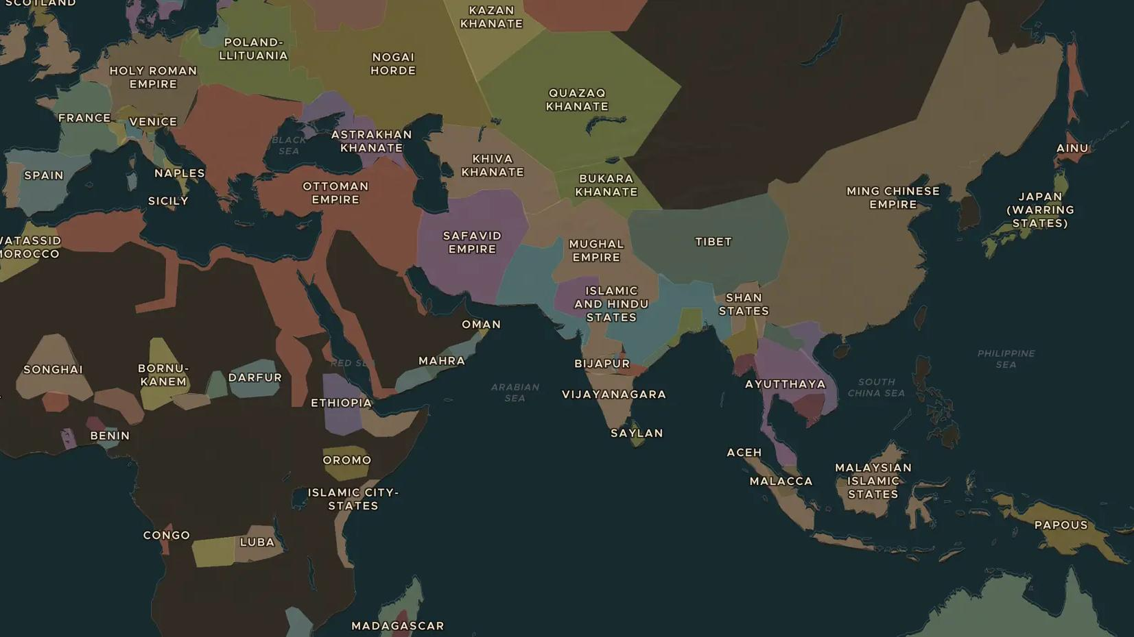
CATHOLIC REFORMATION · 1540-1600
The Counter-Reformation
ChronoAtlas Classroom · Plate 333 · Ages 13-16 · 45 min
ChronoAtlas Classroom · chronoatlas.nl/classroom/lesson/counter-reformation-trent-jesuits

Slide 2
THIS LESSON
What students take from it
The Catholic Church answers the Protestants with reforms of its own. Students follow the bishops to the Council of Trent and the first Jesuits from Rome to India and Japan, and ask how a worldwide church renewed itself.
LENGTH
45 min
AGES
13-16
ON THE MAP
BY THE END, STUDENTS CAN
3 steps, AD 1545
Explain what the Council of Trent decided and why it met.
Trace the journeys of early Jesuits such as Francis Xavier on the map.
Judge whether "Counter-Reformation" or "Catholic Reformation" is the better name for the period.
QUIZ
7 rounds
ChronoAtlas Classroom · chronoatlas.nl/classroom/lesson/counter-reformation-trent-jesuits
2

Slide 3
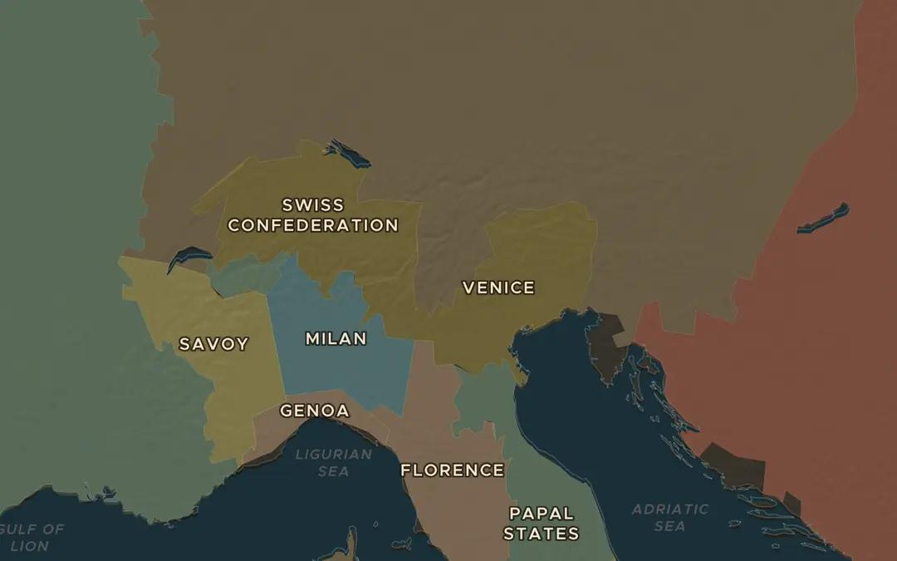
EXPLORE THE MAP · STEP A OF 3 · AD 1545
a
A town between north and south
Open the map in 1545 and find Trent in the Alps, on the road from Germany to Italy. Turn on Historical Events and find the Council of Trent. Why meet here and not in Rome?
Open this view on the live map →
ChronoAtlas Classroom · chronoatlas.nl/classroom/lesson/counter-reformation-trent-jesuits
3
Notes:
Open the map in 1545 and find Trent in the Alps, on the road from Germany to Italy. Turn on Historical Events and find the Council of Trent. Why meet here and not in Rome?
https://chronoatlas.nl/?year=1545&lat=46.1&lng=11.1&zoom=6

Slide 4
CHRONOATLAS CLASSROOM
The rest of this deck comes with Classroom
19 more slides: the other map steps, the discussion questions, the quiz with its answers, and the worksheet.
Every lesson as a deck, every worksheet, every live lesson and homework.
€19 a month, cancel anytime. The free lesson, Rome at its height, comes whole.
https://chronoatlas.nl/pricing
ChronoAtlas Classroom · chronoatlas.nl/classroom/lesson/counter-reformation-trent-jesuits
4

