Slide 1
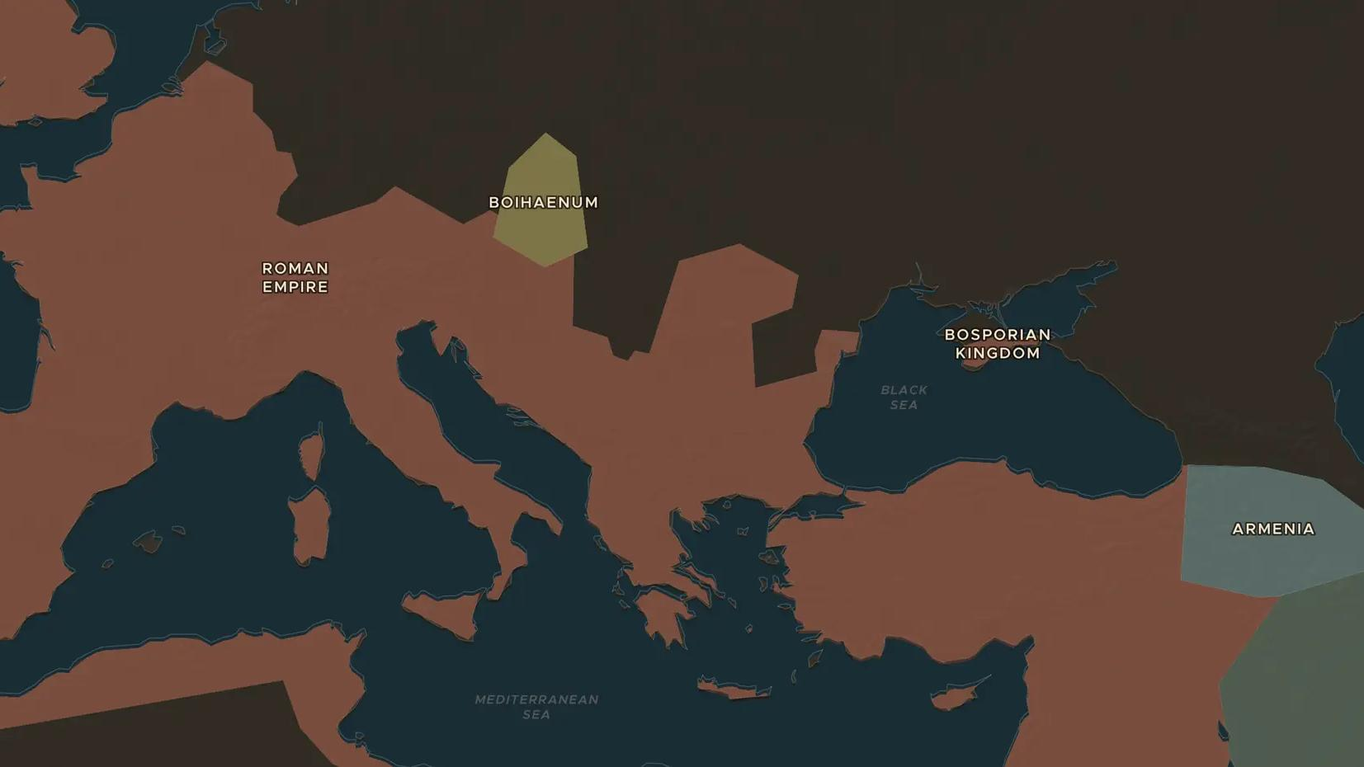
ROMAN EMPIRE · 235-284 AD
The crisis of the third century
ChronoAtlas Classroom · Plate 138 · Ages 13-16 · 50 min
ChronoAtlas Classroom · chronoatlas.nl/classroom/lesson/crisis-of-the-third-century

Slide 2
THIS LESSON
What students take from it
In about 50 years Rome had more than 20 emperors, lost an emperor to the Persians and split into three parts. Students investigate what went wrong, from civil war and invasions to plague and worthless coins, and how the empire survived.
LENGTH
50 min
AGES
13-16
ON THE MAP
BY THE END, STUDENTS CAN
3 steps, AD 250
Describe the main problems of the empire between 235 and 284: civil war, invasion, plague and inflation.
Explain how the Gallic Empire and Palmyra broke away and how Aurelian reunited the empire.
Evaluate which problem was the most dangerous for the empire.
QUIZ
7 rounds
ChronoAtlas Classroom · chronoatlas.nl/classroom/lesson/crisis-of-the-third-century
2

Slide 3
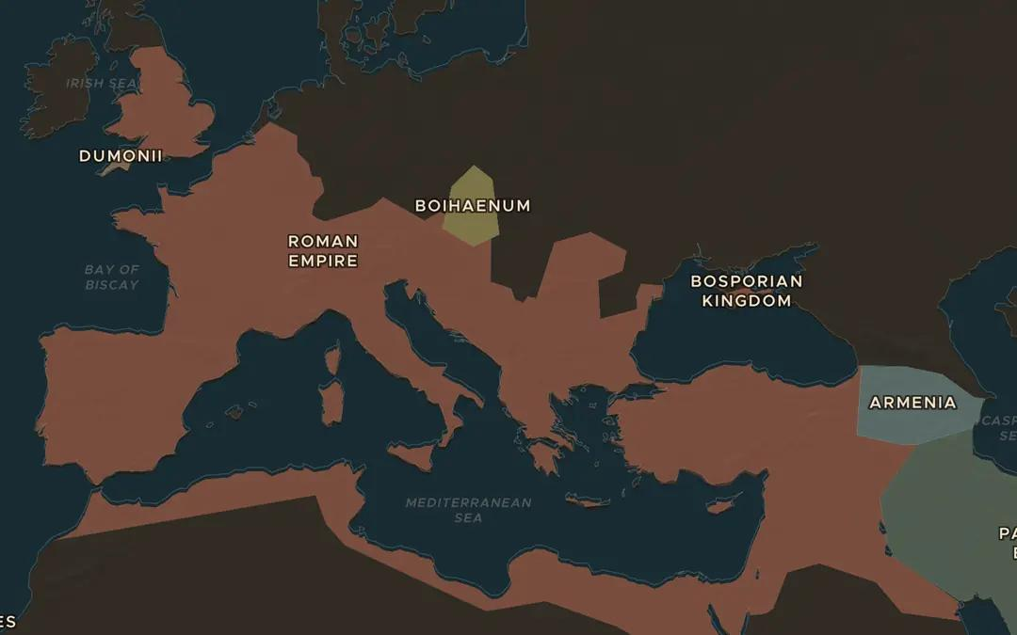
EXPLORE THE MAP · STEP A OF 3 · AD 250
a
Many problems at once
Open the map in AD 250 and look at the long frontier from the Rhine to the Euphrates. Turn on Historical Events and find the Natural Disasters marker for the Plague of Cyprian. Where could enemies break in?
Open this view on the live map →
ChronoAtlas Classroom · chronoatlas.nl/classroom/lesson/crisis-of-the-third-century
3
Notes:
Open the map in AD 250 and look at the long frontier from the Rhine to the Euphrates. Turn on Historical Events and find the Natural Disasters marker for the Plague of Cyprian. Where could enemies break in?
https://chronoatlas.nl/?year=250&lat=44&lng=20&zoom=4

Slide 4
CHRONOATLAS CLASSROOM
The rest of this deck comes with Classroom
19 more slides: the other map steps, the discussion questions, the quiz with its answers, and the worksheet.
Every lesson as a deck, every worksheet, every live lesson and homework.
€19 a month, cancel anytime. The free lesson, Rome at its height, comes whole.
https://chronoatlas.nl/pricing
ChronoAtlas Classroom · chronoatlas.nl/classroom/lesson/crisis-of-the-third-century
4

