Slide 1
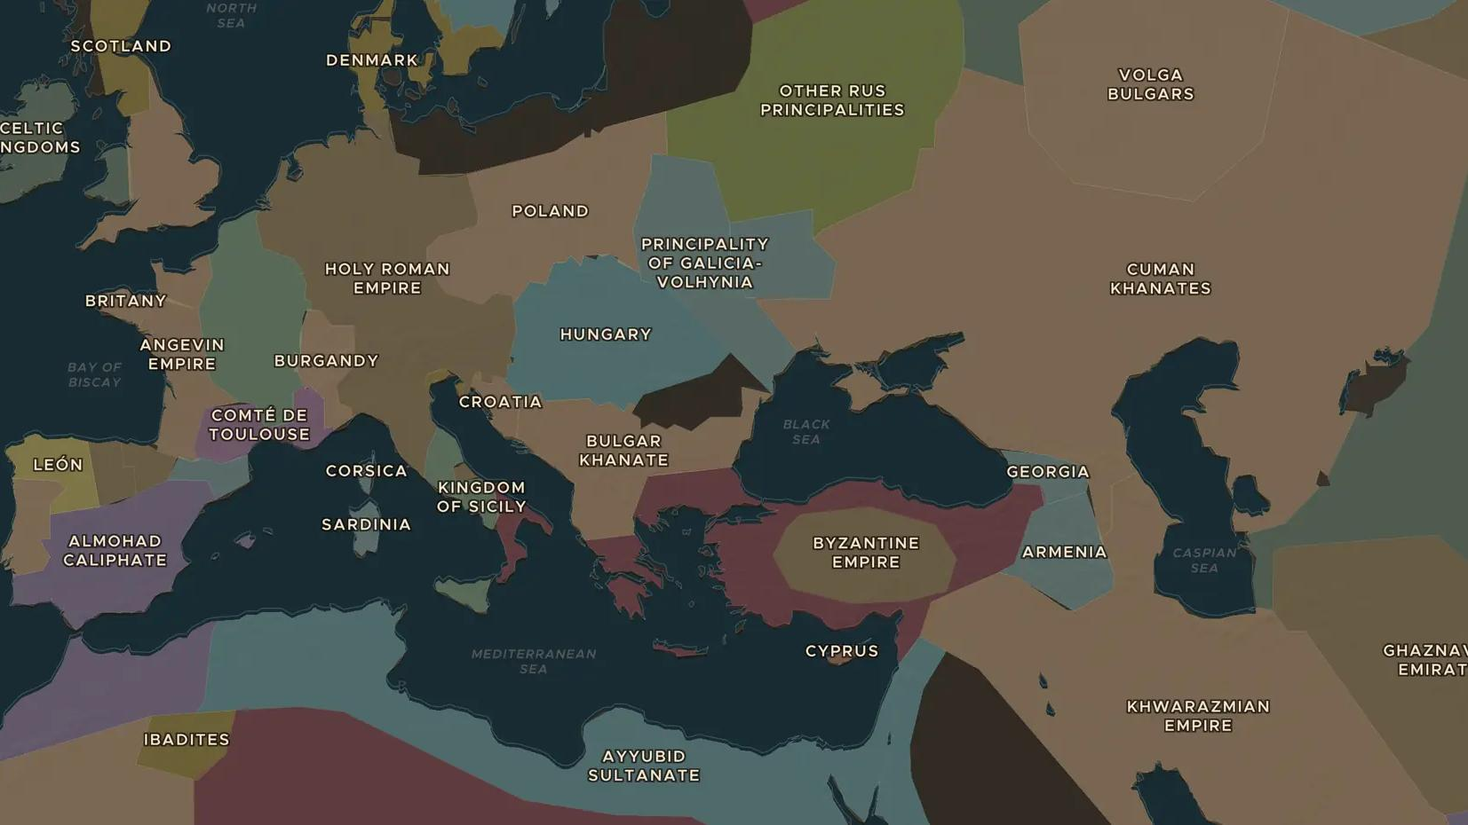
CRUSADES · 1099-1291
Knights of the cross: crusader states and military orders
ChronoAtlas Classroom · Plate 238 · Ages 12-15 · 45 min
ChronoAtlas Classroom · chronoatlas.nl/classroom/lesson/crusader-states-military-orders

Slide 2
THIS LESSON
What students take from it
After 1099 four small crusader states cling to the coast of the eastern Mediterranean, defended by monk-knights such as the Templars and Hospitallers. Students locate the states and their castles, and follow the orders after the last crusader city fell in 1291.
LENGTH
45 min
AGES
12-15
ON THE MAP
BY THE END, STUDENTS CAN
3 steps, AD 1200
Locate the four crusader states and explain why they lay along the coast.
Describe what military orders were and name three of them.
Explain what happened to the Templars, Hospitallers and Teutonic Knights after 1291.
QUIZ
7 rounds
ChronoAtlas Classroom · chronoatlas.nl/classroom/lesson/crusader-states-military-orders
2

Slide 3
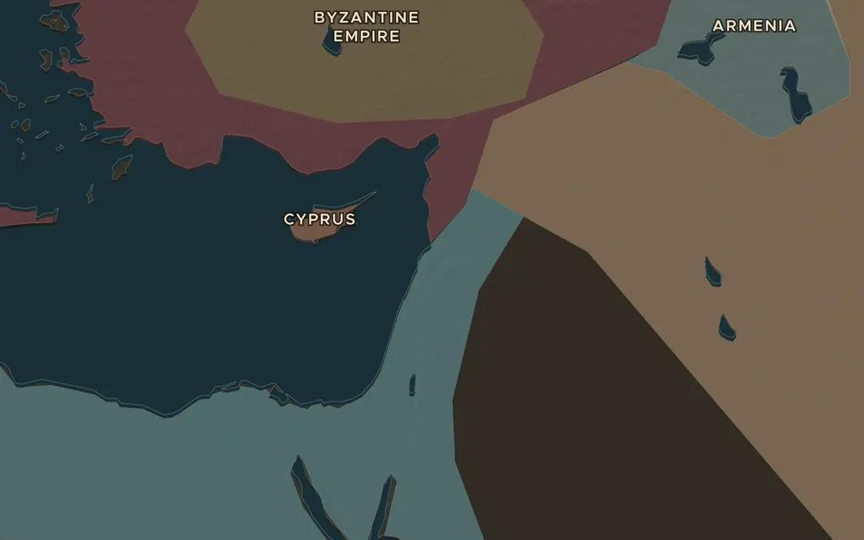
EXPLORE THE MAP · STEP A OF 3 · AD 1200
a
A thin strip of coast
Open the map in 1200 on the eastern Mediterranean. Turn on Historical Events and find the sieges of Antioch, Jerusalem and Acre. Why did the crusader states hug the coast?
Open this view on the live map →
ChronoAtlas Classroom · chronoatlas.nl/classroom/lesson/crusader-states-military-orders
3
Notes:
Open the map in 1200 on the eastern Mediterranean. Turn on Historical Events and find the sieges of Antioch, Jerusalem and Acre. Why did the crusader states hug the coast?
https://chronoatlas.nl/?year=1200&lat=34&lng=36&zoom=5.5

Slide 4
CHRONOATLAS CLASSROOM
The rest of this deck comes with Classroom
19 more slides: the other map steps, the discussion questions, the quiz with its answers, and the worksheet.
Every lesson as a deck, every worksheet, every live lesson and homework.
€19 a month, cancel anytime. The free lesson, Rome at its height, comes whole.
https://chronoatlas.nl/pricing
ChronoAtlas Classroom · chronoatlas.nl/classroom/lesson/crusader-states-military-orders
4

