Slide 1
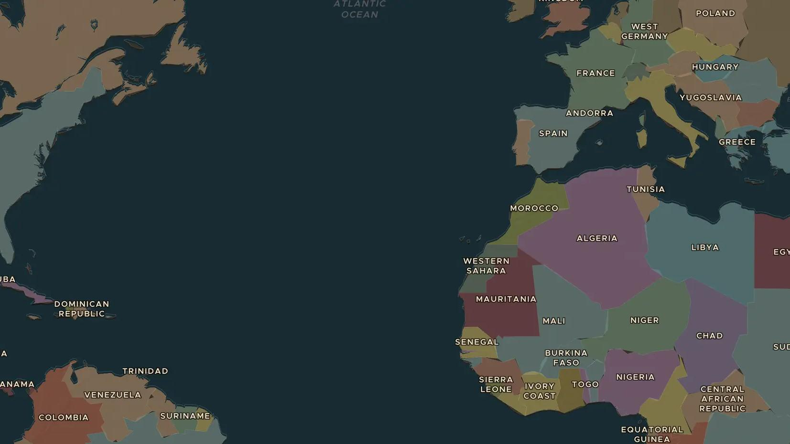
COLD WAR · 1959-1962
Thirteen days: the Cuban Missile Crisis
ChronoAtlas Classroom · Plate 510 · Ages 12-15 · 50 min
ChronoAtlas Classroom · chronoatlas.nl/classroom/lesson/cuban-missile-crisis

Slide 2
THIS LESSON
What students take from it
In October 1962 American spy planes found Soviet nuclear missiles on Cuba, about 150 km from Florida. For thirteen days the world stood close to nuclear war. Students follow the crisis on the map and take the decisions that Kennedy and Khrushchev faced.
LENGTH
50 min
AGES
12-15
ON THE MAP
BY THE END, STUDENTS CAN
3 steps, AD 1960
Explain how the Cuban Revolution of 1959 brought the Cold War to the Caribbean.
Describe the main steps of the crisis of October 1962.
Explain how the crisis was solved and what both sides learned from it.
QUIZ
7 rounds
ChronoAtlas Classroom · chronoatlas.nl/classroom/lesson/cuban-missile-crisis
2

Slide 3
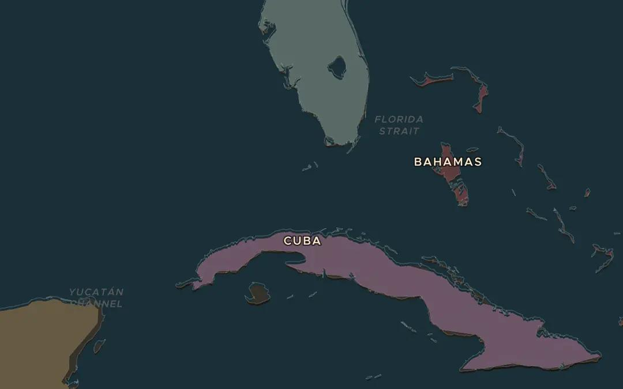
EXPLORE THE MAP · STEP A OF 3 · AD 1960
a
So close
Open the map in 1960 and find Cuba and Florida. Measure the gap between Key West and Havana. Why did missiles here worry Americans so much?
Open this view on the live map →
ChronoAtlas Classroom · chronoatlas.nl/classroom/lesson/cuban-missile-crisis
3
Notes:
Open the map in 1960 and find Cuba and Florida. Measure the gap between Key West and Havana. Why did missiles here worry Americans so much?
https://chronoatlas.nl/?year=1960&lat=24&lng=-81.5&zoom=6

Slide 4
CHRONOATLAS CLASSROOM
The rest of this deck comes with Classroom
19 more slides: the other map steps, the discussion questions, the quiz with its answers, and the worksheet.
Every lesson as a deck, every worksheet, every live lesson and homework.
€19 a month, cancel anytime. The free lesson, Rome at its height, comes whole.
https://chronoatlas.nl/pricing
ChronoAtlas Classroom · chronoatlas.nl/classroom/lesson/cuban-missile-crisis
4

