Slide 1
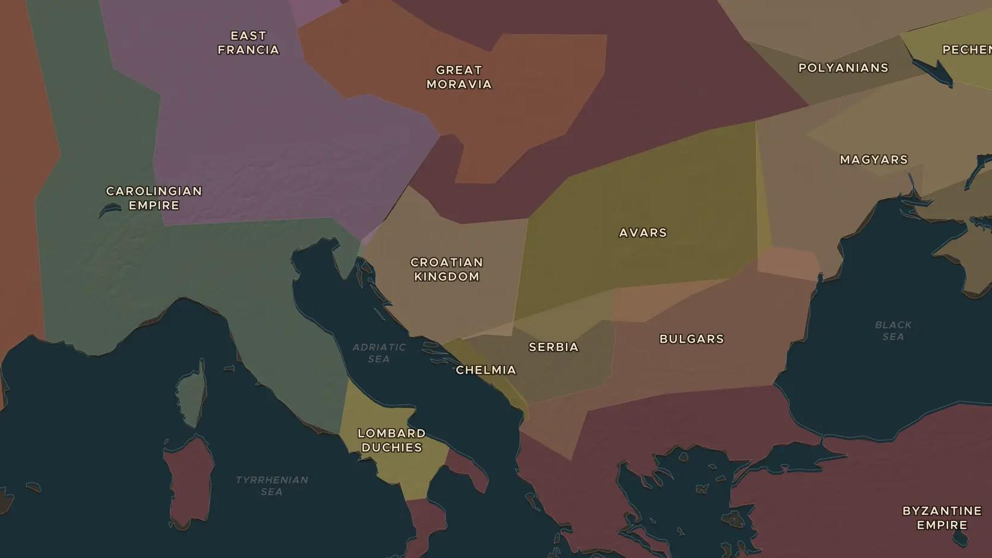
BYZANTIUM AND THE SLAVS · 863-893
Cyril, Methodius and the Slavic alphabet
ChronoAtlas Classroom · Plate 196 · Ages 12-15 · 45 min
ChronoAtlas Classroom · chronoatlas.nl/classroom/lesson/cyril-and-methodius

Slide 2
THIS LESSON
What students take from it
In 863 two brothers from Thessalonica set out for Moravia with a brand-new alphabet. Students follow how a script made for one mission led to Cyrillic, the alphabet that hundreds of millions of people use today.
LENGTH
45 min
AGES
12-15
ON THE MAP
BY THE END, STUDENTS CAN
3 steps, AD 900
Explain why Prince Rastislav of Moravia asked Constantinople for teachers who spoke a Slavic language.
Describe the difference between the Glagolitic and the Cyrillic alphabets and where each was first used.
Trace on the map the route from Thessalonica to Moravia, Rome and Bulgaria.
QUIZ
7 rounds
ChronoAtlas Classroom · chronoatlas.nl/classroom/lesson/cyril-and-methodius
2

Slide 3
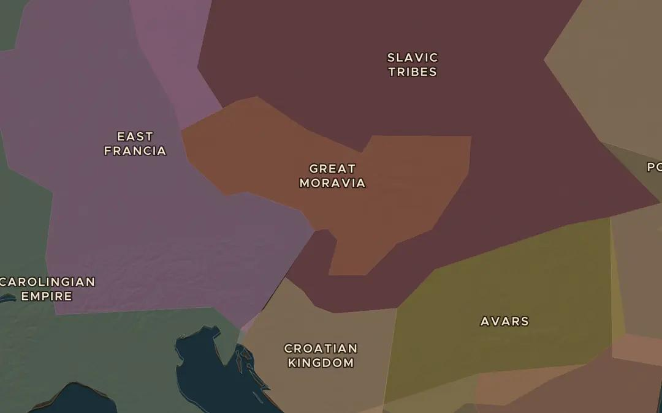
EXPLORE THE MAP · STEP A OF 3 · AD 900
a
Great Moravia
Open the map in 900 and find Great Moravia in central Europe. Which powerful kingdom lies to its west, and who lives to the southeast?
Open this view on the live map →
ChronoAtlas Classroom · chronoatlas.nl/classroom/lesson/cyril-and-methodius
3
Notes:
Open the map in 900 and find Great Moravia in central Europe. Which powerful kingdom lies to its west, and who lives to the southeast?
https://chronoatlas.nl/?year=900&lat=48.5&lng=17.5&zoom=5.5

Slide 4
CHRONOATLAS CLASSROOM
The rest of this deck comes with Classroom
19 more slides: the other map steps, the discussion questions, the quiz with its answers, and the worksheet.
Every lesson as a deck, every worksheet, every live lesson and homework.
€19 a month, cancel anytime. The free lesson, Rome at its height, comes whole.
https://chronoatlas.nl/pricing
ChronoAtlas Classroom · chronoatlas.nl/classroom/lesson/cyril-and-methodius
4

