Slide 1
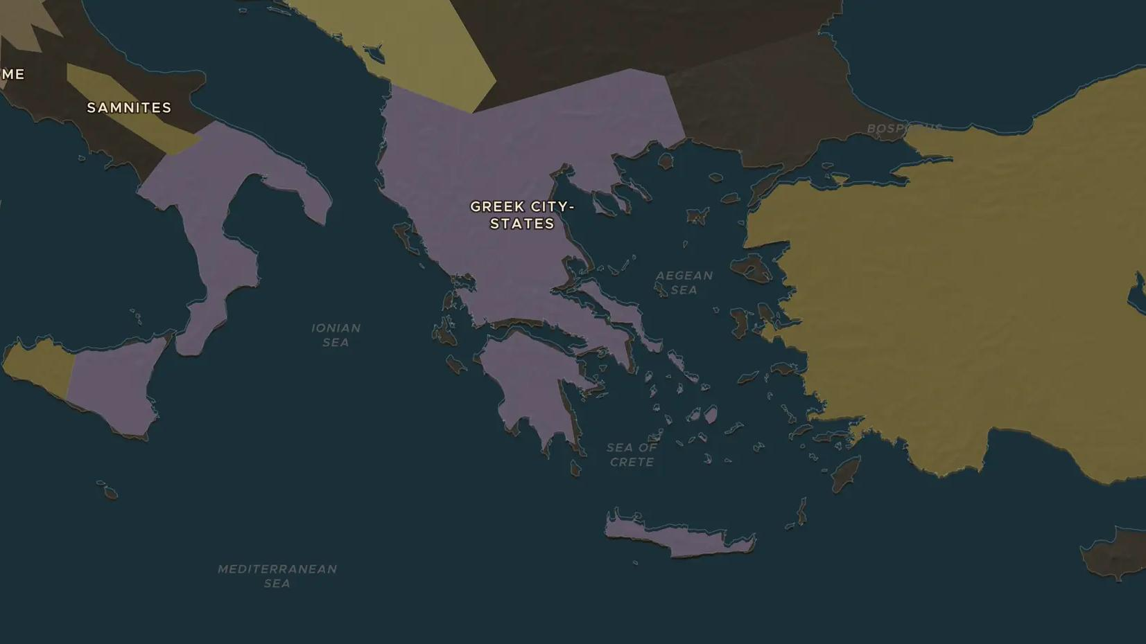
ARCHAIC AND CLASSICAL GREECE · 650-279 BC
Delphi: the oracle at the navel of the world
ChronoAtlas Classroom · Plate 56 · Ages 10-13 · 45 min
ChronoAtlas Classroom · chronoatlas.nl/classroom/lesson/delphi-oracle

Slide 2
THIS LESSON
What students take from it
Kings and cities from Lydia to Sicily sent envoys up a mountain to ask a priestess what to do. Students visit Delphi, learn how the oracle worked, test some famous answers, and ask why a sanctuary no army defended stayed rich and safe for centuries.
LENGTH
45 min
AGES
10-13
ON THE MAP
BY THE END, STUDENTS CAN
3 steps, 650 BC
Locate Delphi and describe the sanctuary of Apollo: the temple, the Pythia and the treasuries.
Explain how a question to the oracle was asked and answered, and why the answers were often ambiguous.
Give two examples of rulers or cities that consulted Delphi and what happened next.
QUIZ
7 rounds
ChronoAtlas Classroom · chronoatlas.nl/classroom/lesson/delphi-oracle
2

Slide 3
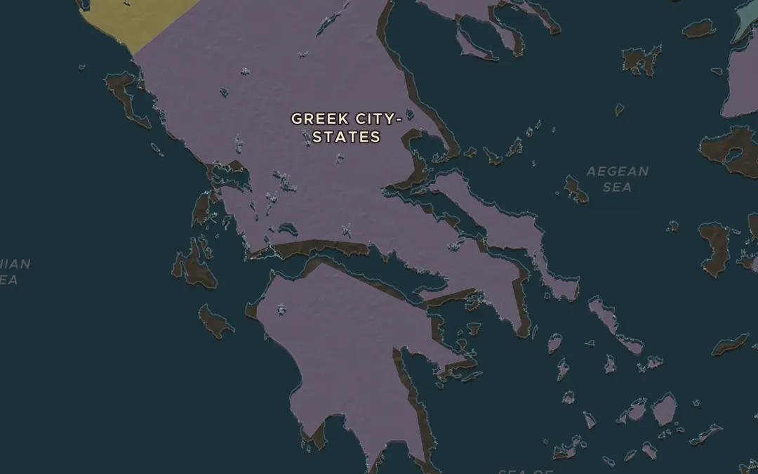
EXPLORE THE MAP · STEP A OF 3 · 650 BC
a
A sanctuary on the mountain
Open the map in 650 BC on Delphi, on the slopes of Mount Parnassus above the Gulf of Corinth. The Greeks called it the navel of the world. Turn on Historical Events (Religious) and find "Oracle at Delphi Established". Zoom in and notice how hard the site is to reach.
Open this view on the live map →
ChronoAtlas Classroom · chronoatlas.nl/classroom/lesson/delphi-oracle
3
Notes:
Open the map in 650 BC on Delphi, on the slopes of Mount Parnassus above the Gulf of Corinth. The Greeks called it the navel of the world. Turn on Historical Events (Religious) and find "Oracle at Delphi Established". Zoom in and notice how hard the site is to reach.
https://chronoatlas.nl/?year=-650&lat=38.48&lng=22.5&zoom=7

Slide 4
CHRONOATLAS CLASSROOM
The rest of this deck comes with Classroom
19 more slides: the other map steps, the discussion questions, the quiz with its answers, and the worksheet.
Every lesson as a deck, every worksheet, every live lesson and homework.
€19 a month, cancel anytime. The free lesson, Rome at its height, comes whole.
https://chronoatlas.nl/pricing
ChronoAtlas Classroom · chronoatlas.nl/classroom/lesson/delphi-oracle
4

