Slide 1
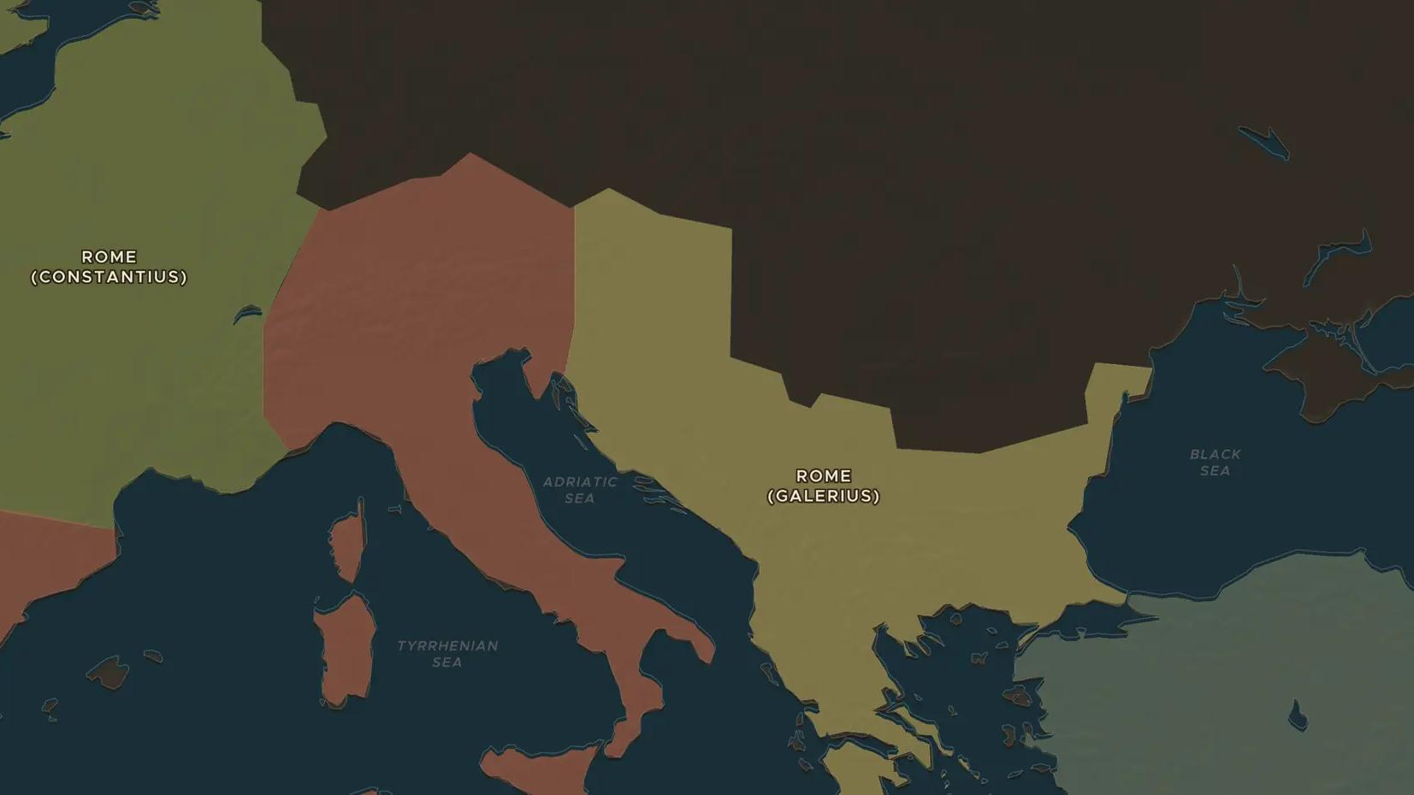
ROMAN EMPIRE · 284-305 AD
Diocletian and the rule of four
ChronoAtlas Classroom · Plate 140 · Ages 12-15 · 50 min
ChronoAtlas Classroom · chronoatlas.nl/classroom/lesson/diocletian-and-the-tetrarchy

Slide 2
THIS LESSON
What students take from it
Diocletian decided the empire was too big for one man and shared it among four emperors. Students explore the Tetrarchy on the map, his reforms of the army, taxes and prices, and his persecution of Christians.
LENGTH
50 min
AGES
12-15
ON THE MAP
BY THE END, STUDENTS CAN
3 steps, AD 300
Explain why Diocletian shared power among four rulers from 293 and how the Tetrarchy worked.
Locate the main seats of the four rulers, such as Nicomedia, Sirmium, Milan and Trier, on the map.
Evaluate Diocletian's reforms, including the Edict on Maximum Prices (301) and the persecution of Christians (303).
QUIZ
7 rounds
ChronoAtlas Classroom · chronoatlas.nl/classroom/lesson/diocletian-and-the-tetrarchy
2

Slide 3
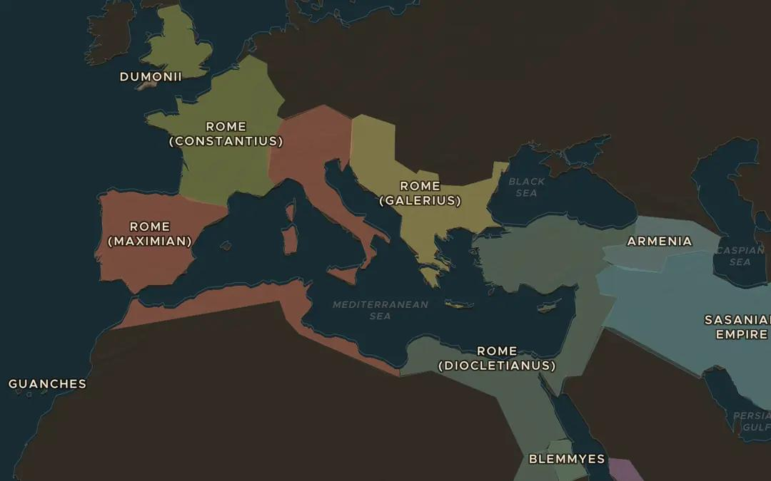
EXPLORE THE MAP · STEP A OF 3 · AD 300
a
Four emperors
Open the map in AD 300. The empire is drawn in four parts, each named after one of its rulers. Which part did Diocletian keep for himself, and which part is the largest?
Open this view on the live map →
ChronoAtlas Classroom · chronoatlas.nl/classroom/lesson/diocletian-and-the-tetrarchy
3
Notes:
Open the map in AD 300. The empire is drawn in four parts, each named after one of its rulers. Which part did Diocletian keep for himself, and which part is the largest?
https://chronoatlas.nl/?year=300&lat=40&lng=18&zoom=3.8

Slide 4
CHRONOATLAS CLASSROOM
The rest of this deck comes with Classroom
19 more slides: the other map steps, the discussion questions, the quiz with its answers, and the worksheet.
Every lesson as a deck, every worksheet, every live lesson and homework.
€19 a month, cancel anytime. The free lesson, Rome at its height, comes whole.
https://chronoatlas.nl/pricing
ChronoAtlas Classroom · chronoatlas.nl/classroom/lesson/diocletian-and-the-tetrarchy
4

