Slide 1
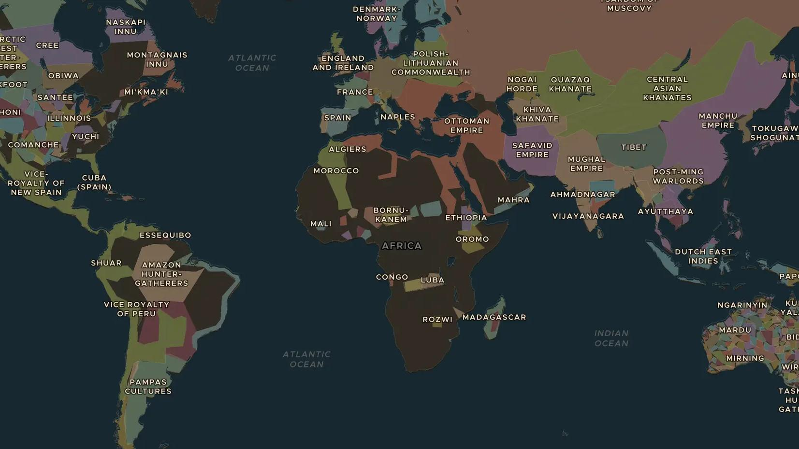
DUTCH REPUBLIC · 1588-1672
The Dutch Golden Age
ChronoAtlas Classroom · Plate 362 · Ages 11-14 · 50 min
ChronoAtlas Classroom · chronoatlas.nl/classroom/lesson/dutch-golden-age

Slide 2
THIS LESSON
What students take from it
A small republic becomes a world power through water, trade and ships. Students trace the trade network and discuss both the wealth and its dark side.
LENGTH
50 min
AGES
11-14
ON THE MAP
BY THE END, STUDENTS CAN
3 steps, AD 1650
Explain how a small country built a global trade network in the 1600s.
Point out three places on the map where the Dutch Republic had trading posts.
Name one positive and one negative consequence of that trade empire.
QUIZ
7 rounds
ChronoAtlas Classroom · chronoatlas.nl/classroom/lesson/dutch-golden-age
2

Slide 3
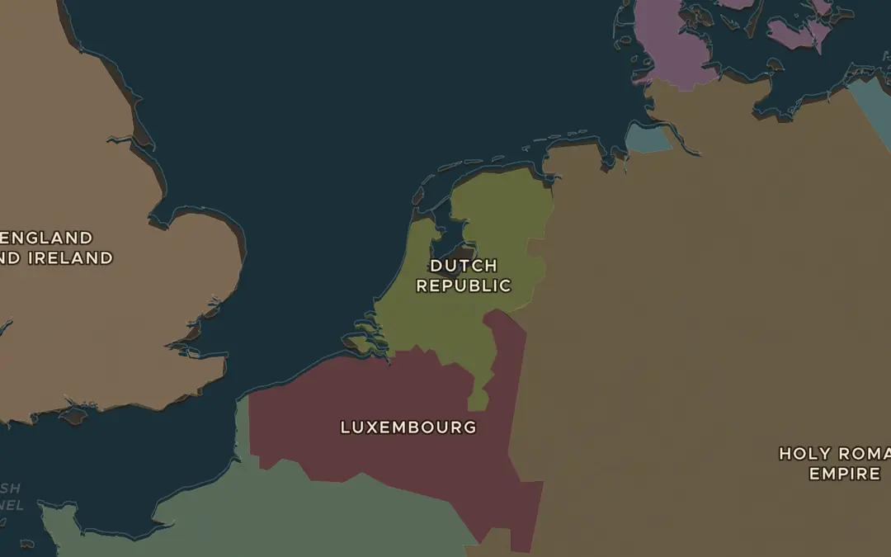
EXPLORE THE MAP · STEP A OF 3 · AD 1650
a
The republic itself
Open the map in 1650 on the Low Countries. Compare the Republic's size with France and Spain. What do you notice?
Open this view on the live map →
ChronoAtlas Classroom · chronoatlas.nl/classroom/lesson/dutch-golden-age
3
Notes:
Open the map in 1650 on the Low Countries. Compare the Republic's size with France and Spain. What do you notice?
https://chronoatlas.nl/?year=1650&lat=52.2&lng=5.3&zoom=6

Slide 4
CHRONOATLAS CLASSROOM
The rest of this deck comes with Classroom
19 more slides: the other map steps, the discussion questions, the quiz with its answers, and the worksheet.
Every lesson as a deck, every worksheet, every live lesson and homework.
€19 a month, cancel anytime. The free lesson, Rome at its height, comes whole.
https://chronoatlas.nl/pricing
ChronoAtlas Classroom · chronoatlas.nl/classroom/lesson/dutch-golden-age
4

