Slide 1
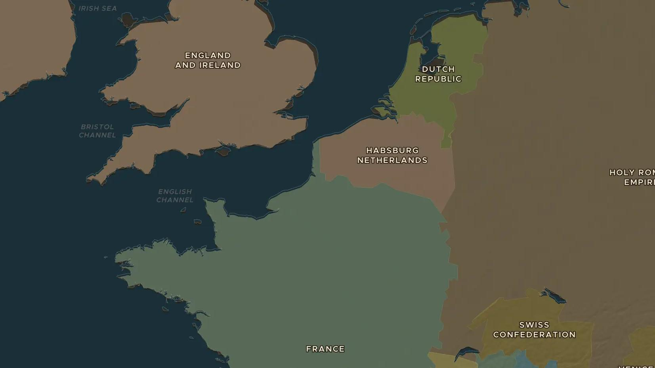
DUTCH REVOLT · 1566-1584
William of Orange and the Dutch Revolt
ChronoAtlas Classroom · Plate 336 · Ages 11-14 · 50 min
ChronoAtlas Classroom · chronoatlas.nl/classroom/lesson/dutch-revolt-william-of-orange

Slide 2
THIS LESSON
What students take from it
The Low Countries rise against Philip II of Spain over taxes, old freedoms and faith. Students follow William of Orange from nobleman to rebel leader, see Leiden saved by flooding the land, and ask why he is called the father of the Dutch nation.
LENGTH
50 min
AGES
11-14
ON THE MAP
BY THE END, STUDENTS CAN
3 steps, AD 1560
Explain three reasons why the Low Countries rebelled against Philip II.
Locate Brielle, Leiden and Utrecht and explain what happened at each.
Describe the role of William of Orange in the revolt.
QUIZ
7 rounds
ChronoAtlas Classroom · chronoatlas.nl/classroom/lesson/dutch-revolt-william-of-orange
2

Slide 3
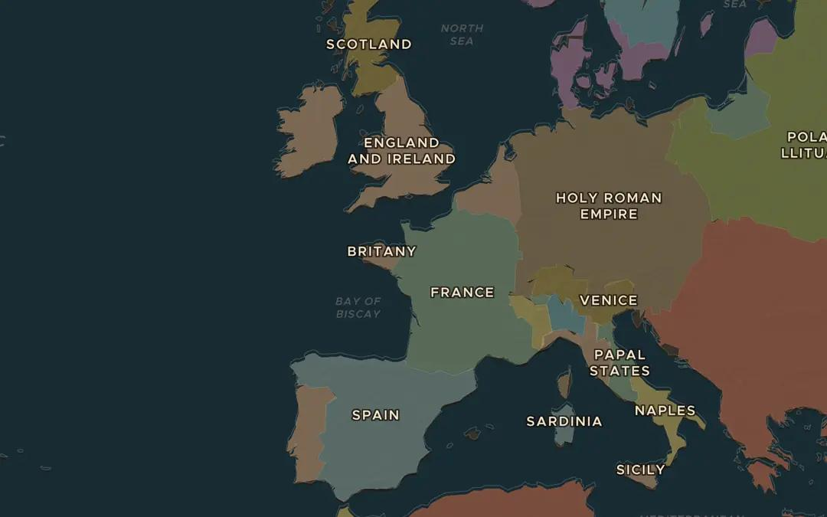
EXPLORE THE MAP · STEP A OF 3 · AD 1560
a
The Habsburg Netherlands
Open the map in 1560 and zoom in on the Low Countries. Find the Habsburg Netherlands. Who rules them, and how far away is Spain, where the king now lives?
Open this view on the live map →
ChronoAtlas Classroom · chronoatlas.nl/classroom/lesson/dutch-revolt-william-of-orange
3
Notes:
Open the map in 1560 and zoom in on the Low Countries. Find the Habsburg Netherlands. Who rules them, and how far away is Spain, where the king now lives?
https://chronoatlas.nl/?year=1560&lat=48&lng=-1&zoom=4.2

Slide 4
CHRONOATLAS CLASSROOM
The rest of this deck comes with Classroom
19 more slides: the other map steps, the discussion questions, the quiz with its answers, and the worksheet.
Every lesson as a deck, every worksheet, every live lesson and homework.
€19 a month, cancel anytime. The free lesson, Rome at its height, comes whole.
https://chronoatlas.nl/pricing
ChronoAtlas Classroom · chronoatlas.nl/classroom/lesson/dutch-revolt-william-of-orange
4

