Slide 1
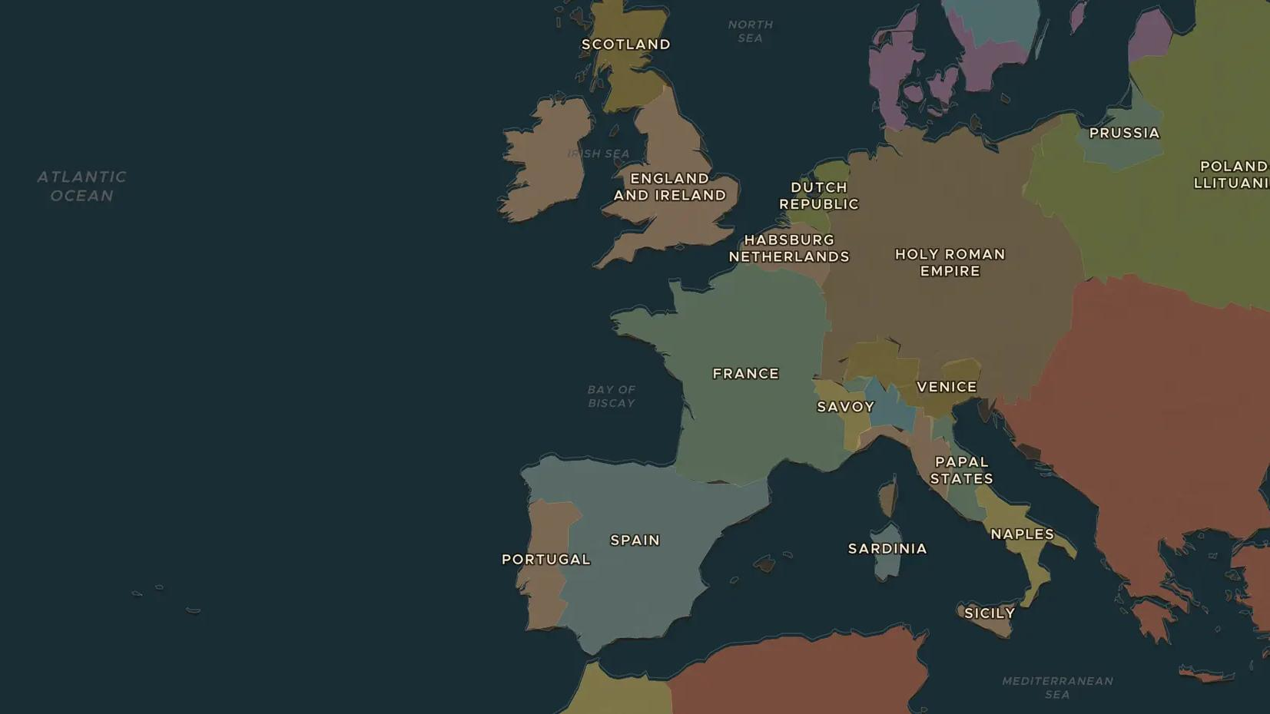
TUDOR ENGLAND · 1558-1603
Elizabeth I and the Spanish Armada
ChronoAtlas Classroom · Plate 339 · Ages 10-13 · 50 min
ChronoAtlas Classroom · chronoatlas.nl/classroom/lesson/elizabeth-i-spanish-armada

Slide 2
THIS LESSON
What students take from it
In 1588 Philip II sends a great fleet to carry an army to England. Students follow the Armada from Lisbon up the Channel to Gravelines and home around Scotland and Ireland, and ask what decided its fate: English ships, Spanish plans or the weather.
LENGTH
50 min
AGES
10-13
ON THE MAP
BY THE END, STUDENTS CAN
3 steps, AD 1592
Explain why Philip II sent the Armada against England in 1588.
Trace the route of the Armada on the map from Lisbon and back to Spain.
Weigh three reasons why the Armada failed.
QUIZ
7 rounds
ChronoAtlas Classroom · chronoatlas.nl/classroom/lesson/elizabeth-i-spanish-armada
2

Slide 3
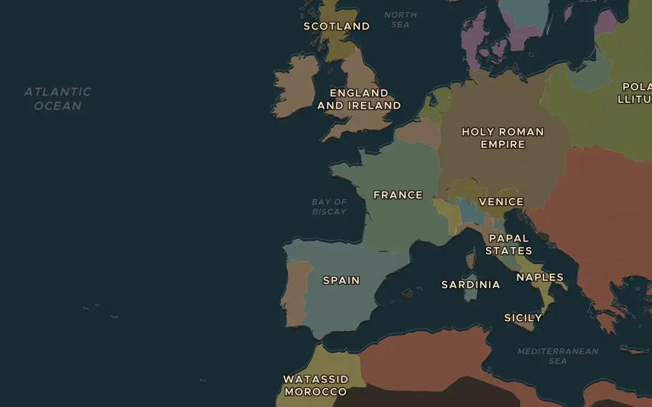
EXPLORE THE MAP · STEP A OF 3 · AD 1592
a
Two rival kingdoms
Open the map in 1592 and zoom out over western Europe. Find England, Spain and Portugal. Philip II had also become king of Portugal in 1580. Why did that make his fleet stronger?
Open this view on the live map →
ChronoAtlas Classroom · chronoatlas.nl/classroom/lesson/elizabeth-i-spanish-armada
3
Notes:
Open the map in 1592 and zoom out over western Europe. Find England, Spain and Portugal. Philip II had also become king of Portugal in 1580. Why did that make his fleet stronger?
https://chronoatlas.nl/?year=1592&lat=46&lng=-5&zoom=4

Slide 4
CHRONOATLAS CLASSROOM
The rest of this deck comes with Classroom
19 more slides: the other map steps, the discussion questions, the quiz with its answers, and the worksheet.
Every lesson as a deck, every worksheet, every live lesson and homework.
€19 a month, cancel anytime. The free lesson, Rome at its height, comes whole.
https://chronoatlas.nl/pricing
ChronoAtlas Classroom · chronoatlas.nl/classroom/lesson/elizabeth-i-spanish-armada
4

