Slide 1
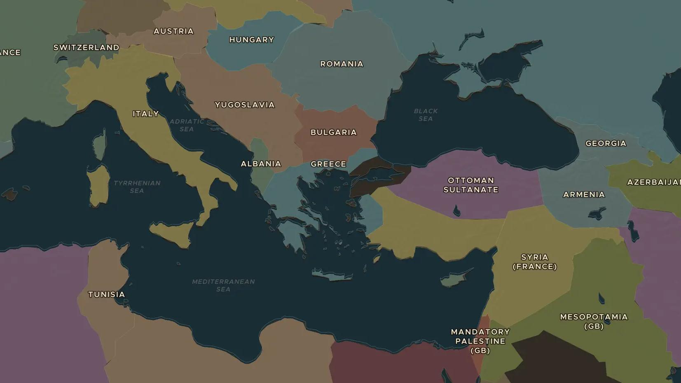
OTTOMAN EMPIRE · 1914-1923
The end of the Ottoman Empire
ChronoAtlas Classroom · Plate 464 · Ages 13-16 · 50 min
ChronoAtlas Classroom · chronoatlas.nl/classroom/lesson/end-of-ottoman-empire

Slide 2
THIS LESSON
What students take from it
The Ottoman Empire entered the First World War in 1914 and did not survive it. Britain and France divided its Arab lands into mandates, and from the ruins rose new states. Students compare the 1914 and 1920 maps of the Middle East and test the promises made during the war.
LENGTH
50 min
AGES
13-16
ON THE MAP
BY THE END, STUDENTS CAN
3 steps, AD 1914
Explain why the Ottoman Empire joined the First World War and what it lost.
Compare the maps of 1914 and 1920 for the Middle East and name the mandates of Britain and France.
Describe how promises made during the war clashed with each other.
QUIZ
7 rounds
ChronoAtlas Classroom · chronoatlas.nl/classroom/lesson/end-of-ottoman-empire
2

Slide 3
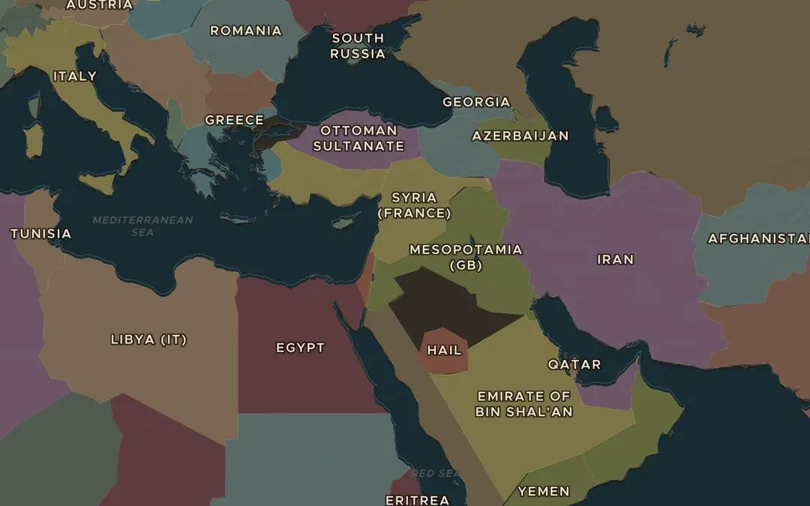
EXPLORE THE MAP · STEP A OF 3 · AD 1914
a
The empire in 1914
Open the map in 1914. Find the Ottoman Empire, from Constantinople to Baghdad, Jerusalem and the Red Sea coast. Which parts of the Arab world did it still rule?
Open this view on the live map →
ChronoAtlas Classroom · chronoatlas.nl/classroom/lesson/end-of-ottoman-empire
3
Notes:
Open the map in 1914. Find the Ottoman Empire, from Constantinople to Baghdad, Jerusalem and the Red Sea coast. Which parts of the Arab world did it still rule?
https://chronoatlas.nl/?year=1914&lat=33&lng=38&zoom=4

Slide 4
CHRONOATLAS CLASSROOM
The rest of this deck comes with Classroom
19 more slides: the other map steps, the discussion questions, the quiz with its answers, and the worksheet.
Every lesson as a deck, every worksheet, every live lesson and homework.
€19 a month, cancel anytime. The free lesson, Rome at its height, comes whole.
https://chronoatlas.nl/pricing
ChronoAtlas Classroom · chronoatlas.nl/classroom/lesson/end-of-ottoman-empire
4

