Slide 1
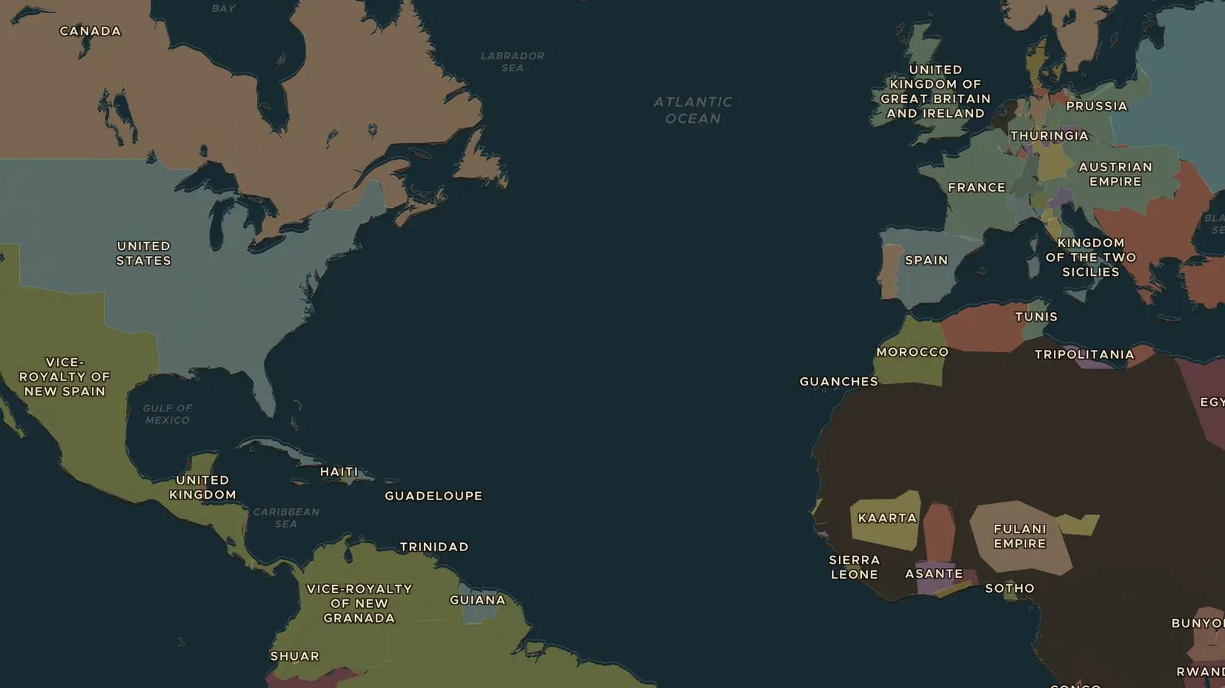
AGE OF ABOLITION · 1787-1838
Ending the Atlantic slave trade
ChronoAtlas Classroom · Plate 402 · Ages 12-15 · 50 min
ChronoAtlas Classroom · chronoatlas.nl/classroom/lesson/ending-the-atlantic-slave-trade

Slide 2
THIS LESSON
What students take from it
Campaigners in Britain, formerly enslaved writers and rebels in the Caribbean all fought the slave trade. Students follow the struggle from the first petitions to the end of slavery in the British colonies, and ask whose actions mattered most.
LENGTH
50 min
AGES
12-15
ON THE MAP
BY THE END, STUDENTS CAN
3 steps, AD 1800
Describe the Atlantic slave trade and the three continents it connected.
Explain how campaigners, formerly enslaved people and rebels helped end the British slave trade (1807) and slavery (1834-1838).
Evaluate why compensation was paid to slave owners and not to the people they had enslaved.
QUIZ
7 rounds
ChronoAtlas Classroom · chronoatlas.nl/classroom/lesson/ending-the-atlantic-slave-trade
2

Slide 3
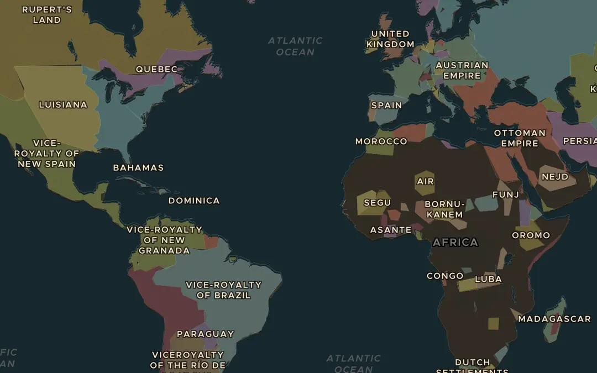
EXPLORE THE MAP · STEP A OF 3 · AD 1800
a
The Atlantic system
Open the map in 1800 and turn on Trade Routes. Follow the Atlantic Triangular Trade. Name the three continents it connects and the European port where it begins and ends.
Open this view on the live map →
ChronoAtlas Classroom · chronoatlas.nl/classroom/lesson/ending-the-atlantic-slave-trade
3
Notes:
Open the map in 1800 and turn on Trade Routes. Follow the Atlantic Triangular Trade. Name the three continents it connects and the European port where it begins and ends.
https://chronoatlas.nl/?year=1800&lat=20&lng=-30&zoom=2.5

Slide 4
CHRONOATLAS CLASSROOM
The rest of this deck comes with Classroom
19 more slides: the other map steps, the discussion questions, the quiz with its answers, and the worksheet.
Every lesson as a deck, every worksheet, every live lesson and homework.
€19 a month, cancel anytime. The free lesson, Rome at its height, comes whole.
https://chronoatlas.nl/pricing
ChronoAtlas Classroom · chronoatlas.nl/classroom/lesson/ending-the-atlantic-slave-trade
4

