Slide 1
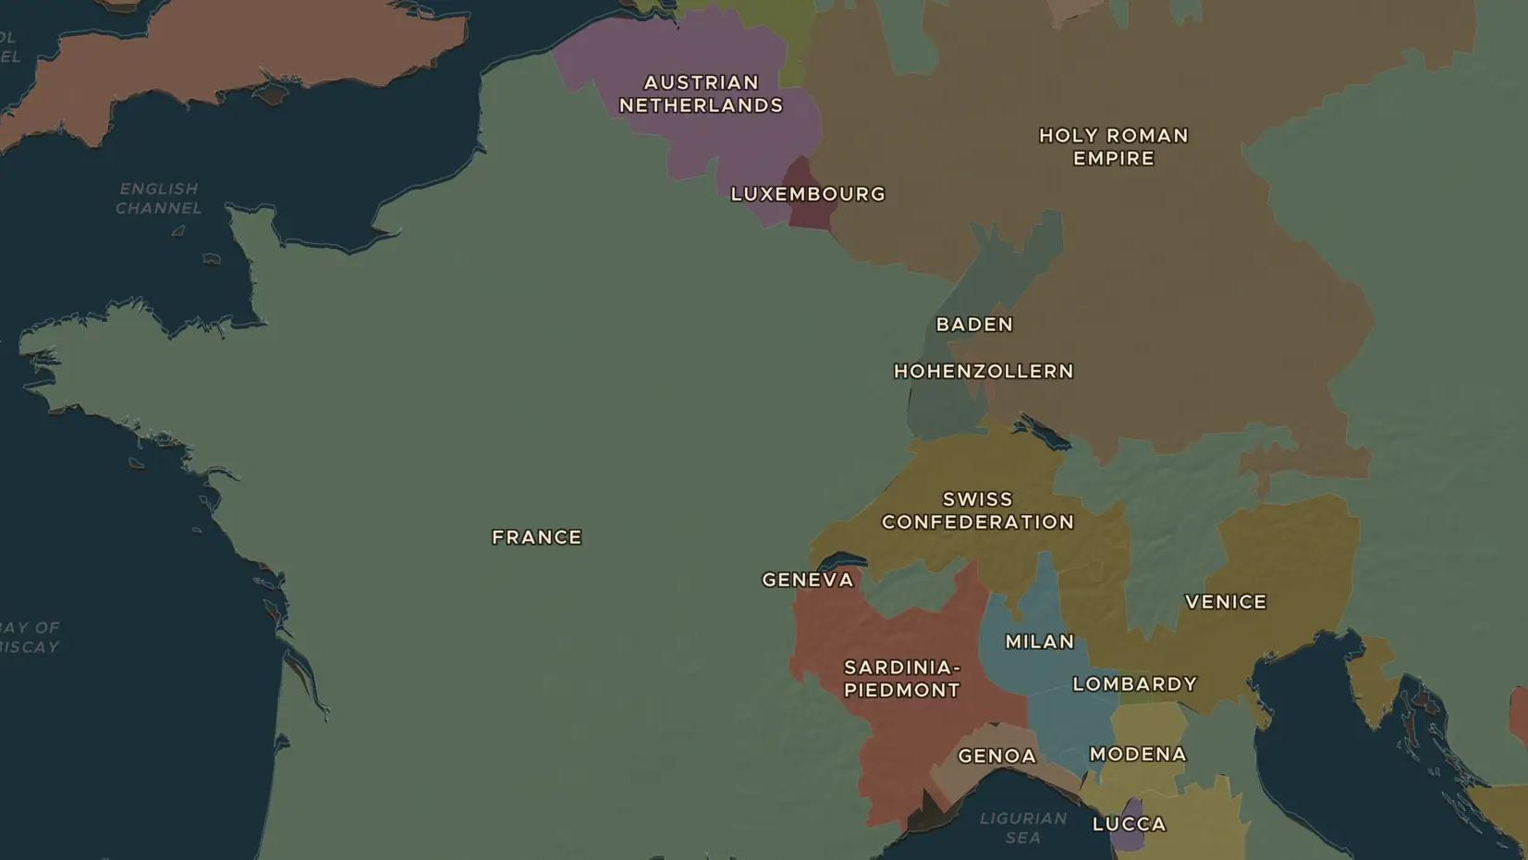
ENLIGHTENMENT · 1748-1784
The Enlightenment: reason, rights and the Encyclopédie
ChronoAtlas Classroom · Plate 388 · Ages 13-16 · 50 min
ChronoAtlas Classroom · chronoatlas.nl/classroom/lesson/enlightenment-reason-encyclopedie

Slide 2
THIS LESSON
What students take from it
In Paris salons, Edinburgh clubs and coffee houses across Europe, writers ask whether reason can improve society. Students meet Montesquieu, Voltaire, Rousseau, Beccaria and Kant, follow the Encyclopédie and ask which of their ideas still shape our laws.
LENGTH
50 min
AGES
13-16
ON THE MAP
BY THE END, STUDENTS CAN
3 steps, AD 1760
Explain the central idea of the Enlightenment: that reason and evidence can improve society.
Match four thinkers with one idea each and the place where they worked.
Explain how one Enlightenment idea, such as the separation of powers, still shapes laws today.
QUIZ
7 rounds
ChronoAtlas Classroom · chronoatlas.nl/classroom/lesson/enlightenment-reason-encyclopedie
2

Slide 3
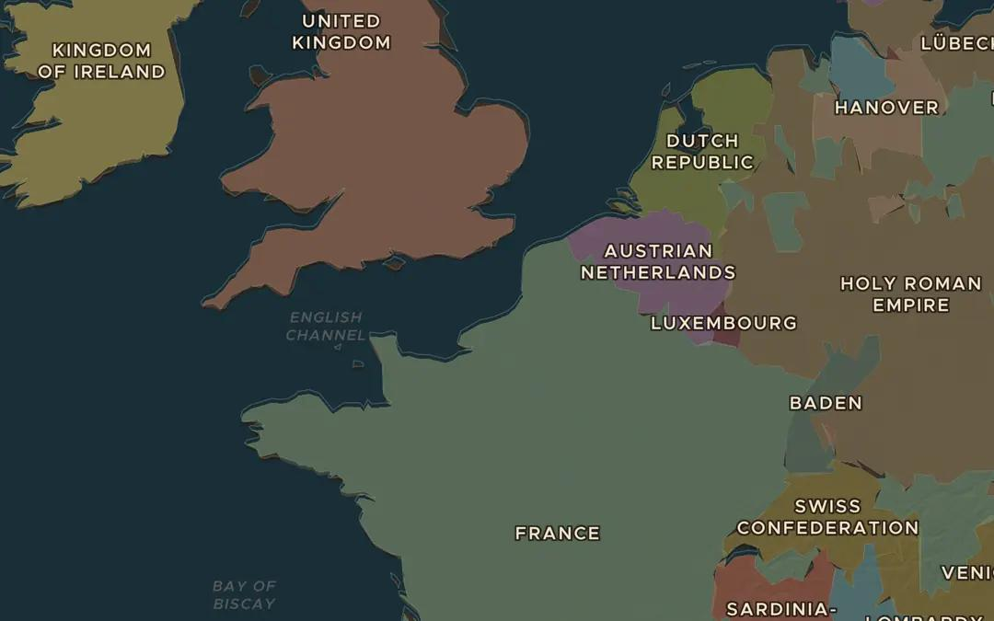
EXPLORE THE MAP · STEP A OF 3 · AD 1760
a
Paris, city of ideas
Open the map in 1760, turn on the Cities layer and find Paris, then London. Why might big cities full of printers, cafés and salons become centres of new ideas?
Open this view on the live map →
ChronoAtlas Classroom · chronoatlas.nl/classroom/lesson/enlightenment-reason-encyclopedie
3
Notes:
Open the map in 1760, turn on the Cities layer and find Paris, then London. Why might big cities full of printers, cafés and salons become centres of new ideas?
https://chronoatlas.nl/?year=1760&lat=50&lng=1&zoom=5.5

Slide 4
CHRONOATLAS CLASSROOM
The rest of this deck comes with Classroom
19 more slides: the other map steps, the discussion questions, the quiz with its answers, and the worksheet.
Every lesson as a deck, every worksheet, every live lesson and homework.
€19 a month, cancel anytime. The free lesson, Rome at its height, comes whole.
https://chronoatlas.nl/pricing
ChronoAtlas Classroom · chronoatlas.nl/classroom/lesson/enlightenment-reason-encyclopedie
4

