Slide 1
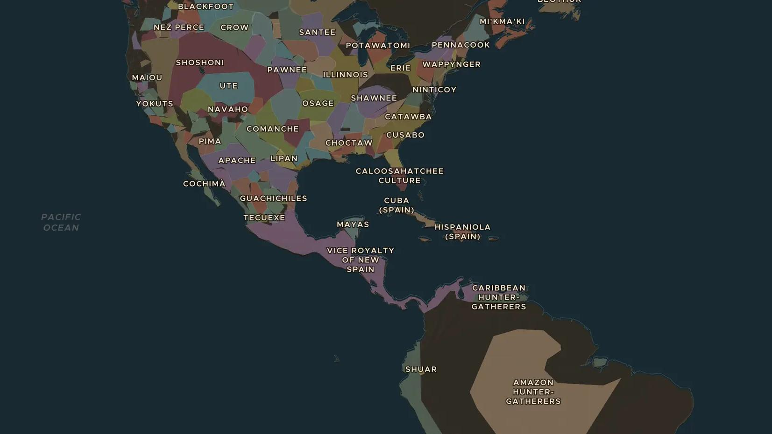
COLUMBIAN EXCHANGE · 1518-1620
The great dying: epidemics in the Americas
ChronoAtlas Classroom · Plate 318 · Ages 12-15 · 50 min
ChronoAtlas Classroom · chronoatlas.nl/classroom/lesson/epidemics-great-dying-americas

Slide 2
THIS LESSON
What students take from it
Smallpox, measles and other diseases from Europe and Africa met people in the Americas who had never faced them. Together with war and forced labour, they caused one of the largest population collapses in history. Students explore how and why, with care.
LENGTH
50 min
AGES
12-15
ON THE MAP
BY THE END, STUDENTS CAN
3 steps, AD 1518
Explain why diseases from Europe and Africa were so deadly in the Americas.
Trace how smallpox spread from the Caribbean to Mexico and the Andes.
Explain why historians link the death toll to war, forced labour and hunger as well as disease.
QUIZ
7 rounds
ChronoAtlas Classroom · chronoatlas.nl/classroom/lesson/epidemics-great-dying-americas
2

Slide 3
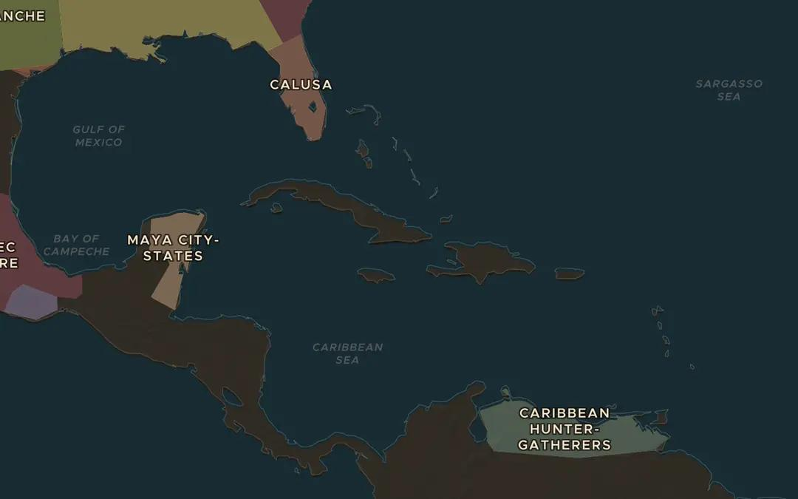
EXPLORE THE MAP · STEP A OF 3 · AD 1518
a
First recorded outbreak
Open the map in 1518 over the Caribbean. Smallpox was first recorded in the Americas on Hispaniola in December 1518. Look at the short sea crossings to Cuba and the mainland. How could a disease travel by ship?
Open this view on the live map →
ChronoAtlas Classroom · chronoatlas.nl/classroom/lesson/epidemics-great-dying-americas
3
Notes:
Open the map in 1518 over the Caribbean. Smallpox was first recorded in the Americas on Hispaniola in December 1518. Look at the short sea crossings to Cuba and the mainland. How could a disease travel by ship?
https://chronoatlas.nl/?year=1518&lat=19.5&lng=-76&zoom=4.5

Slide 4
CHRONOATLAS CLASSROOM
The rest of this deck comes with Classroom
19 more slides: the other map steps, the discussion questions, the quiz with its answers, and the worksheet.
Every lesson as a deck, every worksheet, every live lesson and homework.
€19 a month, cancel anytime. The free lesson, Rome at its height, comes whole.
https://chronoatlas.nl/pricing
ChronoAtlas Classroom · chronoatlas.nl/classroom/lesson/epidemics-great-dying-americas
4

