Slide 1
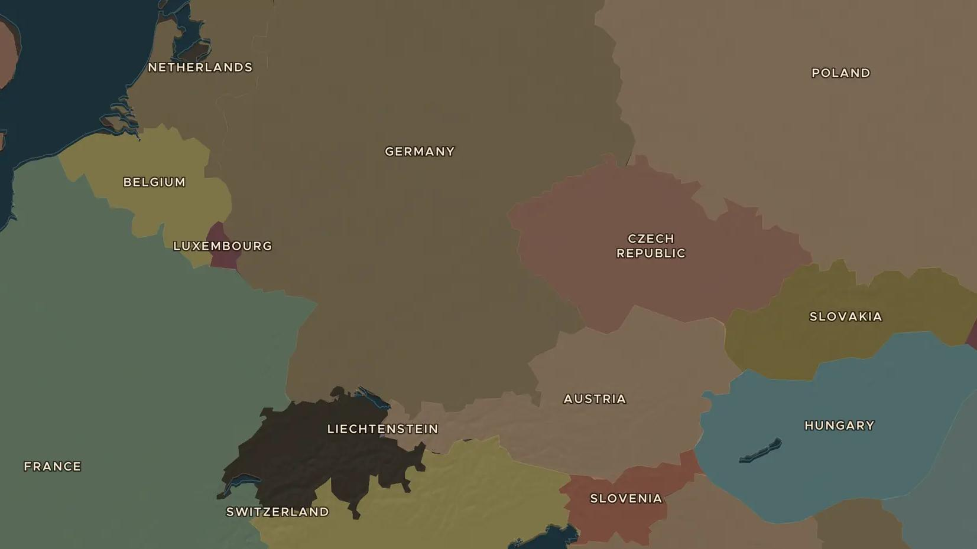
POST-COLD WAR · 1951-2004
From coal and steel to the euro: the European Union
ChronoAtlas Classroom · Plate 504 · Ages 12-15 · 50 min
ChronoAtlas Classroom · chronoatlas.nl/classroom/lesson/european-union-euro

Slide 2
THIS LESSON
What students take from it
Six countries that had just fought a war began in 1951 by sharing coal and steel. Half a century later, hundreds of millions of Europeans crossed open borders and paid in euros. Students follow the growth of the European Union on the map, from Maastricht to the big enlargement of 2004.
LENGTH
50 min
AGES
12-15
ON THE MAP
BY THE END, STUDENTS CAN
3 steps, AD 1960
Explain why France and West Germany began to cooperate in 1951.
Order the main steps from the Coal and Steel Community to the euro.
Show on the map how the Union grew from six to 25 members by 2004.
QUIZ
7 rounds
ChronoAtlas Classroom · chronoatlas.nl/classroom/lesson/european-union-euro
2

Slide 3
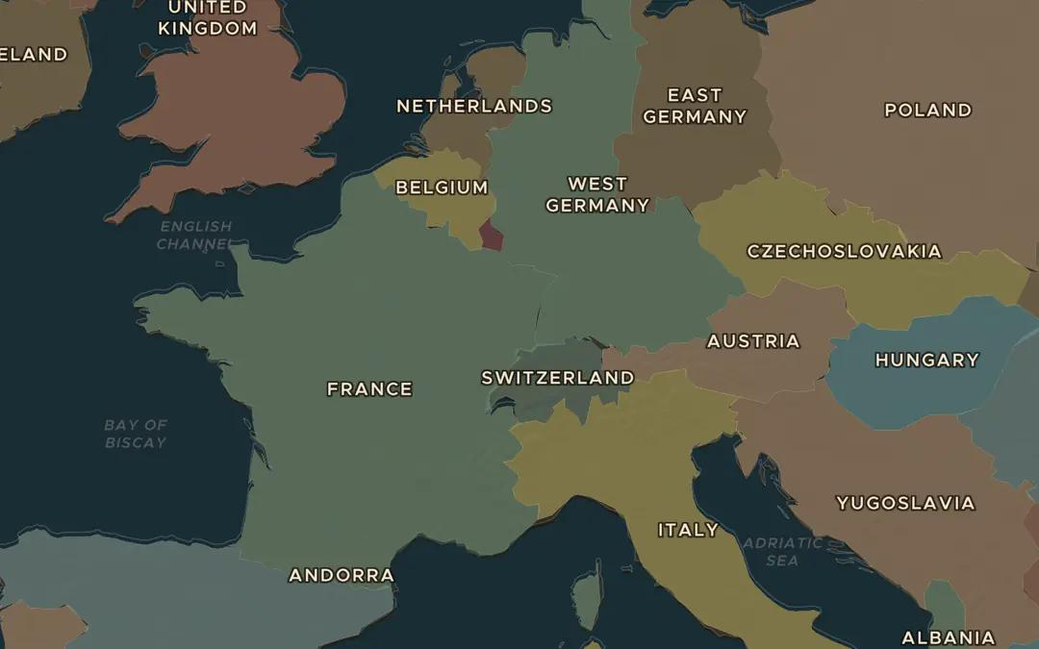
EXPLORE THE MAP · STEP A OF 3 · AD 1960
a
The six
Open the map in 1960 and find France, West Germany, Italy, Belgium, the Netherlands and Luxembourg. Why did these six, and not Britain, start working together?
Open this view on the live map →
ChronoAtlas Classroom · chronoatlas.nl/classroom/lesson/european-union-euro
3
Notes:
Open the map in 1960 and find France, West Germany, Italy, Belgium, the Netherlands and Luxembourg. Why did these six, and not Britain, start working together?
https://chronoatlas.nl/?year=1960&lat=48&lng=7&zoom=5

Slide 4
CHRONOATLAS CLASSROOM
The rest of this deck comes with Classroom
19 more slides: the other map steps, the discussion questions, the quiz with its answers, and the worksheet.
Every lesson as a deck, every worksheet, every live lesson and homework.
€19 a month, cancel anytime. The free lesson, Rome at its height, comes whole.
https://chronoatlas.nl/pricing
ChronoAtlas Classroom · chronoatlas.nl/classroom/lesson/european-union-euro
4

