Slide 1
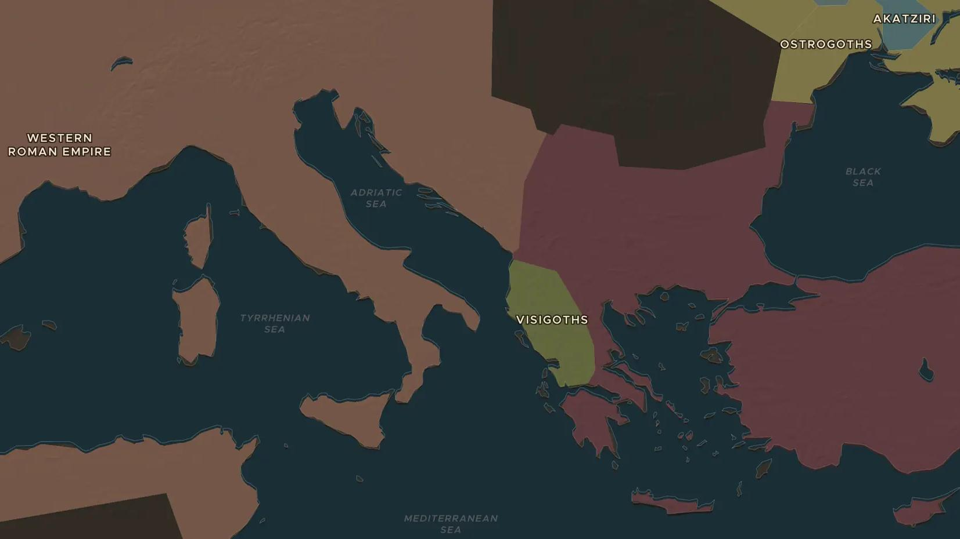
LATE ANTIQUITY · 376-476 AD
The fall of Rome
ChronoAtlas Classroom · Plate 143 · Ages 12-15 · 50 min
ChronoAtlas Classroom · chronoatlas.nl/classroom/lesson/fall-of-rome

Slide 2
THIS LESSON
What students take from it
In one century the western empire crumbles. Using the time slider, students watch a superpower disappear and debate the reasons why.
LENGTH
50 min
AGES
12-15
ON THE MAP
BY THE END, STUDENTS CAN
3 steps, AD 395
Order the key events of the fall of the western empire (376, 410, 455, 476).
Show on the map which new kingdoms replaced Roman provinces.
Weigh at least two different explanations historians give for the fall.
QUIZ
7 rounds
ChronoAtlas Classroom · chronoatlas.nl/classroom/lesson/fall-of-rome
2

Slide 3
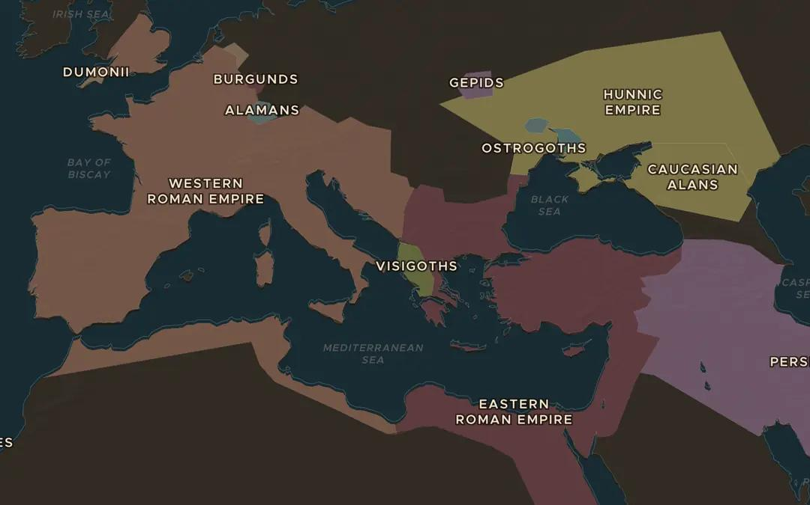
EXPLORE THE MAP · STEP A OF 3 · AD 395
a
Two empires
Open the map in 395 AD. The empire is split in two. Which half looks stronger to you, and why?
Open this view on the live map →
ChronoAtlas Classroom · chronoatlas.nl/classroom/lesson/fall-of-rome
3
Notes:
Open the map in 395 AD. The empire is split in two. Which half looks stronger to you, and why?
https://chronoatlas.nl/?year=395&lat=41&lng=20&zoom=4

Slide 4
CHRONOATLAS CLASSROOM
The rest of this deck comes with Classroom
19 more slides: the other map steps, the discussion questions, the quiz with its answers, and the worksheet.
Every lesson as a deck, every worksheet, every live lesson and homework.
€19 a month, cancel anytime. The free lesson, Rome at its height, comes whole.
https://chronoatlas.nl/pricing
ChronoAtlas Classroom · chronoatlas.nl/classroom/lesson/fall-of-rome
4

