Slide 1
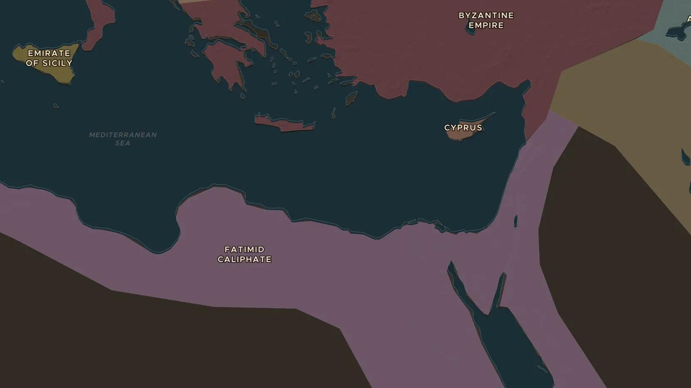
FATIMID CALIPHATE · 909-1171
The Fatimids found Cairo
ChronoAtlas Classroom · Plate 211 · Ages 12-15 · 45 min
ChronoAtlas Classroom · chronoatlas.nl/classroom/lesson/fatimids-found-cairo

Slide 2
THIS LESSON
What students take from it
A Shia dynasty from North Africa conquered Egypt and built a new capital: al-Qahira, Cairo. Students explore Fatimid Cairo, al-Azhar and the trade that made Egypt rich, in a world with three rival caliphs.
LENGTH
45 min
AGES
12-15
ON THE MAP
BY THE END, STUDENTS CAN
3 steps, AD 1000
Locate the Fatimid Caliphate and its rivals on the map in 1000.
Describe how and why the Fatimids founded Cairo and al-Azhar.
Explain why Egypt's position made it rich from trade.
QUIZ
7 rounds
ChronoAtlas Classroom · chronoatlas.nl/classroom/lesson/fatimids-found-cairo
2

Slide 3
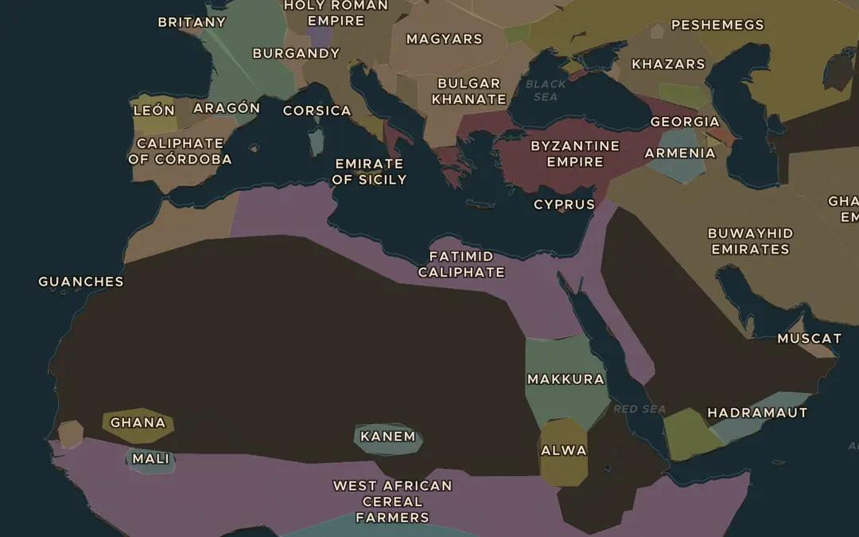
EXPLORE THE MAP · STEP A OF 3 · AD 1000
a
From Ifriqiya to Egypt
Open the map in 1000. Find the Fatimid Caliphate. Where in North Africa did it begin, and how far east does it reach?
Open this view on the live map →
ChronoAtlas Classroom · chronoatlas.nl/classroom/lesson/fatimids-found-cairo
3
Notes:
Open the map in 1000. Find the Fatimid Caliphate. Where in North Africa did it begin, and how far east does it reach?
https://chronoatlas.nl/?year=1000&lat=30&lng=20&zoom=3.6

Slide 4
CHRONOATLAS CLASSROOM
The rest of this deck comes with Classroom
19 more slides: the other map steps, the discussion questions, the quiz with its answers, and the worksheet.
Every lesson as a deck, every worksheet, every live lesson and homework.
€19 a month, cancel anytime. The free lesson, Rome at its height, comes whole.
https://chronoatlas.nl/pricing
ChronoAtlas Classroom · chronoatlas.nl/classroom/lesson/fatimids-found-cairo
4

