Slide 1
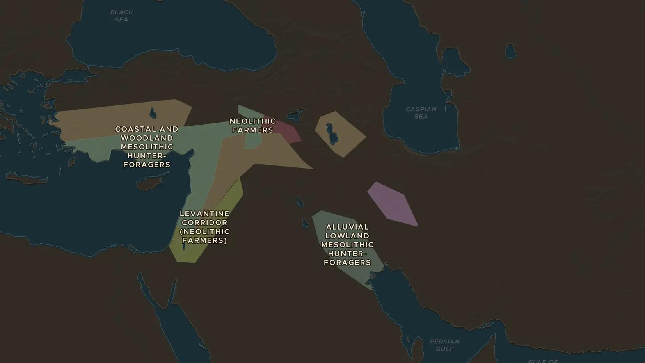
NEOLITHIC · ABOUT 10,000-6000 BC
The first farmers of the Fertile Crescent
ChronoAtlas Classroom · Plate 9 · Ages 11-14 · 50 min
ChronoAtlas Classroom · chronoatlas.nl/classroom/lesson/fertile-crescent-first-farmers

Slide 2
THIS LESSON
What students take from it
Wheat, barley, lentils, sheep and goats: the first farmers of the Fertile Crescent changed how humans live. Students trace the arc of hills where farming began, follow it into Europe and South Asia, and weigh its gains and costs.
LENGTH
50 min
AGES
11-14
ON THE MAP
BY THE END, STUDENTS CAN
3 steps, 8,000 BC
Locate the Fertile Crescent and name its first crops and farm animals.
Explain how farming changed the way people lived, for better and for worse.
Trace how farming spread from the Near East into Europe.
QUIZ
7 rounds
ChronoAtlas Classroom · chronoatlas.nl/classroom/lesson/fertile-crescent-first-farmers
2

Slide 3
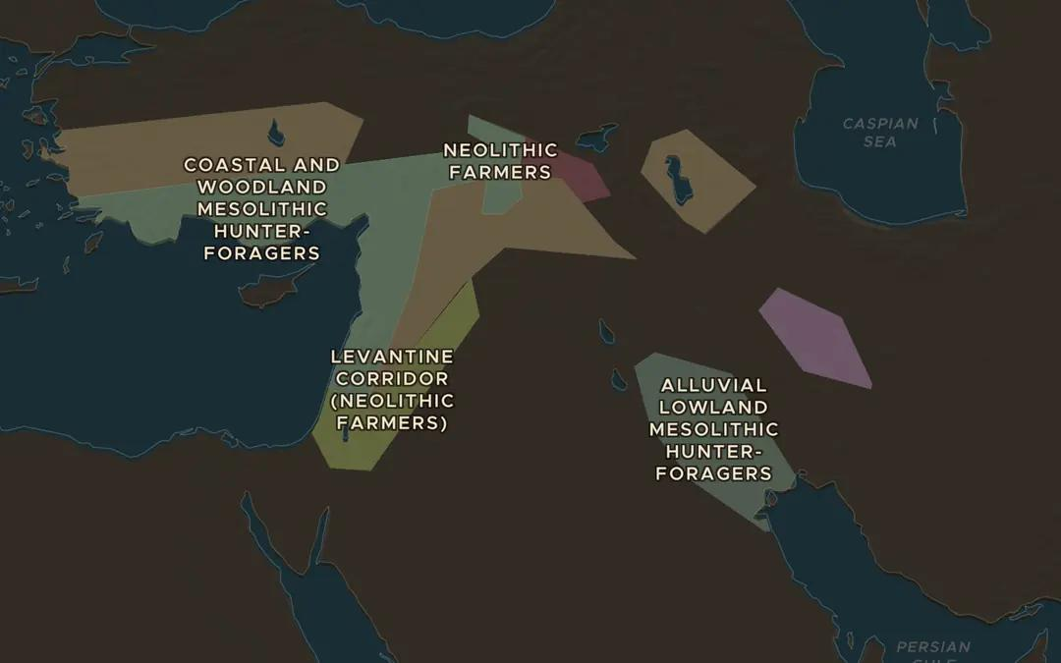
EXPLORE THE MAP · STEP A OF 3 · 8,000 BC
a
The Fertile Crescent
Open the map in 8000 BC. Trace the arc of hills from the Jordan valley north into Anatolia and down along the Zagros Mountains. Find the areas labeled as Neolithic farmers. Why did farming start in these hills and not in the deserts?
Open this view on the live map →
ChronoAtlas Classroom · chronoatlas.nl/classroom/lesson/fertile-crescent-first-farmers
3
Notes:
Open the map in 8000 BC. Trace the arc of hills from the Jordan valley north into Anatolia and down along the Zagros Mountains. Find the areas labeled as Neolithic farmers. Why did farming start in these hills and not in the deserts?
https://chronoatlas.nl/?year=-8000&lat=34&lng=41&zoom=5

Slide 4
CHRONOATLAS CLASSROOM
The rest of this deck comes with Classroom
19 more slides: the other map steps, the discussion questions, the quiz with its answers, and the worksheet.
Every lesson as a deck, every worksheet, every live lesson and homework.
€19 a month, cancel anytime. The free lesson, Rome at its height, comes whole.
https://chronoatlas.nl/pricing
ChronoAtlas Classroom · chronoatlas.nl/classroom/lesson/fertile-crescent-first-farmers
4

